Slide 1
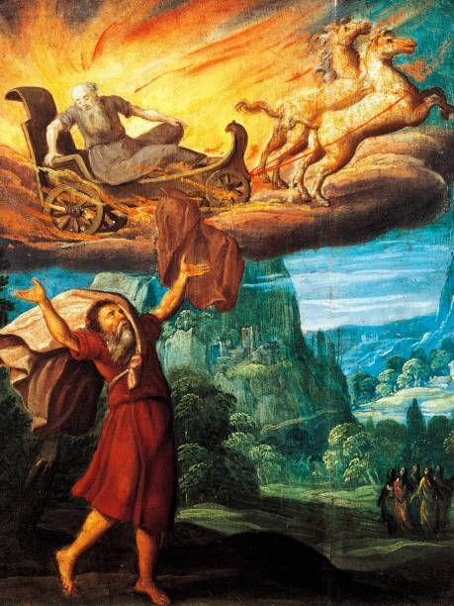
Elijah’s God and
God’s Elijah
2 Kings 2:14

Slide 2
2 Kings 2:14
Then he took the mantle of Elijah that had fallen from him, and struck the water, and said, "Where is the LORD God of Elijah?" And when he also had struck the water, it was divided this way and that; and Elisha crossed over.

Slide 3
Elijah’s God
Hides (protects) His people
(Psa 27:5) For in the time of trouble He shall hide me in His pavilion; In the secret place of His tabernacle, He shall hide me; He shall set me high upon a rock.

Slide 4
Elijah’s God
Provides for them
(Mat 6:31-33) "Therefore do not worry, saying, 'What shall we eat?' or 'What shall we drink?' or 'What shall we wear?’ (32) For after all these things the Gentiles seek. For your heavenly Father knows that you need all these things. (33) But seek first the kingdom of God and His righteousness, and all these things shall be added to you.

Slide 5
Elijah’s God
Provides for them
(Mat 6:30) Now if God so clothes the grass of the field, which today is, and tomorrow is thrown into the oven, will He not much more clothe you, O you of little faith?

Slide 6
Elijah’s God
Guides them
(Isa 58:11) The LORD will guide you continually, And satisfy your soul in drought, And strengthen your bones; You shall be like a watered garden, And like a spring of water, whose waters do not fail.

Slide 7
Elijah’s God
Guides them
(Mat 28:20) teaching them to observe all things that I have commanded you; and lo, I am with you always, even to the end of the age." Amen.

Slide 8
God’s Elijah
We know where Elijah’s God is.
Where is God’s Elijah?

Slide 9
God’s Elijah
You will find Him when you find a man who:
Prays (Jas 5:16) Confess your trespasses to one another, and pray for one another, that you may be healed. The effective, fervent prayer of a righteous man avails much.
(Jas 5:17) Elijah was a man with a nature like ours, and he prayed earnestly that it would not rain; and it did not rain on the land for three years and six months.
(Jas 5:18) And he prayed again, and the heaven gave rain, and the earth produced its fruit.

Slide 10
God’s Elijah
You will find Him when you find a man who:
Obeys (Heb 5:8) though He was a Son, yet He learned obedience by the things which He suffered.
(Heb 5:9) And having been perfected, He became the author of eternal salvation to all who obey Him,

Slide 11
God’s Elijah
You will find Him when you find a man who:
Obeys
Elijah was commanded to:
  Hide near the palace
  Widow will support you
  Show yourself to Ahab
Each time – “He arose and went.”

Slide 12
God’s Elijah
You will find Him when you find a man who:
Stays (Psa 46:10) Be still, and know that I am God; I will be exalted among the nations, I will be exalted in the earth!
(1Co 16:13) Watch, stand fast in the faith, be brave, be strong.

Slide 13
God’s Elijah
You will find Him when you find a man who:
Stays (Php 1:27) Only let your conduct be worthy of the gospel of Christ, so that whether I come and see you or am absent, I may hear of your affairs, that you stand fast in one spirit, with one mind striving together for the faith of the gospel,
(Rev 2:10b) Be faithful until death, and I will give you the crown of life.

