Slide 1
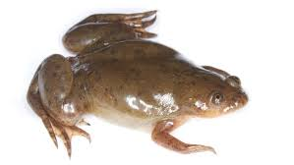
Are Frog Legs Edible?

Slide 2
Deuteronomy 31:6-8
(Deuteronomy 31:6) Be strong and of good courage, do not fear nor be afraid of them; for the LORD your God, He is the One who goes with you. He will not leave you nor forsake you."
(Deuteronomy 31:7) Then Moses called Joshua and said to him in the sight of all Israel, "Be strong and of good courage, for you must go with this people to the land which the LORD has sworn to their fathers to give them, and you shall cause them to inherit it.
(Deuteronomy 31:8) And the LORD, He is the One who goes before you. He will be with you, He will not leave you nor forsake you; do not fear nor be dismayed."

Slide 3
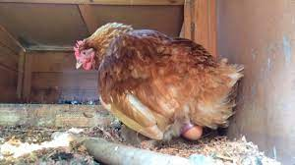
Did you ever wonder - - -
Who was the first person to see this thing come out of the back of a chicken and think – “That would be good to eat for breakfast”?

Slide 4
Did you ever wonder - - -
Who was the first to see a slimy frog come out of a muddy pond and think – “Wouldn’t his legs make a good supper tonight”?

Slide 5
It takes COURAGE!
(Deuteronomy 31:6) Be strong and of good courage, do not fear nor be afraid of them; for the LORD your God, He is the One who goes with you. He will not leave you nor forsake you."
(7) Then Moses called Joshua and said to him in the sight of all Israel, "Be strong and of good courage, for you must go with this people to the land which the LORD has sworn to their fathers to give them, and you shall cause them to inherit it.

Slide 6
We need courage today
WE NEED COURAGE TO BE DIFFERENT
It is too easy to just go along with the crowd
We don’t want to risk losing any friends
Courage = “heart”
(Galatians 6:9) And let us not grow weary while doing good, for in due season we shall reap if we do not lose heart.

Slide 7
We need to have courage in our HOME
Courage to train and discipline children
Courage to honor your parents
Courage to care for aging family members

Slide 8
We need to have courage in RELATIONSHIPS
Courage to be a true friend
(Proverbs 17:17a) A friend loves at all times
Boss – Courage to be fair
Worker – Courage to be honest

Slide 9
We need to have courage with OURSELVES
Courage to see our life and behavior
We must be honest with ourselves
(2 Corinthians 13:5) Examine yourselves as to whether you are in the faith. Test yourselves. Do you not know yourselves, that Jesus Christ is in you?—unless indeed you are disqualified.
(Galatians 6:4) But let each one examine his own work, and then he will have rejoicing in himself alone, and not in another.

Slide 10
We need to have courage to ACT
The hardest part about preaching – get people to respond, to act, to do what they now know they should do.
It takes courage to change your life.
It takes courage to ask for forgiveness.
It takes courage to request baptism.

