Slide 1
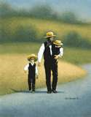
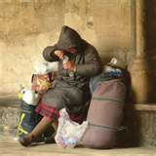
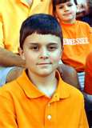
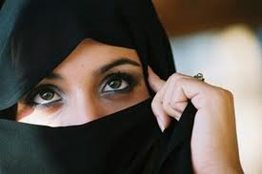
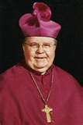
How we dress speaks volumes about our life, values and morals.
The Language of Dress

Slide 2
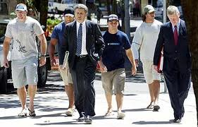
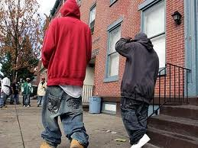
Appearance matters
Dress makes a statement
How we dress speaks volumes about us
We must not be guilty of making laws where God made none.

Slide 3
Clothing makes a statement
Our dress can tell others about our success or failures.

Slide 4
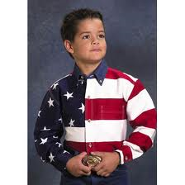
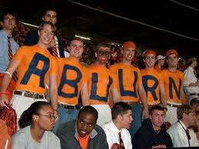
Clothing makes a statement
Our dress can tell about our allegiance to a country or sports team

Slide 5
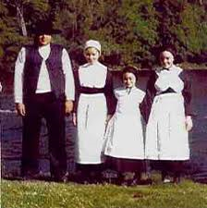
Clothing makes a statement
Our dress can tell about our religious views

Slide 6
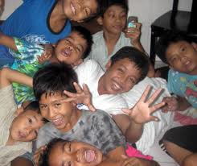
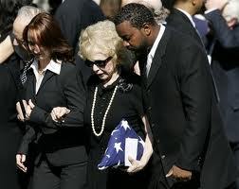
Clothing makes a statement
Our dress can tell about our joy or grief

Slide 7
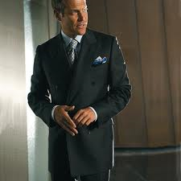
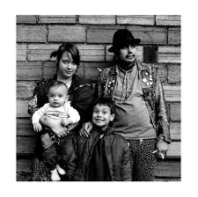
¹ My brethren, do not hold the faith of our Lord Jesus Christ, the Lord of glory, with partiality. ² For if there should come into your assembly a man with gold rings, in fine apparel, and there should also come in a poor man in filthy clothes, ³ and you pay attention to the one wearing the fine clothes and say to him, "You sit here in a good place," and say to the poor man, "You stand there," or, "Sit here at my footstool," ⁴ have you not shown partiality among yourselves, and become judges with evil thoughts? James 2:1-4

Slide 8
WE CAN NOT DENY THAT OUR DRESS SAYS SOMETHING ABOUT US
¹⁴ So she took off her widow's garments, covered herself with a veil and wrapped herself, and sat in an open place which was on the way to Timnah; for she saw that Shelah was grown, and she was not given to him as a wife. ¹⁵ When Judah saw her, he thought she was a harlot, because she had covered her face. Genesis 38:14-15

Slide 9
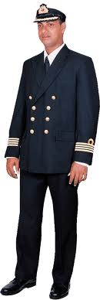
WE CAN NOT DENY THAT OUR DRESS SAYS SOMETHING ABOUT US
And there a woman met him, With the attire of a harlot, and a crafty heart. Proverbs 7:10
"Woe to you, Chorazin! Woe to you, Bethsaida! For if the mighty works which were done in you had been done in Tyre and Sidon, they would have repented long ago in sackcloth and ashes. Matthew 11:21

Slide 10
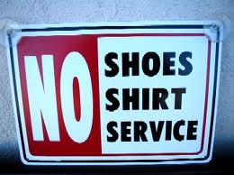
Consider 1 Timothy 2:9-10
⁹ in like manner also, that the women adorn themselves in modest apparel, with propriety and moderation, not with braided hair or gold or pearls or costly clothing, ¹⁰ but, which is proper for women professing godliness, with good works.

Slide 11
Consider 1 Timothy 2:9-10
Modest includes two ideas:
Decent
Appropriate
Most sermons focus on –
What is decent? Too tight. Too short. Too low. Too high. Too revealing.
I can not write your rules.

Slide 12
Consider 1 Timothy 2:9-10
We must also consider what is appropriate.
Attend a funeral or change oil in your car.
Worship God or clean out a clogged sewer line.
Go to a wedding or work in your garden.

Slide 13
What is the point?
How we dress makes a statement about our values, morals, loyalty, attitude, and if we are Christians or not.
I am a child of God. Does my dress say so?
We must consider – Will people say things about us that we do not want said?

Slide 14
What is the point?
We must challenge ourselves to dress in a way that is both decent and appropriate.
Do you need to put on the new man in Christ? Do you need to be clothed with the garments of righteousness?
How we dress speaks volumes about our life, values and morals.

