Slide 1
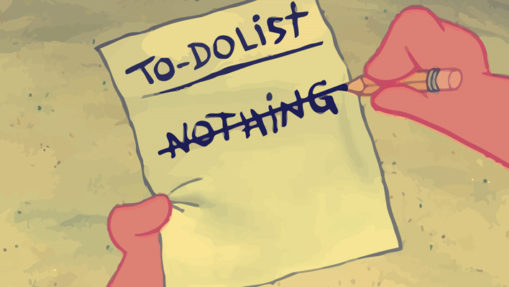
Sin of Doing Nothing
Judges 5:23

Slide 2
Texts
(Judges 5:23) 'Curse Meroz,' said the angel of the LORD, 'Curse its inhabitants bitterly, Because they did not come to the help of the LORD, To the help of the LORD against the mighty.’
(James 4:17) Therefore, to him who knows to do good and does not do it, to him it is sin.

Slide 3
Introduction
Background
  Barak refuses to go against Sisera
  Deborah becomes the leader
  God will deliver Sisera into the hands of a woman
  Deborah sings a song of victory
(Judges 4:9) So she said, "I will surely go with you; nevertheless there will be no glory for you in the journey you are taking, for the LORD will sell Sisera into the hand of a woman." Then Deborah arose and went with Barak to Kedesh.

Slide 4
Curse Meroz
By whose authority?
  The angel of the Lord
What did Meroz do?
  NOTHING
  It isn’t what they DID, but what they DID NOT do.
Why the curse?
  Because they did nothing to help

Slide 5
Curse Meroz
What should Meroz have done?
  Helped Jehovah
Does Jehovah need our help?
  No – He is all powerful
  No – He won the battle
  Yes – God uses us as we allow Him
  Potter and clay
  Mordicai to Esther – Deliverance will come from some other place. If you don’t someone else will.

Slide 6
Another Example
(Judges 8:4) When Gideon came to the Jordan, he and the three hundred men who were with him crossed over, exhausted but still in pursuit.
(Judges 8:5) Then he said to the men of Succoth, "Please give loaves of bread to the people who follow me, for they are exhausted, and I am pursuing Zebah and Zalmunna, kings of Midian."
(Judges 8:6) And the leaders of Succoth said, "Are the hands of Zebah and Zalmunna now in your hand, that we should give bread to your army?"
(Judges 8:7) So Gideon said, "For this cause, when the LORD has delivered Zebah and Zalmunna into my hand, then I will tear your flesh with the thorns of the wilderness and with briers!"

Slide 7
The sin of Doing NOTHING
Man is commanded to work
  Adam – Genesis 2:15
  4th Commandment – Exodus 20:9
  God often called men who were busy
    Moses
    David
    Peter, Andrew, James and John
    Matthew
    Saul of Tarsus

Slide 8
The curse of Idleness
Idleness is a sin
(James 4:17) Therefore, to him who knows to do good and does not do it, to him it is sin.
It violates the command to work
(1 Corinthians 15:58) Therefore, my beloved brethren, be steadfast, immovable, always abounding in the work of the Lord, knowing that your labor is not in vain in the Lord.

Slide 9
The curse of Idleness
Talent and energy are wasted
(Matthew 25:15) And to one he gave five talents, to another two, and to another one, to each according to his own ability; and immediately he went on a journey.
(Matthew 25:26) "But his lord answered and said to him, 'You wicked and lazy servant, you knew that I reap where I have not sown, and gather where I have not scattered seed. (27) So you ought to have deposited my money with the bankers, and at my coming I would have received back my own with interest.

Slide 10
The curse of Idleness
Trouble comes from doing nothing
(2 Thessalonians 3:10) For even when we were with you, we commanded you this: If anyone will not work, neither shall he eat. (11) For we hear that there are some who walk among you in a disorderly manner, not working at all, but are busybodies. (12) Now those who are such we command and exhort through our Lord Jesus Christ that they work in quietness and eat their own bread.

Slide 11
The curse of Idleness
Trouble comes from doing nothing
(1 Timothy 5:11) But refuse the younger widows; for when they have begun to grow wanton against Christ, they desire to marry, (12) having condemnation because they have cast off their first faith. (13) And besides they learn to be idle, wandering about from house to house, and not only idle but also gossips and busybodies, saying things which they ought not.

Slide 12
The curse of Idleness
We must follow the example of Christ
(John 9:4) I must work the works of Him who sent Me while it is day; the night is coming when no one can work.
(1 Peter 2:21) For to this you were called, because Christ also suffered for us, leaving us an example, that you should follow His steps:

