Slide 1
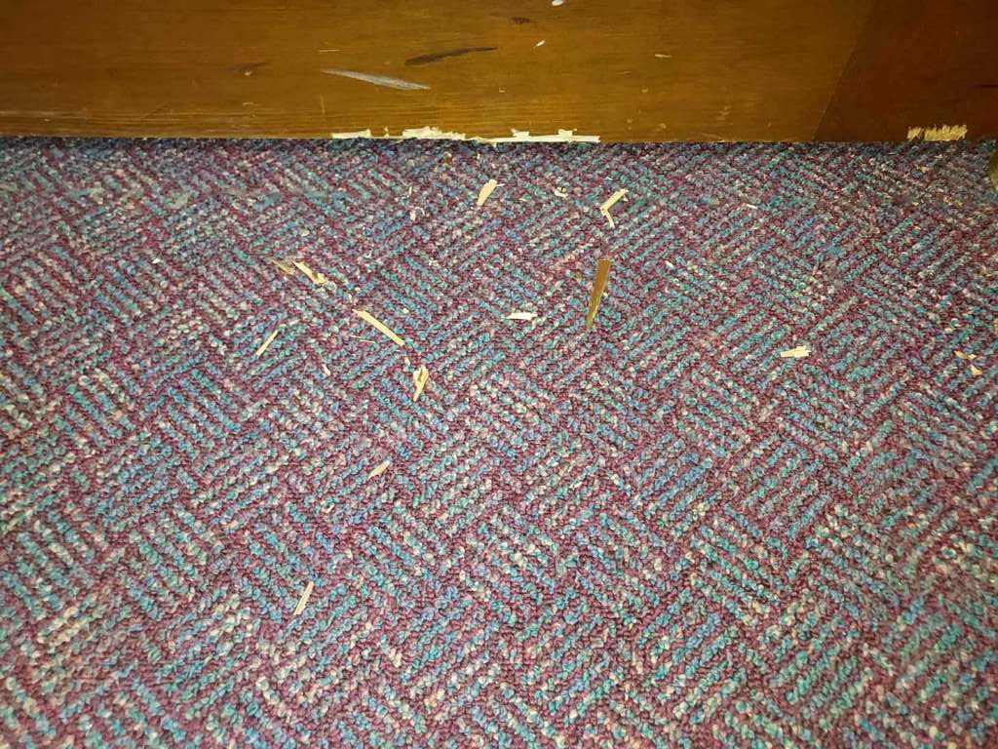
Tennessee Squirrel in the building

Slide 2
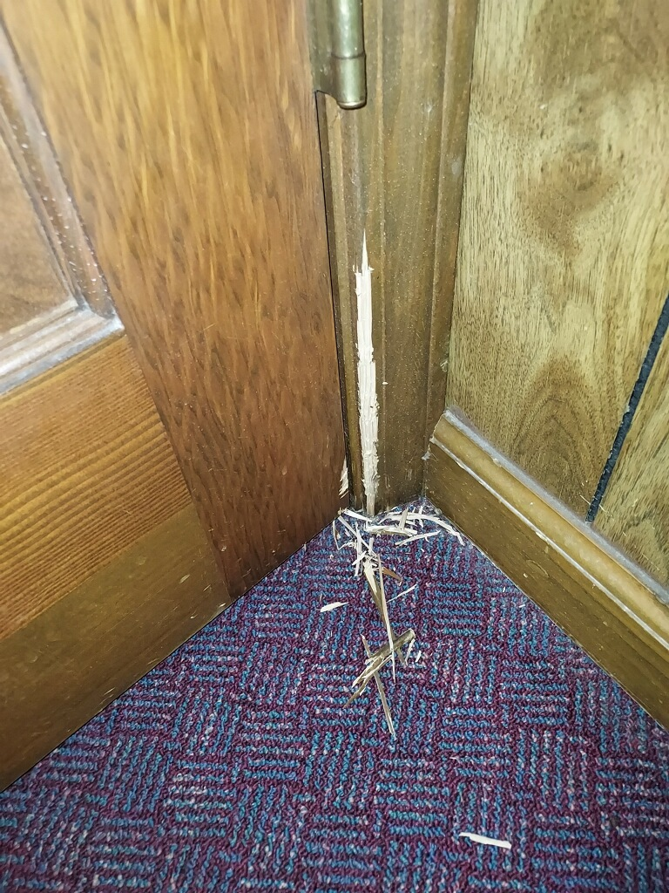
Tennessee Squirrel in the building

Slide 3
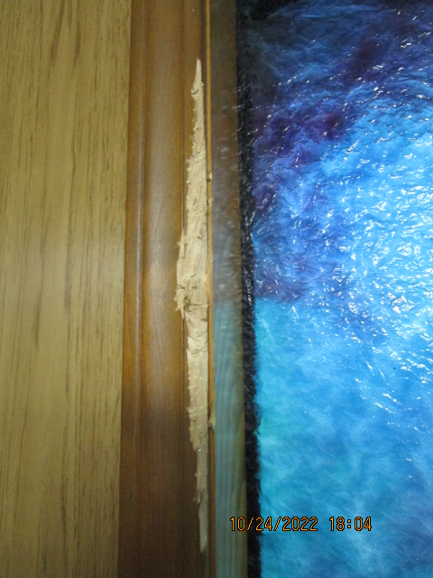
Tennessee Squirrel in the building

Slide 4
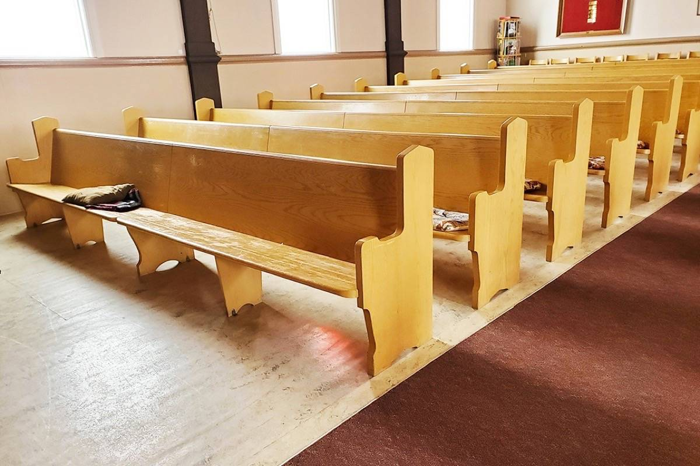
Do Not Come Forward
MOST SERMONS WILL END WITH AN INVITATION TO COME FORWARD AND LET YOUR REQUEST FOR BAPTISM OR FOR PRAYER AND FORGIVENESS.

Slide 5
Some Examples
2 teen girls are friends, but they have a dispute. They argue, call each other names and break their friendship.
At the end of the sermon, one girl comes forward. She tells the preacher, “I have said and done things that are wrong and I need forgiveness.”

Slide 6
Some Examples
A brother agrees to buy a car from another brother in the church. They agree on a price, sign the title, pay the cash, and the deal is done.
Then the car has some problem. The new owner decides that the previous owner knew about the problem and did not disclose it. An argument results and they are both angry at the other.
The one who bought the car comes forward to make amends and try to have peace in the church.

Slide 7
The Problem with these examples
Neither of the girls addressed the issues that divided them.
Neither of the men addressed the problem the caused the dispute.
Someone says, “But they came forward. You have to forgive them”
Who made that rule?

Slide 8
What Jesus said
(Luke 17:1) Then He said to the disciples, "It is impossible that no offenses should come, but woe to him through whom they do come!
(Luke 17:2) It would be better for him if a millstone were hung around his neck, and he were thrown into the sea, than that he should offend one of these little ones.

Slide 9
What Jesus said
(Luke 17:3) Take heed to yourselves. If your brother sins against you, rebuke him; and if he repents, forgive him.
(Luke 17:4) And if he sins against you seven times in a day, and seven times in a day returns to you, saying, 'I repent,' you shall forgive him."

Slide 10
What Jesus said
(Matthew 5:23) Therefore if you bring your gift to the altar, and there remember that your brother has something against you,
(Matthew 5:24) leave your gift there before the altar, and go your way. First be reconciled to your brother, and then come and offer your gift.

Slide 11
What Jesus said
(Matthew 18:15) "Moreover if your brother sins against you, go and tell him his fault between you and him alone. If he hears you, you have gained your brother. (16) But if he will not hear, take with you one or two more, that 'BY THE MOUTH OF TWO OR THREE WITNESSES EVERY WORD MAY BE ESTABLISHED.’ (17) And if he refuses to hear them, tell it to the church. But if he refuses even to hear the church, let him be to you like a heathen and a tax collector.

Slide 12
Joseph is an example –
The brothers feel guilty years later
(Genesis 42:21) Then they said to one another, "We are truly guilty concerning our brother, for we saw the anguish of his soul when he pleaded with us, and we would not hear; therefore this distress has come upon us."
(Genesis 42:22) And Reuben answered them, saying, "Did I not speak to you, saying, 'Do not sin against the boy'; and you would not listen? Therefore behold, his blood is now required of us."
(Genesis 42:23) But they did not know that Joseph understood them, for he spoke to them through an interpreter.

Slide 13
Joseph is an example –
Joseph is ready to forgive
(Genesis 45:3) Then Joseph said to his brothers, "I am Joseph; does my father still live?" But his brothers could not answer him, for they were dismayed in his presence.
(Genesis 45:4) And Joseph said to his brothers, "Please come near to me." So they came near. Then he said: "I am Joseph your brother, whom you sold into Egypt.
(Genesis 45:5) But now, do not therefore be grieved or angry with yourselves because you sold me here; for God sent me before you to preserve life.

Slide 14
Joseph is an example –
Forgiveness comes with confession
(Genesis 50:16) So they sent messengers to Joseph, saying, "Before your father died he commanded, saying,
(Genesis 50:17) 'Thus you shall say to Joseph: "I beg you, please forgive the trespass of your brothers and their sin; for they did evil to you." ' Now, please, forgive the trespass of the servants of the God of your father." And Joseph wept when they spoke to him.

Slide 15
Joseph is an example –
Forgiveness comes with confession
(Genesis 50:18) Then his brothers also went and fell down before his face, and they said, "Behold, we are your servants."
(Genesis 50:19) Joseph said to them, "Do not be afraid, for am I in the place of God?

Slide 16
Joseph is an example –
Forgiveness comes with confession
(James 5:16) Confess your trespasses to one another, and pray for one another, that you may be healed. The effective, fervent prayer of a righteous man avails much.

Slide 17
Principle to remember
The confession should be to the ones you wronged.
Home, family, friend, boss, clerk, bank cashier, neighbor, etc.
Who knows about the wrong?

Slide 18
Principle to remember
The confession should be as public as the sin.
I cannot forgive you for a sin that I don’t know anything about.
If I don’t know – you have not wronged me.

Slide 19
Easy way out
It is easier to come forward, and make a general statement of sin.
Jesus commands us to go to the one we wronged / the one who wronged us.
This is where it must be resolved.

Slide 20
Don’t Come Forward
It is easier to come forward, and make a general statement of sin.
Sin against family? Tell them.
Sin against a friend? Talk to them.
Sin against a brother? Go to them.

Slide 21
Don’t Come Forward
Private sin – confess to God
Between 1 or a few – confess to them
If the sin is publicly known, then a public correction is needed.

