Slide 1
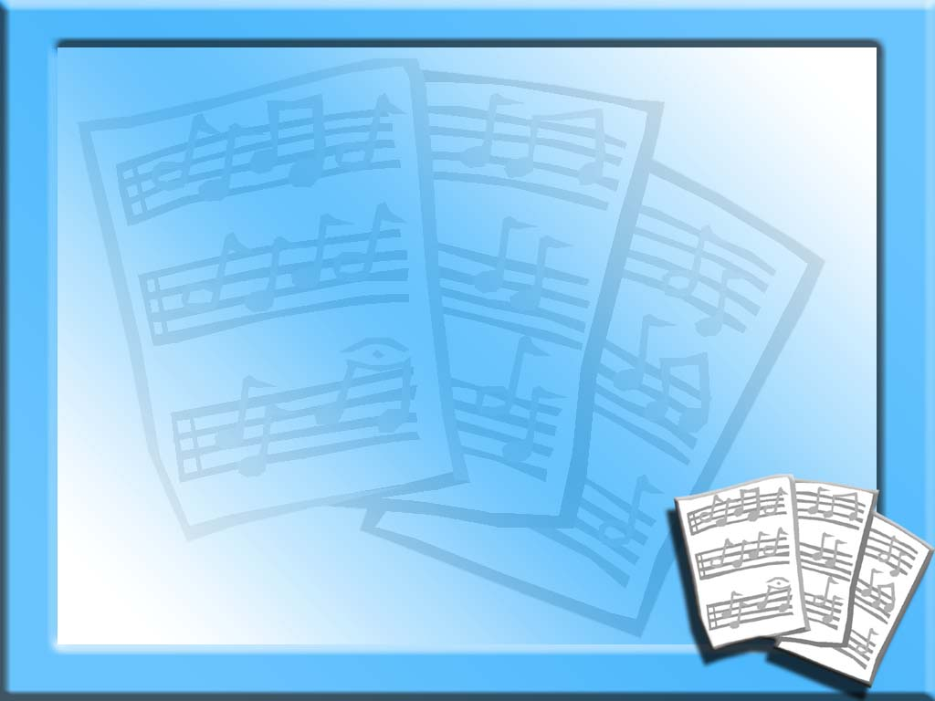
What about David?
Didn’t David play musical instruments in worship?
If OK for David, why not now?

Slide 2
What about David?
The Question: Since David played musical instruments in worship to God, would it be permitted for us to use them today?

Slide 3
Several answers
I could dig deep into the meaning and usage of Greek and Hebrew words
I could make arguments from the silence of Scripture
I could argue the law of exclusion

Slide 4
Several answers
The simple answer is – NO
Why?
Because we do not live under the Law of Moses

Slide 5
In Russia
There is a law in Russia that you must carry your passport (natives as well as foreign visitors).
How many of you have your passport with you right now?
Why not?

Slide 6
Law of Moses
David lived under the Law of Moses. He kept many of the regulations of that law.
Blow the trumpet at the time of the New Moon, At the full moon, on our solemn feast day. Psalms 81:3

Slide 7
Law of Moses
Let my prayer be set before You as incense, The lifting up of my hands as the evening sacrifice. Psalms 141:2
May He remember all your offerings, And accept your burnt sacrifice. Psalms 20:3

Slide 8
Law of Moses
Blow the trumpet at the time of the New Moon, At the full moon, on our solemn feast day. Psalms 81:3
The Lord is in His holy temple, The Lord's throne is in heaven; His eyes behold, Psalms 11:4

Slide 9
Law of Moses Ended
¹⁴ For He Himself is our peace, who has made both one, and has broken down the middle wall of separation, ¹⁵ having abolished in His flesh the enmity, that is, the law of commandments contained in ordinances, so as to create in Himself one new man from the two, thus making peace, Ephesians 2:14-15

Slide 10
Law of Moses Ended
¹⁴ having wiped out the handwriting of requirements that was against us, which was contrary to us. And He has taken it out of the way, having nailed it to the cross. ¹⁵ Having disarmed principalities and powers, He made a public spectacle of them, triumphing over them in it. Colossians 2:14-15

Slide 11
Law of Moses Ended
⁶ But now He has obtained a more excellent ministry, inasmuch as He is also Mediator of a better covenant, which was established on better promises. ⁷ For if that first covenant had been faultless, then no place would have been sought for a second. Hebrews 8:6-7

Slide 12
Law of Moses Ended
In that He says, "A new covenant," He has made the first obsolete. Now what is becoming obsolete and growing old is ready to vanish away. Hebrews 8:13

Slide 13
No Instruments in NT
We do not use musical instruments in worship today
There are many arguments and discussions about Greek words, meanings of passages, what applies and what does not

Slide 14
No Instruments in NT
SAME REASON WE DON’T HAVE:
Burnt animal sacrifices
New Moon festivals
Incense
Feast Days / Days of Fasting
Worship at the Temple

Slide 15
No Instruments in NT
We do not keep the Passover, Day of Atonement, Pentecost, etc.
All of these are part of the same law
If you carry over part of this law, why don’t you carry over the rest?

Slide 16
CONCLUSION
We are under the Law of Christ
David did not observe communion or worship on the 1st day of the week
You will be judged by the law under which you lived.

