Slide 1
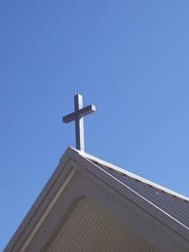
Why Do We - - - Not have a Cross on the Building?

Slide 2
Lesson #1 – Numbers 21:5-9
And the people spoke against God and against Moses: "Why have you brought us up out of Egypt to die in the wilderness? For there is no food and no water, and our soul loathes this worthless bread." 6 So the LORD sent fiery serpents among the people, and they bit the people; and many of the people of Israel died. 7 Therefore the people came to Moses, and said, "We have sinned, for we have spoken against the LORD and against you; pray to the LORD that He take away the serpents from us." So Moses prayed for the people.

Slide 3
Lesson #1 – Numbers 21:5-9
8 Then the LORD said to Moses, "Make a fiery serpent, and set it on a pole; and it shall be that everyone who is bitten, when he looks at it, shall live." 9 So Moses made a bronze serpent, and put it on a pole; and so it was, if a serpent had bitten anyone, when he looked at the bronze serpent, he lived.

Slide 4
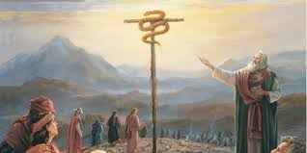
Lesson #1 – 2 Kings 18:4
Hezekiah was the king of Judah.
He removed the high places and broke the sacred pillars, cut down the wooden image and broke in pieces the bronze serpent that Moses had made; for until those days the children of Israel burned incense to it, and called it Nehushtan.
Nehushtan = Hebrew word for “Brass”

Slide 5
Lesson #1 – 2 Kings 18:4
The brass pole with a serpent on it was:
Saved from the wilderness wandering
Taken with them to Canaan
Preserved as a token of their salvation
Worshiped, burn incense to it
This is why Hezekiah destroyed it!

Slide 6
Lesson #2 – Catholic Church
They worship Mary, the mother of Jesus and pray to her

Slide 7
Lesson #2 – Catholic Church
They worship Mary, the mother of Jesus and pray to her
They worship the place of Jesus birth in Bethlehem

Slide 8
Lesson #2 – Catholic Church
They worship Mary, the mother of Jesus and pray to her
They worship the place of Jesus birth in Bethlehem
They worship the cup Jesus used at the Last Supper (Holy Grail)

Slide 9
Lesson #2 – Catholic Church
They worship Mary, the mother of Jesus and pray to her
They worship the place of Jesus birth in Bethlehem
They worship the cup Jesus used at the Last Supper (Holy Grail)
They worship the crown of thorns

Slide 10
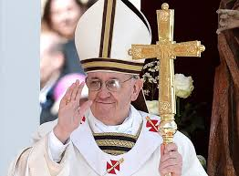
Lesson #2 – Catholic Church
They worship Mary, the mother of Jesus and pray to her
They worship the place of Jesus birth in Bethlehem
They worship the cup Jesus used at the Last Supper (Holy Grail)
They worship the crown of thorns
They worship the cross

Slide 11
Lesson #2 – Catholic Church
They worship Mary, the mother of Jesus and pray to her
They worship the place of Jesus birth in Bethlehem
They worship the cup Jesus used at the Last Supper (Holy Grail)
They worship the crown of thorns
They worship the cross
NONE OF THESE ARE TO BE THE OBJECT OF OUR WORSHIP.

Slide 12
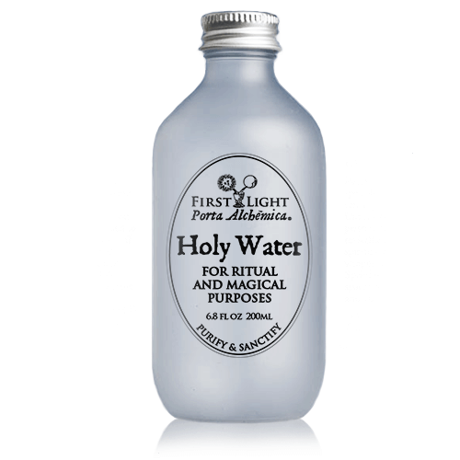
Lesson #3 - Baptism
There are many things connected with our salvation
1. The water – Is the water of baptism Holy Water?
1 John 5:6-8 This is He who came by water and blood—Jesus Christ; not only by water, but by water and blood. And it is the Spirit who bears witness, because the Spirit is truth. 7 For there are three that bear witness in heaven: the Father, the Word, and the Holy Spirit; and these three are one. 8 And there are three that bear witness on earth: the Spirit, the water, and the blood; and these three agree as one.

Slide 13
Lesson #3 - Baptism
There are many things connected with our salvation
1. The water – Is the water of baptism Holy Water?
2. The Location – River, swimming pool, bathtub, Fiberglas baptistry, cattle pond – Many worship the River Jordan

Slide 14
Lesson #3 - Baptism
There are many things connected with our salvation
1. The water – Is the water of baptism Holy Water?
2. The Location – River, swimming pool, bathtub, Fiberglas baptistry, cattle pond – Many worship the River Jordan
3. Person who baptized you - has no special power to save
1 Corinthians 1:12-13 Now I say this, that each of you says, "I am of Paul," or "I am of Apollos," or "I am of Cephas," or "I am of Christ." 13 Is Christ divided? Was Paul crucified for you? Or were you baptized in the name of Paul?

Slide 15
Lesson We MUST Learn
We, like Israel, often substitute the symbol (something connected with our salvation) as if it was to be worshiped!

Slide 16
Lesson We MUST Learn
The River Jordan does not save
The tomb of Christ does not save
The cross of Christ does not save
The crown of thorns does not save
Mary does not save
The cup at the Last Supper does not save

Slide 17
Lesson We MUST Learn
Matthew 1:21 And she will bring forth a Son, and you shall call His name JESUS, for He will save His people from their sins."
We must NOT worship the thing rather than Diety.
Worship God – worship Jesus
Do not worship the things associated with Jesus

Slide 18
Lesson We MUST Learn
John 4:23-24 But the hour is coming, and now is, when the true worshipers will worship the Father in spirit and truth; for the Father is seeking such to worship Him. 24 God is Spirit, and those who worship Him must worship in spirit and truth."

Slide 19
Some final Questions
Is it wrong to have a cross on a building?
Is it wrong to wear a cross as jewelry?
Is it wrong to sing songs about the cross?
None of these is wrong (sinful) – BUT – with caution. We must not worship the thing instead of the Savior.

