Slide 1
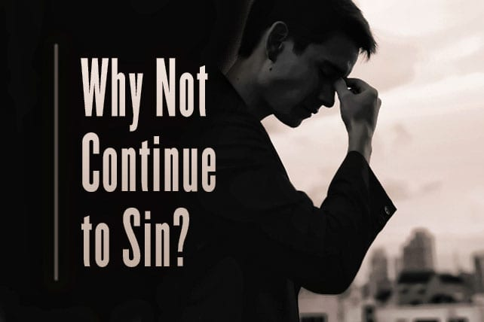
Romans 5:20 – Romans 6:1

Slide 2
Romans 5:20 – Romans 6:1
(Romans 5:20) Moreover the law entered that the offense might abound. But where sin abounded, grace abounded much more,
(Romans 5:21) so that as sin reigned in death, even so grace might reign through righteousness to eternal life through Jesus Christ our Lord.
(Romans 6:1) What shall we say then? Shall we continue in sin that grace may abound?

Slide 3
The Problem of Sin
1. All people sin
(Romans 3:23) for all have sinned and fall short of the glory of God,
2. Where there is sin, we need grace.
(Romans 5:20) Moreover the law entered that the offense might abound. But where sin abounded, grace abounded much more,
3. Many today take sin lightly. It’s OK, God’s grace will cover it.

Slide 4
Shall we continue in sin?
NO! We died to sin.
(Romans 6:2) Certainly not! How shall we who died to sin live any longer in it?
We are no longer slaves of sin.
(Romans 6:6) knowing this, that our old man was crucified with Him, that the body of sin might be done away with, that we should no longer be slaves of sin.

Slide 5
Shall we continue in sin?
NO! We died to sin.
We can live with the Spirit
(Romans 6:8) Now if we died with Christ, we believe that we shall also live with Him,
(Romans 6:9) knowing that Christ, having been raised from the dead, dies no more. Death no longer has dominion over Him.
(Romans 6:10) For the death that He died, He died to sin once for all; but the life that He lives, He lives to God.

Slide 6
Shall we continue in sin?
NO! We are alive to God.
(Romans 6:11) Likewise you also, reckon yourselves to be dead indeed to sin, but alive to God in Christ Jesus our Lord.
Sin does not have to reign in us.
(Romans 6:12) Therefore do not let sin reign in your mortal body, that you should obey it in its lusts.
Grace frees us from sin’s hold.
(Romans 6:14) For sin shall not have dominion over you, for you are not under law but under grace.

Slide 7
Shall we continue in sin?
NO! We are slaves to righteousness.
(Romans 6:19) I speak in human terms because of the weakness of your flesh. For just as you presented your members as slaves of uncleanness, and of lawlessness leading to more lawlessness, so now present your members as slaves of righteousness for holiness.

Slide 8
Shall we continue in sin?
NO! We are slaves to righteousness.
We are slaves to whom we obey.
(Romans 6:16) Do you not know that to whom you present yourselves slaves to obey, you are that one's slaves whom you obey, whether of sin leading to death, or of obedience leading to righteousness?

Slide 9
Shall we continue in sin?
NO! The wages of sin is death.
(Romans 6:22) But now having been set free from sin, and having become slaves of God, you have your fruit to holiness, and the end, everlasting life.
(Romans 6:23) For the wages of sin is death, but the gift of God is eternal life in Christ Jesus our Lord.

Slide 10
CONCLUSION
Paul’s response (various translations)
It is not to be thought of – Knox
Not at all – Williams
Of course not – Phillips
Far be it – Robertson
Never – Moffatt
By no means – Goodpasture, NASB
Heaven forbid – TCNT
God forbid – KJV, ASV
Certainly not – NKJV

