Slide 1
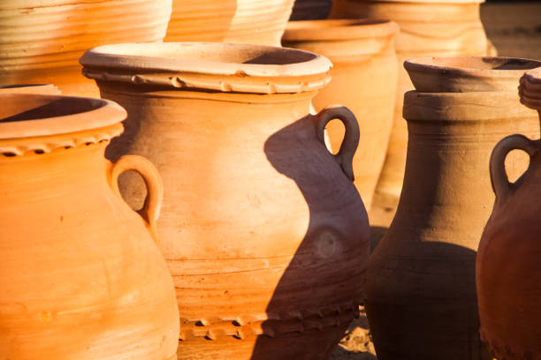
Treasure In Clay Pots
2 Corinthians 4:2

Slide 2
2 Corinthians 4:7
(2 Corinthians 4:7) But we have this treasure in earthen vessels, that the excellence of the power may be of God and not of us.

Slide 3
1} What is the “treasure”?
(2 Corinthians 4:5) For we do not preach ourselves, but Christ Jesus the Lord, and ourselves your bondservants for Jesus' sake.
(2 Corinthians 4:6) For it is the God who commanded light to shine out of darkness, who has shone in our hearts to give the light of the knowledge of the glory of God in the face of Jesus Christ.

Slide 4
1} What is the “treasure”?
1. We preach not ourselves, but Christ
2. A light shining in the darkness
3. Knowledge of the glory of God
4. Glory in the face of Jesus Christ

Slide 5
2} What are the “clay pots”?
(Genesis 2:7) And the LORD God formed man of the dust of the ground, and breathed into his nostrils the breath of life; and man became a living being.
We are the clay pots!

Slide 6
2} What are the “clay pots”?
1. God shined the light in our hearts.
2. We have the treasure (knowledge of God).

Slide 7
3} What is the Power?
Enthusiasm = God in us!
(2 Corinthians 4:7) But we have this treasure in earthen vessels, that the excellence of the power may be of God and not of us.

Slide 8
What is the Power?
God does not GIVE you strength.
God IS your strength.

Slide 9
What is the Power?
(2 Corinthians 12:7) And lest I should be exalted above measure by the abundance of the revelations, a thorn in the flesh was given to me, a messenger of Satan to buffet me, lest I be exalted above measure.
(2 Corinthians 12:8) Concerning this thing I pleaded with the Lord three times that it might depart from me.

Slide 10
What is the Power?
(2 Corinthians 12:9) And He said to me, "My grace is sufficient for you, for My strength is made perfect in weakness." Therefore most gladly I will rather boast in my infirmities, that the power of Christ may rest upon me.

Slide 11
What is the Power?
(1 Corinthians 2:4) And my speech and my preaching were not with persuasive words of human wisdom, but in demonstration of the Spirit and of power,
(1 Corinthians 2:5) that your faith should not be in the wisdom of men but in the power of God.

Slide 12
Conclusion
We are the clay pots.
We have the knowledge from God.
We are a clay jar; we don’t have any power.
The power is of God.

