Slide 1

Choose this day

Slide 2
Joshua 24:15
And if it seems evil to you to serve the LORD, choose for yourselves this day whom you will serve, whether the gods which your fathers served that were on the other side of the River, or the gods of the Amorites, in whose land you dwell. But as for me and my house, we will serve the LORD."

Slide 3
Background
Man is a “free moral agent”
We are given the freedom to choose
We have the freedom to make bad choices
With each choice comes responsibility

Slide 4
The Choice is Inescapable
Sometimes we MUST make a choice
In the picture – there are 3 choices:
  Turn right
  Turn left
  Turn around

Slide 5
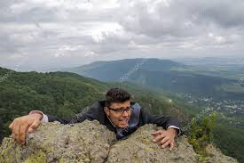
The Choice is Inescapable
Often the choice is narrow
  Hang on or let go
  God or world
  Right or Wrong
  Good or Evil
(Romans 6:17) But God be thanked that though you were slaves of sin, yet you obeyed from the heart that form of doctrine to which you were delivered.

Slide 6
The Choice is Inescapable
Israel had to choose
  Idols or God
Moses had to choose
  Pleasure of sin / suffer with God’s people
David had to choose
  Stand up to Goliath or run in fear
We have to choose
  Eternity with God or away from God

Slide 7
The Choice is Inescapable
(Matthew 7:13) "Enter by the narrow gate; for wide is the gate and broad is the way that leads to destruction, and there are many who go in by it.
(Matthew 7:14) Because narrow is the gate and difficult is the way which leads to life, and there are few who find it.

Slide 8
The Choice is Individual
Judgment will be individual, not group
(2 Corinthians 5:10) For we must all appear before the judgment seat of Christ, that each one may receive the things done in the body, according to what he has done, whether good or bad.

Slide 9
The Choice is Individual
Your choice independent of:
  Family
  Friends
  What is popular
  Preacher
  Elders
There is no “passing the buck”, blaming others

Slide 10
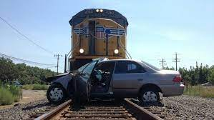
The Choice is Immediate
Some choices can be delayed
  Education, marriage, buy new car or house
Some choices are immediate
  You can’t delay
  Immediate action is required
  Procrastination is dangerous

Slide 11
The Choice is Immediate
When there are choices:
Choosing A = Not choosing other options
Delay is not a good option
  Felix and Agrippa
  Like a True / False test
  There is no third option
NOT choosing God is a choice
Choosing God is a choice

