Slide 1
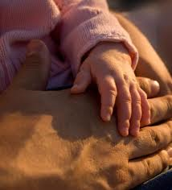
“A FATHER YOU CAN BRAG ABOUT”
Today is father's day
Text: ephesians 6:4

Slide 2
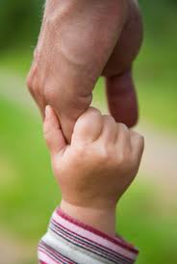
EPHESIANS 6:4
“A FATHER YOU CAN BRAG ABOUT”
4 And you, fathers, do not provoke your children to wrath, but bring them up in the training and admonition of the Lord.

Slide 3
Father's Day
We honored our mothers last month.
Today we honor our fathers.
Children like to brag about their fathers – how strong they are, what they do, how rich they are
Colossians 3:21 Fathers, do not provoke your children, lest they become discouraged.

Slide 4
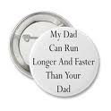
Brag about father

Slide 5
And you, fathers, do not provoke your children to wrath,
Provoke
Greek word – para = with, alongside; orgizo = to enrage, provoke
Word means to anger alongside, to provoke another to anger or rage
Hebrews 10:24 And let us consider one another to provoke unto love and to good works:
Colossians 3:21 Fathers, do not provoke your children, lest they become discouraged.

Slide 6
But bring them up
Bring
Some children just “come up”
Weeds come up; flowers are cared for
Parents job – Bring them to maturity
Ephesians 5:29 For no one ever hated his own flesh, but nourishes and cherishes it, just as the Lord does the church.

Slide 7
In the training (nurture, KJV)
Nurture
Education, training, discipline, correction, teach, instruct, chasten
Teach about God, Bible, Jesus, church
Teach moral values, priorities
Teach maturity – finances, work ethic, family responsibility
2 Timothy 3:16 – Scripture is given for instruction
Hebrews 12:5, 7, 8, 12 – God chastens us

Slide 8
And admonition of the Lord
Admonition
Call attention to, mild rebuke, warn
Don't let things go uncorrected
1 Corinthians 10:11 Now all these things happened to them as examples, and they were written for our admonition, upon whom the ends of the ages have come.
Titus 3:10 Reject a divisive man after the first and second admonition,

Slide 9
FACTS FOR DADS TO ADMIT:
I am a dad.

Slide 10
FACTS FOR DADS TO ADMIT:
I am a dad.
The home is the most important influence on my family.

Slide 11
FACTS FOR DADS TO ADMIT:
I am a dad.
The home is the most important influence on my family.
Because of its inherent difficulty and importance, fathering is the most dignified role I will ever play.

Slide 12
FACTS FOR DADS TO ADMIT:
I am a dad.
The home is the most important influence on my family.
Because of its inherent difficulty and importance, fathering is the most dignified role I will ever play.
Being a parent is one of the greatest sources of joy we can ever know.

Slide 13
FACTS FOR DADS TO ADMIT:
I am a dad.
The home is the most important influence on my family.
Because of its inherent difficulty and importance, fathering is the most dignified role I will ever play.
Being a parent is one of the greatest sources of joy we can ever know.
We all can improve.

Slide 14
FACTS FOR DADS TO ADMIT:
I am a dad.
The home is the most important influence on my family.
Because of its inherent difficulty and importance, fathering is the most dignified role I will ever play.
Being a parent is one of the greatest sources of joy we can ever know.
We all can improve.
Everyone is unique.

Slide 15
FACTS FOR DADS TO ADMIT:
I am a dad.
The home is the most important influence on my family.
Because of its inherent difficulty and importance, fathering is the most dignified role I will ever play.
Being a parent is one of the greatest sources of joy we can ever know.
We all can improve.
Everyone is unique.
It is difficult to be a good parent.

Slide 16
Conclusion:
Father's have a special role in the family
As we honor our fathers on this day – we should strive to be a father our children can brag about
3 boys bragging about their fathers
Make sure that your family has someone to brag about.

