Slide 1
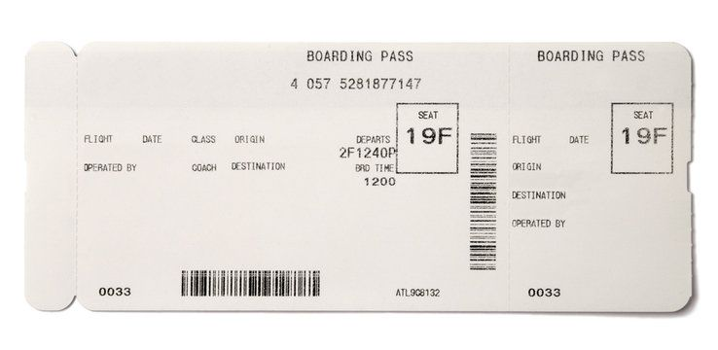
Boarding pass
If you want to go
to heaven Make sure
you have your
Boarding pass.

Slide 2
introduction
The song says –
“This world is not my home,
I’m just a passing through.”
WHERE ARE YOU HEADED?

Slide 3
IN ORDER TO GET TO HEAVEN:
1) YOU HAVE TO ACKNOWLEDGE YOUR SIN
(1 Peter 3:18) For Christ also suffered once for sins, the just for the unjust, that He might bring us to God, being put to death in the flesh but made alive by the Spirit,
(Romans 3:23) for all have sinned and fall short of the glory of God,

Slide 4
IN ORDER TO GET TO HEAVEN:
2) YOU MUST LEAVE SIN IN THE PAST
(Hebrews 12:1) Therefore we also, since we are surrounded by so great a cloud of witnesses, let us lay aside every weight, and the sin which so easily ensnares us, and let us run with endurance the race that is set before us,
(2) looking unto Jesus, the author and finisher of our faith, who for the joy that was set before Him endured the cross, despising the shame, and has sat down at the right hand of the throne of God.

Slide 5
IN ORDER TO GET TO HEAVEN:
2) YOU MUST LEAVE SIN IN THE PAST
There are things you are not allowed to take on an airplane.
Aerosol cans over 6 ounces
Material possessions will not go to heaven.
(2 Peter 3:11) Therefore, since all these things will be dissolved, what manner of persons ought you to be in holy conduct and godliness, (12) looking for and hastening the coming of the day of God, because of which the heavens will be dissolved, being on fire, and the elements will melt with fervent heat?

Slide 6
IN ORDER TO GET TO HEAVEN:
3) YOU MUST TRAVEL THE RIGHT DIRECTION
(Matthew 7:13) "Enter by the narrow gate; for wide is the gate and broad is the way that leads to destruction, and there are many who go in by it.
(14) Because narrow is the gate and difficult is the way which leads to life, and there are few who find it.
You can’t go to heaven if you are on the wrong road!

Slide 7
IN ORDER TO GET TO HEAVEN:
4) DON’T BRING CARES OF THIS WORLD
(1 John 2:15) Do not love the world or the things in the world. If anyone loves the world, the love of the Father is not in him.
(16) For all that is in the world—the lust of the flesh, the lust of the eyes, and the pride of life—is not of the Father but is of the world.
(17) And the world is passing away, and the lust of it; but he who does the will of God abides forever.

Slide 8
IN ORDER TO GET TO HEAVEN:
5) HAVE A CLEAN CONSCIENCE
(Hebrews 9:13) For if the blood of bulls and goats and the ashes of a heifer, sprinkling the unclean, sanctifies for the purifying of the flesh, (14) how much more shall the blood of Christ, who through the eternal Spirit offered Himself without spot to God, cleanse your conscience from dead works to serve the living God?

Slide 9
IN ORDER TO GET TO HEAVEN:
6) HAVE A SPIRITUAL BODY
(Philippians 3:20) For our citizenship is in heaven, from which we also eagerly wait for the Savior, the Lord Jesus Christ, (21) who will transform our lowly body that it may be conformed to His glorious body, according to the working by which He is able even to subdue all things to Himself.

Slide 10
IN ORDER TO GET TO HEAVEN:
7) HAVE A CONTINUED FORGIVENESS
(1 John 2:1) My little children, these things I write to you, so that you may not sin. And if anyone sins, we have an Advocate with the Father, Jesus Christ the righteous. (2) And He Himself is the propitiation for our sins, and not for ours only but also for the whole world.

Slide 11
IN ORDER TO GET TO HEAVEN:
8) MUST HAVE NAME IN HEAVEN
(Revelation 20:12) And I saw the dead, small and great, standing before God, and books were opened. And another book was opened, which is the Book of Life. And the dead were judged according to their works, by the things which were written in the books.
(Revelation 20:14) Then Death and Hades were cast into the lake of fire. This is the second death. (15) And anyone not found written in the Book of Life was cast into the lake of fire.

Slide 12
conclusion
WHERE ARE YOU HEADED?
WHAT WILL BE YOUR
ETERNAL DESTINATION?
DO YOU HAVE A BOARDING PASS
FOR ETERNAITY IN HEAVEN?

