Slide 1
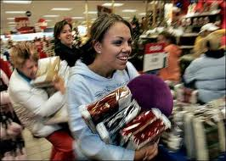
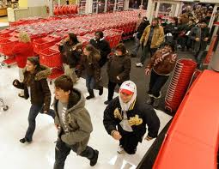
Black Friday
Black Friday is the day after Thanksgiving.

Slide 2
Black Friday
For retailers – Black Friday is a big shopping day
There are special deals – discounts – limited quantities
Black = accounting term – black means making a profit; red – means losing money

Slide 3
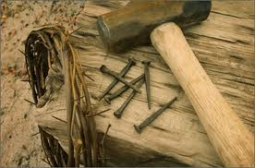
Black Friday
There was another “Black Friday”
This black Friday is the day that Christ died on the cross.
Why is this Friday so BLACK?

Slide 4
Black Friday – DESIRE to be rid of Christ
Pilate said to them, "What then shall I do with Jesus who is called Christ?" They all said to him, "Let Him be crucified!" Then the governor said, "Why, what evil has He done?" But they cried out all the more, saying, "Let Him be crucified!" Matthew 27:22-23

Slide 5
Black Friday – DESERTION of his apostles and others
But all this was done that the Scriptures of the prophets might be fulfilled. Then all the disciples forsook Him and fled. Matthew 26:56

Slide 6
Black Friday – DISLOYALTY of Judas
⁴⁸ Now His betrayer had given them a sign, saying, "Whomever I kiss, He is the One; seize Him." ⁴⁹ Immediately he went up to Jesus and said, "Greetings, Rabbi!" and kissed Him. Matthew 26:48-49

Slide 7
Black Friday – DISLOYALTY of Judas
⁵⁰ But Jesus said to him, "Friend, why have you come?" Then they came and laid hands on Jesus and took Him. Matthew 26:50

Slide 8
Black Friday – DENIAL of Peter
⁷⁴ Then he began to curse and swear, saying, "I do not know the Man!" Immediately a rooster crowed. Matthew 26:74

Slide 9
Black Friday – DENIAL of Peter
⁷⁵ And Peter remembered the word of Jesus who had said to him, "Before the rooster crows, you will deny Me three times." So he went out and wept bitterly. Matthew 26:75

Slide 10
Black Friday – DEBT of sin
For He made Him who knew no sin to be sin for us, that we might become the righteousness of God in Him. 2 Corinthians 5:21
Not a sale, no ½ off, not 2fers, no 70% off, no BOGO

Slide 11
Black Friday – DEATH
For the wages of sin is death, but the gift of God is eternal life in Christ Jesus our Lord. Romans 6:23

Slide 12
Full Price was Paid
TASTED DEATH FOR EVERY MAN
Christ has redeemed us from the curse of the law, having become a curse for us (for it is written, "Cursed is everyone who hangs on a tree" ), Galatians 3:13

Slide 13
Full Price was Paid
TASTED DEATH FOR EVERY MAN
The next day John saw Jesus coming toward him, and said, "Behold! The Lamb of God who takes away the sin of the world! John 1:29

Slide 14
Full Price was Paid
TASTED DEATH FOR EVERY MAN
But we see Jesus, who was made a little lower than the angels, for the suffering of death crowned with glory and honor, that He, by the grace of God, might taste death for everyone. Hebrews 2:9

Slide 15
Full Price was Paid
FORSAKEN OF GOD
And about the ninth hour Jesus cried out with a loud voice, saying, "Eli, Eli, lama sabachthani?" that is, "My God, My God, why have You forsaken Me?" Matthew 27:46

Slide 16
Full Price was Paid
DARK HOURS, EARTHQUAKE, TEMPLE VEIL TORN
Now from the sixth hour until the ninth hour there was darkness over all the land. Matthew 27:45

Slide 17
Full Price was Paid
DARK HOURS, EARTHQUAKE, TEMPLE VEIL TORN
Then, behold, the veil of the temple was torn in two from top to bottom; and the earth quaked, and the rocks were split, Matthew 27:51

Slide 18
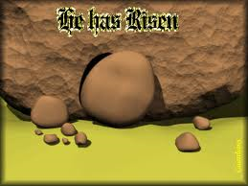
It was a Black Friday But a Bright Sunday
Jesus was raised the 3rd day – 1 Corinthians 15:1-3
He gave us hope of eternal life
He proved that He is the Son of God – Romans 1:4

Slide 19
It was a Black Friday But a Bright Sunday
Our obedience in baptism
Our death to sin
Our burial in water
Our resurrection to a new life
Our decision to follow Christ
The death of Christ was a black Friday – followed by a bright Sunday.

