Slide 1
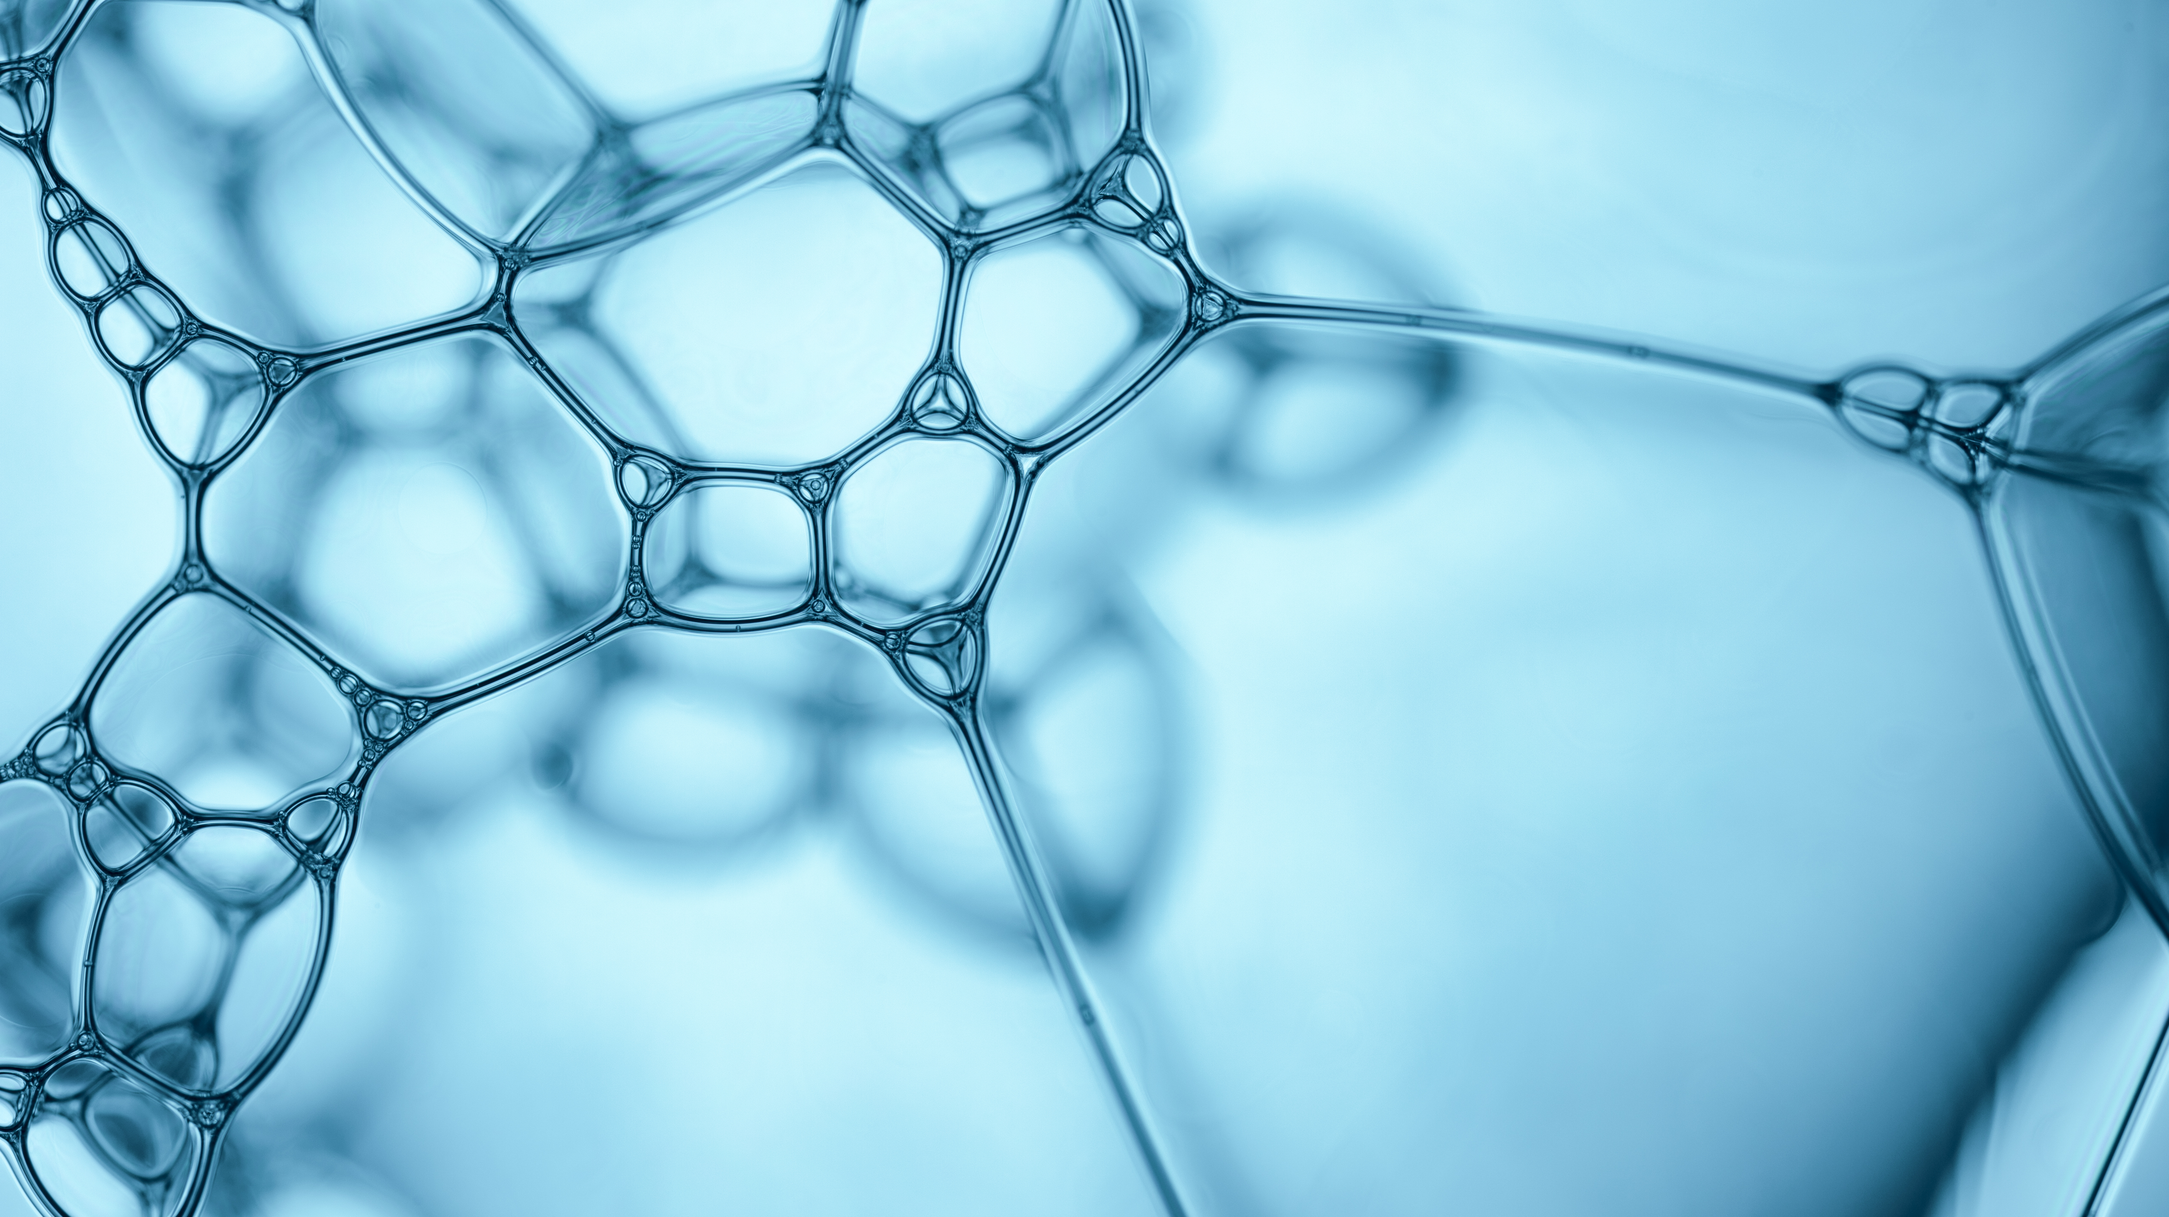
Bible Certainties
1 John 2:3-5

Slide 2
1 John 2:3-5
(1 John 2:3) Now by this we know that we know Him, if we keep His commandments.
(1 John 2:4) He who says, "I know Him," and does not keep His commandments, is a liar, and the truth is not in him.
(1 John 2:5) But whoever keeps His word, truly the love of God is perfected in him. By this we know that we are in Him.

Slide 3
Introduction
This is a time of skepticism and doubt.
Many are happy and content with speculation and uncertainty.
The Bible gives us some CERTAINTIES.

Slide 4
WE KNOW
THAT OUR REDEEMER LIVES
(Job 19:25) For I know that my Redeemer lives, And He shall stand at last on the earth;
This is the basis of the gospel.
Gospel – Death, burial and resurrection
Confucius, Mohammed, Buddha, Moses – all are dead.

Slide 5
WE KNOW
THAT OUR REDEEMER LIVES
Christ is alive!!!
(Hebrews 7:25) Therefore He is also able to save to the uttermost those who come to God through Him, since He always lives to make intercession for them.

Slide 6
WE KNOW
THAT WE HAVE PASSED FROM DEATH TO LIFE
(1 John 3:14) We know that we have passed from death to life, because we love the brethren. He who does not love his brother abides in death.
Sin separated us from God.
This is spiritual death.
Salvation = New life, Born again, Start over

Slide 7
WE KNOW
THAT WE HAVE PASSED FROM DEATH TO LIFE
Salvation = New life, Born again, Start over
(2 Corinthians 5:17) Therefore, if anyone is in Christ, he is a new creation; old things have passed away; behold, all things have become new.

Slide 8
WE KNOW
THAT ALL THINGS WORK TOGETHER FOR GOOD
(Romans 8:28) And we know that all things work together for good to those who love God, to those who are the called according to His purpose.
NOT: All things are good.

Slide 9
WE KNOW
THAT ALL THINGS WORK TOGETHER FOR GOOD
God can take lemons and make lemonade.
God can take a vacant lot and build a service station.
God can take me and preach the gospel around the world.
God can take YOU and serve, teach, influence to those around you.

Slide 10
WE KNOW
THAT WE WILL HAVE AN ETERNAL DWELLING WITH GOD
(2 Corinthians 5:1) For we know that if our earthly house, this tent, is destroyed, we have a building from God, a house not made with hands, eternal in the heavens.

Slide 11
WE KNOW
THAT WE WILL HAVE AN ETERNAL DWELLING WITH GOD
Christians know that death is not the end of our existence.
The body may perish – but the soul is eternal.
(Matthew 10:28) And do not fear those who kill the body but cannot kill the soul. But rather fear Him who is able to destroy both soul and body in hell.

Slide 12
WE KNOW
THAT WE WILL BE LIKE CHRIST
(1 John 3:1) Behold what manner of love the Father has bestowed on us, that we should be called children of God! Therefore the world does not know us, because it did not know Him.
(1 John 3:2) Beloved, now we are children of God; and it has not yet been revealed what we shall be, but we know that when He is revealed, we shall be like Him, for we shall see Him as He is.

Slide 13
WE KNOW
THAT WE WILL BE LIKE CHRIST
We will recognize Christ. We will see Him face to face.
He is coming again. We will see Him.
(Revelation 1:7) Behold, He is coming with clouds, and every eye will see Him, even they who pierced Him. And all the tribes of the earth will mourn because of Him. Even so, Amen.

Slide 14
WE KNOW
THAT WE WILL BE LIKE CHRIST
Christ is able to save us.
(2 Timothy 1:12) For this reason I also suffer these things; nevertheless I am not ashamed, for I know whom I have believed and am persuaded that He is able to keep what I have committed to Him until that Day.

Slide 15
HOW CERTAIN ARE YOU?
You can know for sure.
You can know if you have believed in Jesus, repented of your sins, and been baptized for the forgiveness of sins.
You can know your current relationship with God.

