Slide 1
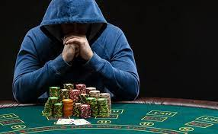
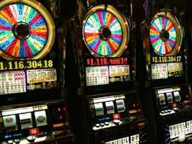
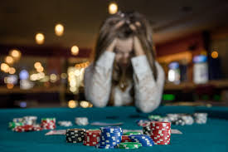
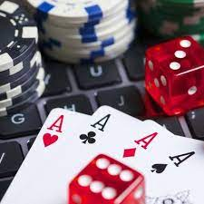
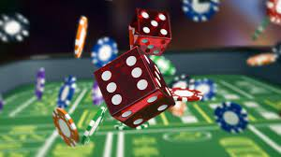
Don’t Bet On It
What is gambling?
What is wrong with gambling?

Slide 2
What is gambling?
There is a difference in taking a risk and gambling.
Risk Taking
Taking a risk – study, learn, seek to avoid failing.
Start a business, drive on the highway, take a course in college, take out a loan, change jobs or occupation, buy a house
Most jobs involve some element of risk
BUT we do all we can to avoid the danger, harm or loss

Slide 3
What is gambling?
There is a difference in taking a risk and gambling.
Gambling
Seeks to INCREASE THE RISK!
The greater the risk, the more attractive it becomes.
If you bet $1 and can win a $1.02 – not worth it
If you bet $1 and can win a $1,000,000 – many go for it.
Gambling FEEDS on the risk.

Slide 4
What is wrong with gambling?
1 – Something for nothing (or much for a little)
(Genesis 3:17) Then to Adam He said, "Because you have heeded the voice of your wife, and have eaten from the tree of which I commanded you, saying, 'You shall not eat of it': "Cursed is the ground for your sake; In toil you shall eat of it All the days of your life.
(Genesis 3:18) Both thorns and thistles it shall bring forth for you, And you shall eat the herb of the field.
(Genesis 3:19) In the sweat of your face you shall eat bread Till you return to the ground, For out of it you were taken; For dust you are, And to dust you shall return."

Slide 5
What is wrong with gambling?
1 – Something for nothing (or much for a little)
(Ephesians 4:28) Let him who stole steal no longer, but rather let him labor, working with his hands what is good, that he may have something to give him who has need.
(2 Thessalonians 3:10) For even when we were with you, we commanded you this: If anyone will not work, neither shall he eat.

Slide 6
What is wrong with gambling?
2 – Promotes laziness
(Matthew 25:26) "But his lord answered and said to him, 'You wicked and lazy servant, you knew that I reap where I have not sown, and gather where I have not scattered seed.
(Matthew 25:27) So you ought to have deposited my money with the bankers, and at my coming I would have received back my own with interest.

Slide 7
What is wrong with gambling?
3 – Lack of Stewardship
Steward = one who oversees the property of another
Bank – is a steward of my saving account
We are stewards of all that God has given to us.
(1 Corinthians 4:1) Let a man so consider us, as servants of Christ and stewards of the mysteries of God.
(1 Corinthians 4:2) Moreover it is required in stewards that one be found faithful.

Slide 8
What is wrong with gambling?
3 – Lack of Stewardship
(Psalms 50:10) For every beast of the forest is Mine, And the cattle on a thousand hills.
(Psalms 50:11) I know all the birds of the mountains, And the wild beasts of the field are Mine.
(Psalms 50:12) "If I were hungry, I would not tell you; For the world is Mine, and all its fullness.
(Haggai 2:8) 'The silver is Mine, and the gold is Mine,' says the LORD of hosts.

Slide 9
What is wrong with gambling?
4 – Habit forming - addiction
(1 Corinthians 6:12) All things are lawful for me, but all things are not helpful. All things are lawful for me, but I will not be brought under the power of any.

Slide 10
What is wrong with gambling?
5 – The Fruit it Bears
(Matthew 7:16) You will know them by their fruits. Do men gather grapes from thornbushes or figs from thistles?
(Matthew 7:17) Even so, every good tree bears good fruit, but a bad tree bears bad fruit.
Deceit, violence, murder, debt, poverty, divorce, theft, lying, fraud, suicide, family neglected

Slide 11
What is wrong with gambling?
6 - Greed
(1 Timothy 6:9) But those who desire to be rich fall into temptation and a snare, and into many foolish and harmful lusts which drown men in destruction and perdition.
(1 Timothy 6:10) For the love of money is a root of all kinds of evil, for which some have strayed from the faith in their greediness, and pierced themselves through with many sorrows.

Slide 12
What is wrong with gambling?
7 – Violates the Golden Rule
(Matthew 7:12) Therefore, whatever you want men to do to you, do also to them, for this is the Law and the Prophets.
The gambler says, “I want to win your money. I don’t want you to win my money.”

Slide 13
Conclusion
Gambling is wrong, sinful, a violation of God’s will.
The size of the wager is not important.
High stakes poker or a lottery ticket are both gambling.
The Bible emphasizes the principles violated.

