Slide 1
The “Be Happy” Attitude
Matthew 5:1-12

Slide 2
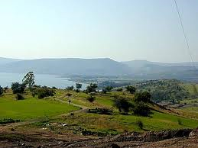
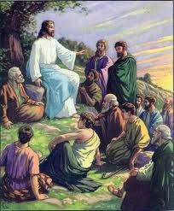
Sermon on the Mount
Matthew 5 – 7 records a sermon Jesus preached near the Sea of Galilee
The beginning of this sermon is a section called “The Beatitudes”

Slide 3
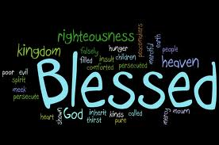
Blessed
The word translated “blessed” literally means happy, cheerful
Read each beatitude with “happy” instead of blessed and you will get the meaning
Happy is an attitude we should have
Beatitudes explain how to be happy
Today we will look at 3 of these

Slide 4
Blessed
There are two parts to each of these
THE PEOPLE WHO ARE HAPPY
THE PROMISE FOR THE HAPPY

Slide 5
Pure in Heart
Blessed are the pure in heart, For they shall see God. Matthew 5:8
PEOPLE - Pure in heart
Pure in mind, thought
Pure in speech, life

Slide 6
Pure in Heart
And everyone who has this hope in Him purifies himself, just as He is pure. 1 John 3:3
²² Since you have purified your souls in obeying the truth through the Spirit in sincere love of the brethren, love one another fervently with a pure heart, ²³ having been born again, not of corruptible seed but incorruptible, through the word of God which lives and abides forever, 1 Peter 1:22-23

Slide 7
Pure in Heart
Blessed are the pure in heart, For they shall see God. Matthew 5:8
PROMISE – See God
God is not visible – YET!
We will see Him in Heaven
And after my skin is destroyed, this I know, That in my flesh I shall see God, Job 19:26

Slide 8
Peacemakers
Blessed are the peacemakers, For they shall be called sons of God. Matthew 5:9
PEOPLE - Peacemakers
Not troublemakers, stir up strife
Try to settle arguments

Slide 9
Peacemakers
¹⁷ Repay no one evil for evil. Have regard for good things in the sight of all men. ¹⁸ If it is possible, as much as depends on you, live peaceably with all men. Romans 12:17-18

Slide 10
Peacemakers
Blessed are the peacemakers, For they shall be called sons of God. Matthew 5:9
PROMISE – Called Sons of God
Christians are sons of God
We will still be sons of God in Heaven

Slide 11
Peacemakers
²⁶ For you are all sons of God through faith in Christ Jesus. ²⁷ For as many of you as were baptized into Christ have put on Christ. ²⁸ There is neither Jew nor Greek, there is neither slave nor free, there is neither male nor female; for you are all one in Christ Jesus. Galatians 3:26-28

Slide 12
Peacemakers
¹² But as many as received Him, to them He gave the right to become children of God, to those who believe in His name: ¹³ who were born, not of blood, nor of the will of the flesh, nor of the will of man, but of God. John 1:12-13

Slide 13
Persecuted
Blessed are those who are persecuted for righteousness' sake, For theirs is the kingdom of heaven. Matthew 5:10
PEOPLE - Persecuted
Not just – have problems or trouble in life
Suffer BECAUSE of our faith
Ridiculed, teased, threatened, jailed, or killed

Slide 14
Persecuted
Blessed are those who are persecuted for righteousness' sake, For theirs is the kingdom of heaven. Matthew 5:10
PROMISE – Inherit the Kingdom of Heaven
Reward of the faithful
If we remain faithful – We will be rewarded

Slide 15
Persecuted
PROMISE – Inherit the Kingdom of Heaven
Kingdom of Heaven has two meanings in Matthew
Often is a reference to the church
and saying, "Repent, for the kingdom of heaven is at hand!" Matthew 3:2
"Assuredly, I say to you, among those born of women there has not risen one greater than John the Baptist; but he who is least in the kingdom of heaven is greater than he. Matthew 11:11

Slide 16
Persecuted
PROMISE – Inherit the Kingdom of Heaven
Kingdom of Heaven has two meanings in Matthew
This phrase also looks to the eternal abode of the righteous
"Not everyone who says to Me, 'Lord, Lord,' shall enter the kingdom of heaven, but he who does the will of My Father in heaven. Matthew 7:21

Slide 17
Persecuted
PROMISE – Inherit the Kingdom of Heaven
¹¹ "Blessed are you when they revile and persecute you, and say all kinds of evil against you falsely for My sake. ¹² Rejoice and be exceedingly glad, for great is your reward in heaven, for so they persecuted the prophets who were before you. Matthew 5:11-12

Slide 18
Conclusion
Jesus wants us to be happy
Not just free to do whatever I want
But – real, genuine happiness
To be happy we must be the people of these Beatitudes.
THEN we can have the promises in them.

