Slide 1
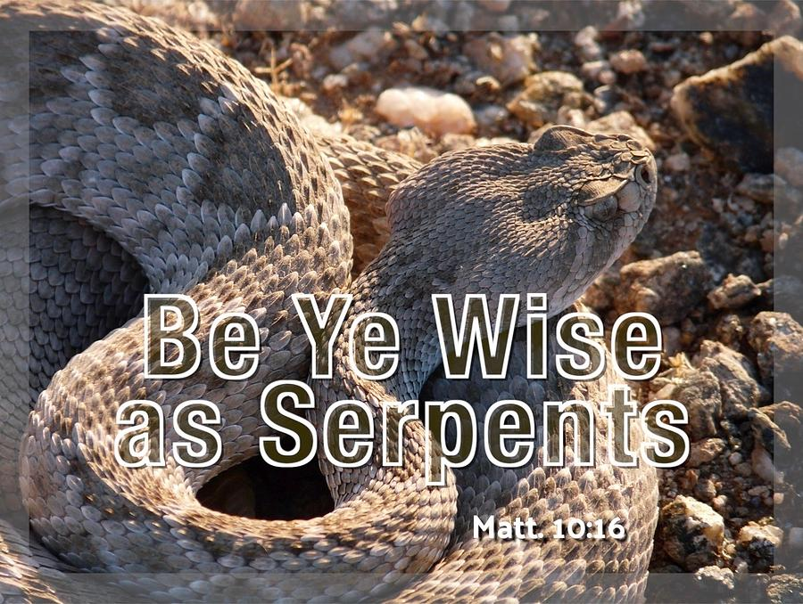

Slide 2
Matthew 10:16
Behold, I send you out as sheep in the midst of wolves. Therefore be wise as serpents and harmless as doves.

Slide 3
Strong’s Hebrew / Greek Dictionary
About the word – WISE
thoughtful, that is, discreet
(implying a cautious character)

Slide 4
1] We must be snakes
Jesus taught us about being wise
(Matthew 7:24) "Therefore whoever hears these sayings of Mine, and does them, I will liken him to a wise man who built his house on the rock:

Slide 5
1] We must be snakes
Jesus taught us about being wise
Matthew 25 – 5 wise virgins vs. the 5 foolish virgins
Contrast – wise = prepared, ready
foolish = not ready, unprepared

Slide 6
2] We must NOT be conceited
Not conceited wisdom – smart aleck
Not full of pride, boasting
(Romans 11:25) For I do not desire, brethren, that you should be ignorant of this mystery, lest you should be wise in your own opinion, that blindness in part has happened to Israel until the fullness of the Gentiles has come in.

Slide 7
2] We must NOT be conceited
Not conceited wisdom – smart aleck
Not full of pride, boasting
(Romans 12:16) Be of the same mind toward one another. Do not set your mind on high things, but associate with the humble. Do not be wise in your own opinion.

Slide 8
2] We must NOT be conceited
Not conceited wisdom – smart aleck
Not full of pride, boasting
(1 Corinthians 10:12) Therefore let him who thinks he stands take heed lest he fall.

Slide 9
3] Wisdom is seen in our conduct
(James 3:13) Who is wise and understanding among you? Let him show by good conduct that his works are done in the meekness of wisdom.
(James 3:14) But if you have bitter envy and self-seeking in your hearts, do not boast and lie against the truth.
(James 3:15) This wisdom does not descend from above, but is earthly, sensual, demonic.
(James 3:16) For where envy and self-seeking exist, confusion and every evil thing are there.

Slide 10
3] Wisdom is seen in our conduct
(James 3:13) Who is wise and understanding among you? Let him show by good conduct that his works are done in the meekness of wisdom.
KJV – “conversation” = manner of life, how one conducts their life

Slide 11
3] Wisdom is seen in our conduct
The opposite of wisdom =
Bitter, envy, self-seeking
Boast, lie against the truth
Earthly, sensual, demonic
Confusion and every evil thing

Slide 12
4] Wisdom about our salvation
(2 Timothy 3:14) But you must continue in the things which you have learned and been assured of, knowing from whom you have learned them,
(2 Timothy 3:15) and that from childhood you have known the Holy Scriptures, which are able to make you wise for salvation through faith which is in Christ Jesus.

Slide 13
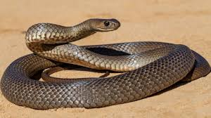
BE WISE AS A SNAKE
Are we wise with the wisdom of the world?
Do you have a wisdom that is from above?
JESUS COMMANDS US
TO BE “A SNAKE”

