Slide 1

SERIES IN 2023 – BALANCE
In 2023 some sermons will examine some ways we need balance in our understanding of the Bible.

Slide 2
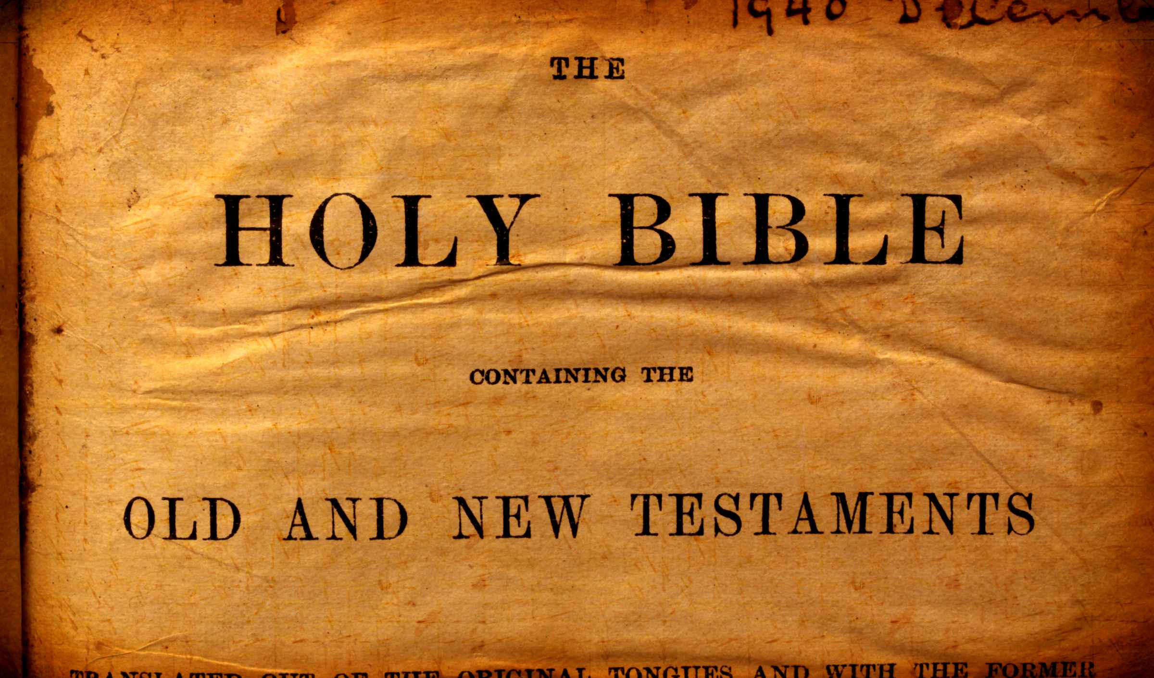

Slide 3
OLD TESTAMENT / NEW TESTAMENT
MEANING OF THE WORD “TESTAMENT”
1. A will – “Last will and Testament” – After death instructions, Express your desire for the distribution of your property
2. Covenant, contract, agreement
3. Bible = Old Testament and New Testament – 2 major sections

Slide 4
1. Divisions of the Bible
OLD TESTAMENT
39 BOOKS – GENESIS TO MALACHI
HISTORY OF CREATION, NATION OF ISRAEL
SUB SECTIONS – LAW, HISTORY, POETRY, MAJOR PROPHETS, MINOR PROPHETS

Slide 5
1. Divisions of the Bible
NEW TESTAMENT
27 BOOKS – MATTHEW - REVELATION
CHRIST AND ESTABLISHMENT OF THE CHURCH
SUB SECTIONS – GOSPELS, HISTORY, PAUL’S EPISTLES, GENERAL EPISTLES, PROPHECY

Slide 6
2. Dispensations
PATRIARCHAL
DEFINITION: a system of order, government, or organization of a nation, community, etc., especially as existing at a particular time.
ADAM TO CHRIST – ABOUT 6,000 YEARS

Slide 7
2. Dispensations
MOSAICAL
MOSES TO END OF OLD TESTAMENT
ALSO INCLUDES THE LIFE OF CHRIST (MATTHEW, MARK, LUKE, JOHN)
ABOUT 2,000 YEARS

Slide 8
2. Dispensations
CHRISTIAN
DEATH OF CHRIST TO END OF NEW TESTAMENT
INCLUDES ESTABLISHMENT OF CHURCH
INCLUDES THE SPREAD OF CHRISTIANITY
ABOUT 60 YEARS

Slide 9
3. LAWS
PATRIARCHAL – FATHERS RECEIVED MESSAGES DIRECT FROM GOD
MOSAICAL – LAW OF MOSES, WRITTEN BY INSPIRED MEN, READ AND STUDIED
CHRISTIAN – WRITTEN BY INSPIRED MEN TO BE OBEYED TILL 2ND COMING OF CHRIST

Slide 10
4. WHAT TO TEACH AND PREACH
OLD TESTAMENT
(Romans 15:4) For whatever things were written before were written for our learning, that we through the patience and comfort of the Scriptures might have hope.

Slide 11
4. WHAT TO TEACH AND PREACH
OLD TESTAMENT
WE LEARN BY EXAMPLE
LEARN HOW GOD EXPECTS US TO OBEY
DOES GOD MEAN WHAT HE SAYS?

Slide 12
4. WHAT TO TEACH AND PREACH
NEW TESTAMENT
NEW TESTAMENT CANCELED THE JEWISH LAWS
(Colossians 2:14) having wiped out the handwriting of requirements that was against us, which was contrary to us. And He has taken it out of the way, having nailed it to the cross.

Slide 13
4. WHAT TO TEACH AND PREACH
NEW TESTAMENT ALSO CANCELED PATRIARCHAL LAWS
(Ephesians 2:13) But now in Christ Jesus you who once were far off have been brought near by the blood of Christ.
(Ephesians 2:14) For He Himself is our peace, who has made both one, and has broken down the middle wall of separation,
(Ephesians 2:15) having abolished in His flesh the enmity, that is, the law of commandments contained in ordinances, so as to create in Himself one new man from the two, thus making peace,

Slide 14
KEEP THEM IN BALANCE
We need to read, study and understand both sections of the Bible.
OT to understand origin, history, how God demands obedience
NT to know what God requires of us for salvation, worship, morals, and faith.

