Slide 1
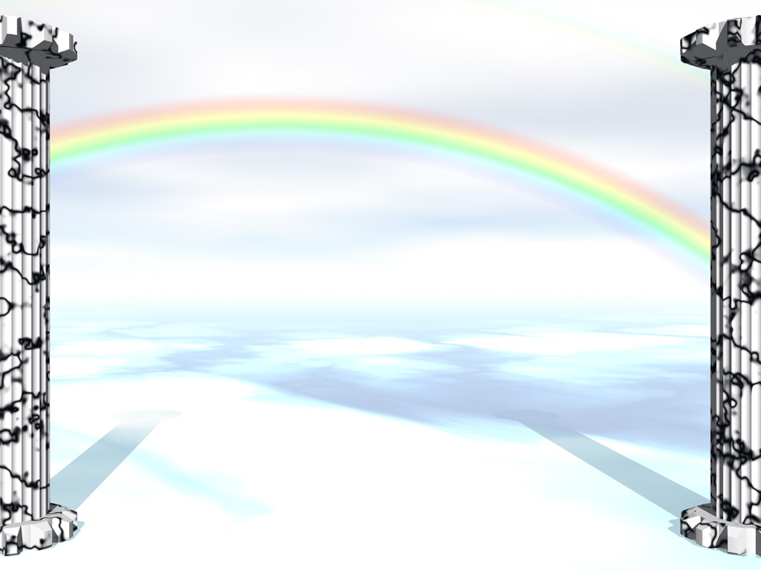
GOD, OUR AWESOME FRIEND
GOD IS BOTH TRANSCENDENT
AND IMMANENT

Slide 2
EXODUS 19:16-17
danieldaviddalton@gmail.com
¹⁶ Then it came to pass on the third day, in the morning, that there were thunderings and lightnings, and a thick cloud on the mountain; and the sound of the trumpet was very loud, so that all the people who were in the camp trembled. ¹⁷ And Moses brought the people out of the camp to meet with God, and they stood at the foot of the mountain. Exodus 19:16-17

Slide 3
EXODUS 19:18-19
danieldaviddalton@gmail.com
¹⁸ Now Mount Sinai was completely in smoke, because the Lord descended upon it in fire. Its smoke ascended like the smoke of a furnace, and the whole mountain quaked greatly. ¹⁹ And when the blast of the trumpet sounded long and became louder and louder, Moses spoke, and God answered him by voice. Exodus 19:18-19

Slide 4
Introduction
danieldaviddalton@gmail.com
The context of this passage
Who is the God of the 10 Commandments?
What are his attributes?
What is He like?
Exodus 20:21 - So the people stood afar off, but Moses drew near the thick darkness where God was.

Slide 5
Purpose in these warnings
danieldaviddalton@gmail.com
Communicate His nature
He gave the 10 Commandments
He also gave some 613 other laws
365 negative ones
248 positive or affirmative ones

Slide 6
Purpose in these warnings
danieldaviddalton@gmail.com
The law governed all of life
Political
Social
Health
Marital, family
Economic, inheritance
Moral
Spiritual, worship, service

Slide 7
GOD IS TRANSCENDENT
danieldaviddalton@gmail.com
Transcendence = beyond the ordinary, rises above and beyond the limits
Babe Ruth “trancends” baseball
Arnold Palmer “trancends” golf
God is beyond the ordinary, higher than the mountains, deeper than the ocean, larger than the universe.

Slide 8
GOD IS TRANSCENDENT
danieldaviddalton@gmail.com
Exodus 19:2 - For they had departed from Rephidim, had come to the Wilderness of Sinai, and camped in the wilderness. So Israel camped there before the mountain.
Traveled 22 miles from Red Sea
Came to a level plain
2 miles long, half mile wide
Exodus 19:12 - You shall set bounds for the people all around, saying, 'Take heed to yourselves that you do not go up to the mountain or touch its base. Whoever touches the mountain shall surely be put to death.

Slide 9
GOD IS TRANSCENDENT
danieldaviddalton@gmail.com
Exodus 19:16 - Then it came to pass on the third day, in the morning, that there were thunderings and lightnings, and a thick cloud on the mountain; and the sound of the trumpet was very loud, so that all the people who were in the camp trembled
Thunder and lightning
Very loud, smoke, cloud
People trembled

Slide 10
GOD’S IMMANENCE
danieldaviddalton@gmail.com
There are 3 words that sound alike, spelled differently, have different meanings
Eminence – important, dignitary, a king is “His Eminence.”
Imminence – Near, close, coming soon, “The storm is an imminent disaster.”
Immanence – Nearness, approachable, able to be close to, as a friend

Slide 11
TRANSCENDENCE / IMMANENCE
danieldaviddalton@gmail.com
TRANSCENCENCE | IMMANENCE
Distance | Nearness
Raw Power | Concern
Awesome Sovereign | Compassionate Friend
King, Lord, Ruler | Shepherd, Gentle, Kind
Separateness | Approachability

Slide 12
GOD’S IMMANENCE
danieldaviddalton@gmail.com
Jeremiah 23:23 - "Am I a God near at hand," says the Lord, "And not a God afar off?
Isaiah 40:10 - Behold, the Lord God shall come with a strong hand, And His arm shall rule for Him; Behold, His reward is with Him, And His work before Him.
Here God is Transcendent – rules with power

Slide 13
GOD’S IMMANENCE
danieldaviddalton@gmail.com
Isaiah 40:11 - He will feed His flock like a shepherd; He will gather the lambs with His arm, And carry them in His bosom, And gently lead those who are with young.
Here God is Immanent – Shepherd, carried you, brought you to Himself

Slide 14
IS ONE PREDOMINATE?
danieldaviddalton@gmail.com
Some think OT – shows God’s power, might
They think the NT – is Loving Shepherd
BOTH are present in Exodus 19
Exodus 19:4 - 'You have seen what I did to the Egyptians, and how I bore you on eagles' wings and brought you to Myself.

Slide 15
IS ONE PREDOMINATE IN NT?
danieldaviddalton@gmail.com
In Jesus – Immanence is clearly seen
No one has seen God at any time. The only begotten Son, who is in the bosom of the Father, He has declared Him. John 1:18
Colossians 1:19 - For it pleased the Father that in Him all the fullness should dwell,

Slide 16
IS ONE PREDOMINATE IN NT?
danieldaviddalton@gmail.com
Hebrews 12:18 - For you have not come to the mountain that may be touched and that burned with fire, and to blackness and darkness and tempest,
Hebrews 12:22 - But you have come to Mount Zion and to the city of the living God, the heavenly Jerusalem, to an innumerable company of angels,

Slide 17
IS ONE PREDOMINATE IN NT?
danieldaviddalton@gmail.com
Romans 11:22 – Therefore consider the goodness and severity of God: on those who fell, severity; but toward you, goodness, if you continue in His goodness. Otherwise you also will be cut off.

Slide 18
IMPACT ON US?
danieldaviddalton@gmail.com
We can enjoy the nearness, compassion, love, mercy, and kindness of God
We can celebrate the nearness of God
DON’T ALLOW FAMILIARITY TO BREED CONTEMPT.

Slide 19
CONCLUSION
danieldaviddalton@gmail.com
Don’t ignore the power, might, of an Almighty, Awesome God.
Don’t assume that His love has done away with his Transcendence.
Allow God to become your:
Awesome (Transcendent) God
Friend (Immanent) God
GOD IS OUR AWESOME FRIEND.

