Slide 1
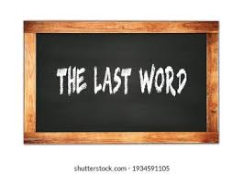

Slide 2
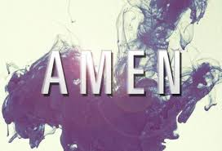

Slide 3
Revelation 22:21 (This is the last verse in the Bible)
(21) The grace of our Lord Jesus Christ be with you all. Amen.

Slide 4
Mt Gerizim / Shechem / Mt Ebal

Slide 5
Deuteronomy 27:14-17
(14) "And the Levites shall speak with a loud voice and say to all the men of Israel:
(15) 'Cursed is the one who makes a carved or molded image, an abomination to the LORD, the work of the hands of the craftsman, and sets it up in secret.' "And all the people shall answer and say, 'Amen!'
(16) 'Cursed is the one who treats his father or his mother with contempt.' "And all the people shall say, 'Amen!'
(17) 'Cursed is the one who moves his neighbor's landmark.' "And all the people shall say, 'Amen!’
This continues through verse 26.

Slide 6
Meanings of “Amen”
So be it, May it be so, So it is
With certainty, Verily, Truly
Acceptance, agreement, approval
Israel heard the statement and was in agreement with it.

Slide 7
Who can say, Amen?
Congregation
(Nehemiah 5:13) Then I shook out the fold of my garment and said, "So may God shake out each man from his house, and from his property, who does not perform this promise. Even thus may he be shaken out and emptied." And all the assembly said, "Amen!" and praised the LORD. Then the people did according to this promise.

Slide 8
Who can say, Amen?
Visitors
(1 Corinthians 14:16) Otherwise, if you bless with the spirit, how will he who occupies the place of the uninformed say "Amen" at your giving of thanks, since he does not understand what you say?

Slide 9
Who can say, Amen?
Women
(Numbers 5:22) and may this water that causes the curse go into your stomach, and make your belly swell and your thigh rot." 'Then the woman shall say, "Amen, so be it."

Slide 10
When should people say, Amen?
Prayer
Song
Sermon
Scripture reading

Slide 11
Why did we quit?
It was common in the days of Alexander Campbell and Barton W. Stone.
It was common through the 1940’s and into the 1950’s.
THEN WE CHANGED:
Stiff and more formal worship
Tradition bound
Ritualistic
Sophisticated

Slide 12
The Last Word
(21) The grace of our Lord Jesus Christ be with you all. Amen.
A. God will bless us as we read publicly and privately from the Bible.
B. God’s grace will shine on us as we listen, study and understand this book.
C. Christ will be with you as you obey the commands of this book.

