Slide 1
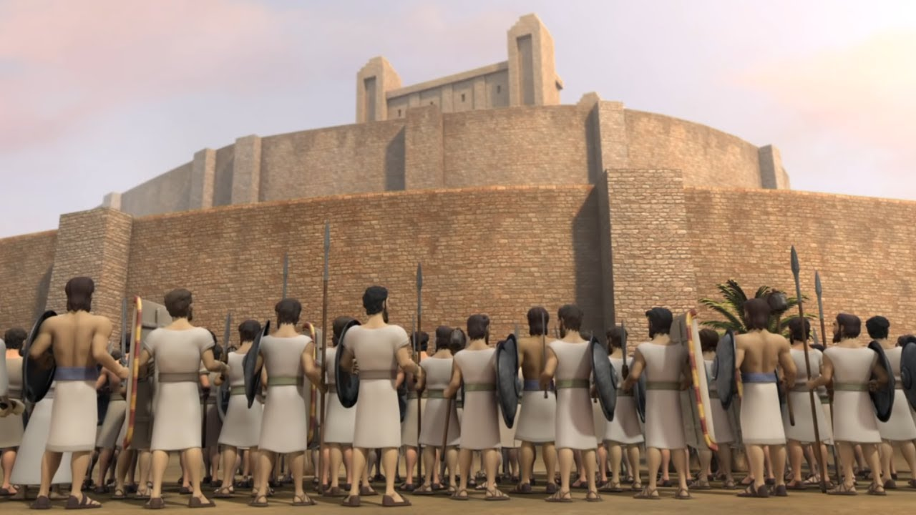
Faith that took down a City
How did Israel take down a fortified city?

Slide 2
Faith that took down a City
How did Israel take down a fortified city?
Outer wall – 6’ thick
Inner wall – 12’ thick

Slide 3
Hebrews 11:30-31
(Heb 11:30) By faith the walls of Jericho fell down after they were encircled for seven days.
(Heb 11:31) By faith the harlot Rahab did not perish with those who did not believe, when she had received the spies with peace.

Slide 4
Jericho was a gift from God
(Joshua 6:3) You shall march around the city, all you men of war; you shall go all around the city once. This you shall do six days. (4) And seven priests shall bear seven trumpets of rams' horns before the ark. But the seventh day you shall march around the city seven times, and the priests shall blow the trumpets. (5) It shall come to pass, when they make a long blast with the ram's horn, and when you hear the sound of the trumpet, that all the people shall shout with a great shout; then the wall of the city will fall down flat. And the people shall go up every man straight before him."

Slide 5
Jericho was a gift from God
God gave them the city.
(Joshua 6:16) And the seventh time it happened, when the priests blew the trumpets, that Joshua said to the people: "Shout, for the LORD has given you the city!

Slide 6
Jericho was a gift from God
It was a gift.
It was a conditional gift.
Israel must do their part.
God will give them the city.

Slide 7
Jericho was a gift from God
God gave them the city.
Salvation is also a conditional gift.
(Romans 6:23) For the wages of sin is death, but the gift of God is eternal life in Christ Jesus our Lord.

Slide 8
Jericho was a gift from God
Salvation is also a conditional gift.
We must conquer sin.
(2Co 10:4) For the weapons of our warfare are not carnal but mighty in God for pulling down strongholds,
(2Co 10:5) casting down arguments and every high thing that exalts itself against the knowledge of God, bringing every thought into captivity to the obedience of Christ,

Slide 9
Received after conditions met
(Joshua 6:5) It shall come to pass, when they make a long blast with the ram's horn, and when you hear the sound of the trumpet, that all the people shall shout with a great shout; then the wall of the city will fall down flat. And the people shall go up every man straight before him.“
After you blow the horn.
After the sound of the trumpet.
After the people shout.

Slide 10
Received after conditions met
(Joshua 6:20) So the people shouted when the priests blew the trumpets. And it happened when the people heard the sound of the trumpet, and the people shouted with a great shout, that the wall fell down flat. Then the people went up into the city, every man straight before him, and they took the city.

Slide 11
Received after conditions met
The same is true for our salvation.
(Heb 5:8) though He was a Son, yet He learned obedience by the things which He suffered.
(Heb 5:9) And having been perfected, He became the author of eternal salvation to all who obey Him,

Slide 12
Received after conditions met
The same is true for our salvation.
(John 3:16) For God so loved the world that He gave His only begotten Son, that whoever believes in Him should not perish but have everlasting life.
(John 3:36) He who believes in the Son has everlasting life; and he who does not believe the Son shall not see life, but the wrath of God abides on him."

Slide 13
Received after conditions met
The same is true for our salvation.
(Gal 5:6) For in Christ Jesus neither circumcision nor uncircumcision avails anything, but faith working through love.
(Act 17:30) Truly, these times of ignorance God overlooked, but now commands all men everywhere to repent,

Slide 14
Received after conditions met
The same is true for our salvation.
(Romans 10:9) that if you confess with your mouth the Lord Jesus and believe in your heart that God has raised Him from the dead, you will be saved. (10) For with the heart one believes unto righteousness, and with the mouth confession is made unto salvation.

Slide 15
Received after conditions met
The same is true for our salvation.
(Gal 3:26) For you are all sons of God through faith in Christ Jesus.
(Gal 3:27) For as many of you as were baptized into Christ have put on Christ.

Slide 16
The wall of sin can come down
Have you met the conditions?
Believe
Love God / Obey God
Repent
Confess your faith
Be baptized

