Slide 1
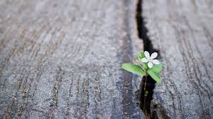
5 pictures of hope (a flower growing in a crack)

Slide 2
Hope is difficult to describe
A picture is worth a thousand words.
5 pictures are worth an entire sermon.
The Bible uses 5 pictures to help us grasp the teaching of hope

Slide 3
Hope is light to see through the darkness
(Psalm132:17) There I will make the horn of David grow; I will prepare a lamp for My Anointed.
Hope does not deny the reality of the darkness. It shines a light into the dark valley and shows the way out.

Slide 4
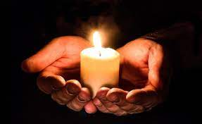
Hope is light to see through the darkness
(Exodus 27:20) "And you shall command the children of Israel that they bring you pure oil of pressed olives for the light, to cause the lamp to burn continually.
The lamp in the tabernacle was never to go out.
(Psalms 119:105) Your word is a lamp to my feet And a light to my path.
(Proverbs 6:23) For the commandment is a lamp, And the law a light; Reproofs of instruction are the way of life,

Slide 5
Hope is a nail to hold things together
(Ezra 9:8) And now for a little while grace has been shown from the LORD our God, to leave us a remnant to escape, and to give us a peg (nail in KJV) in His holy place, that our God may enlighten our eyes and give us a measure of revival in our bondage.

Slide 6
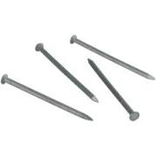
Hope is a nail to hold things together
(Isaiah 22:20) 'Then it shall be in that day, That I will call My servant Eliakim the son of Hilkiah;
(Isaiah 22:21) I will clothe him with your robe And strengthen him with your belt; I will commit your responsibility into his hand. He shall be a father to the inhabitants of Jerusalem And to the house of Judah.
(Isaiah 22:22) The key of the house of David I will lay on his shoulder; So he shall open, and no one shall shut; And he shall shut, and no one shall open.
(Isaiah 22:23) I will fasten him as a peg in a secure place, And he will become a glorious throne to his father's house.

Slide 7
Hope is a nail to hold things together
We hope tomorrow will be better.
We can sing:
When sorrows like sea billows roll;
Whatever my lot,
Thou hast taught me to say,
It is well, it is well with my soul.

Slide 8
Hope is a door – a way out of despair
For many, hope is an uncertainty, a wish it might happen.
Biblical hope is a DESIRE for something good in the future
Hope also EXPECTS it to happen
And it is CONFIDENT that it will happen.

Slide 9
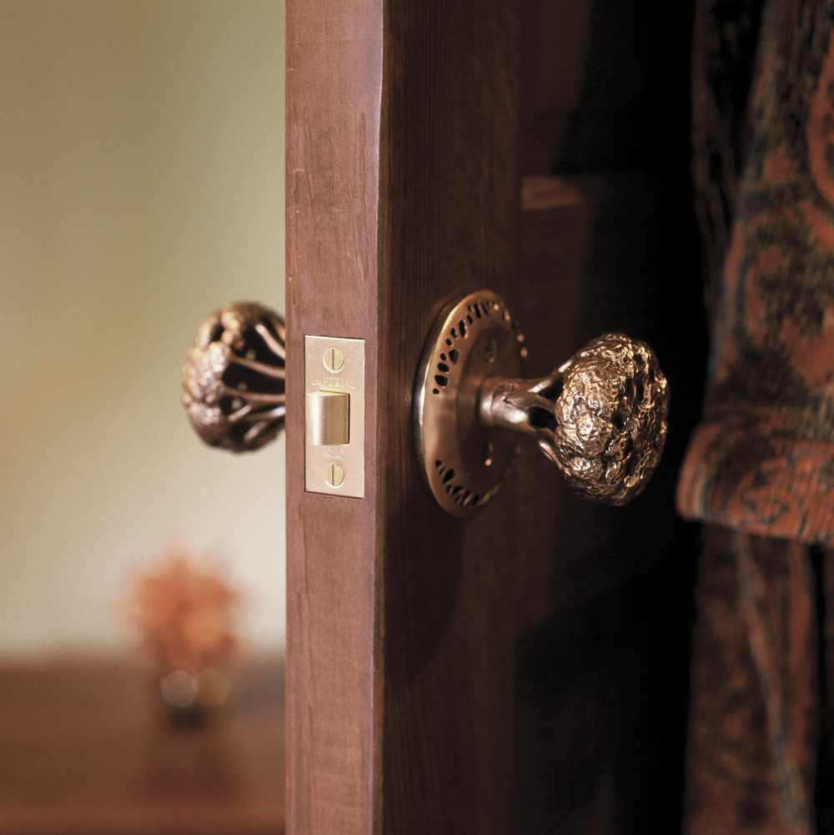
Hope is a door – a way out of despair
(1 Corinthians 10:13) No temptation has overtaken you except such as is common to man; but God is faithful, who will not allow you to be tempted beyond what you are able, but with the temptation will also make the way of escape, that you may be able to bear it.
Hope does not mean “cross your fingers.”
Hope is based on a moral certainty because it is rooted in the character of God. Paul said, (1 Corinthians 1:9) God is faithful, by whom you were called into the fellowship of His Son, Jesus Christ our Lord.

Slide 10
Hope is a helmet to shield us from harsh blows
(Ephesians 6:17) And take the helmet of salvation, and the sword of the Spirit, which is the word of God;
The helmet is designed to protect: a soldier’s head in battle; a player in some sport; a construction worker from danger; a Christian from the wicked blows of Satan

Slide 11
Hope is an anchor to hold us in a storm
(Hebrews 6:19) This hope we have as an anchor of the soul, both sure and steadfast, and which enters the Presence behind the veil,

Slide 12
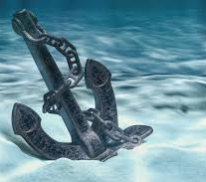
Hope is an anchor to hold us in a storm
(Colossians 1:23) if indeed you continue in the faith, grounded and steadfast, and are not moved away from the hope of the gospel which you heard, which was preached to every creature under heaven, of which I, Paul, became a minister.
What an anchor is to a ship, hope is to the soul.
Like an anchor, hope grabs what is out of our sight.
Among the storms of life, hope is what give us something sure and steadfast to hang on.

Slide 13
Hope must be based in our faith
Our faith must be growing stronger and maintained, because to lose our faith is to lose our hope.
(Hebrews 3:12) Beware, brethren, lest there be in any of you an evil heart of unbelief in departing from the living God;
(Hebrews 4:12) For the word of God is living and powerful, and sharper than any two-edged sword, piercing even to the division of soul and spirit, and of joints and marrow, and is a discerner of the thoughts and intents of the heart.
(Hebrews 4:13) And there is no creature hidden from His sight, but all things are naked and open to the eyes of Him to whom we must give account.

