Slide 1
Quesada, Costa Rica – Last Sunday

Slide 2
A woman was baptized last week.

Slide 3
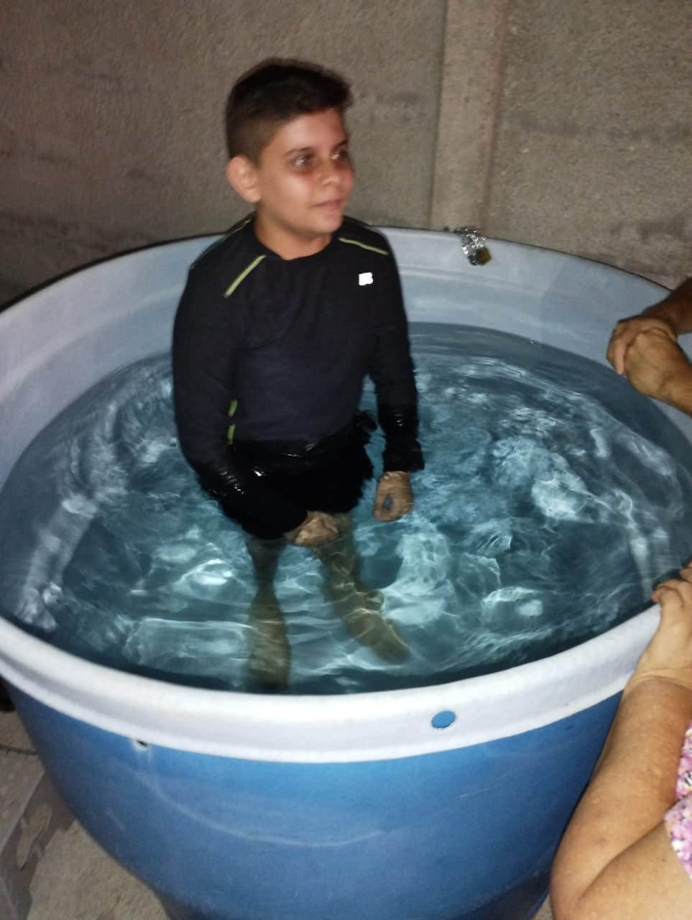
Yael, son of Christopher and Jenny

Slide 4
5 Rhetorical Questions
A study of
Romans 8:31-35

Slide 5
What is a rhetorical question?

Slide 6
1 – Romans 8:31 Who can be against us?
What then shall we say to these things? If God is for us, who can be against us?

Slide 7
1 – Romans 8:31 Who can be against us?
Do you believe God is for us?
Why do we need to be afraid?
God is on our side.

Slide 8
1 – Romans 8:31 Who can be against us?
Are you on God’s side?

Slide 9
2 – Romans 8:32 Will God give us all things?
He who did not spare His own Son, but delivered Him up for us all, how shall He not with Him also freely give us all things?

Slide 10
2 – Romans 8:32 Will God give us all things?
God gave us His Son
See John 3:16
Do you believe God can give us what we need?

Slide 11
3 – Romans 8:33 Who will charge God’s family?
Who shall bring a charge against God's elect? It is God who justifies.

Slide 12
3 – Romans 8:33 Who will charge God’s family?
Many blame Christians for the problems in the world.
Who dares to charge God’s family with wrong?

Slide 13
4 – Romans 8:34 Who condemns God?
Who is he who condemns? It is Christ who died, and furthermore is also risen, who is even at the right hand of God, who also makes intercession for us.

Slide 14
4 – Romans 8:34 Who condemns God?
If you don’t know - - -
Christ died, was raised
Is at the right hand of God
Christ makes intercession for us

Slide 15
4 – Romans 8:34 Who condemns God?
Do you think you are in charge?
Many pronounce condemnation on others out of anger.
Does God have the power to save or condemn?

Slide 16
5 – Romans 8:35 Who shall separate God from us?
Who shall separate us from the love of Christ? Shall tribulation, or distress, or persecution, or famine, or nakedness, or peril, or sword?

Slide 17
5 – Romans 8:35 Who shall separate God from us?
What can keep God from loving you?
Distress, persecution
Hunger, nakedness
Peril, sword, death

Slide 18
5 – Romans 8:35 Who shall separate God from us?
What can keep God from loving you?
ANSWER: NOTHING!

Slide 19
Conclusion: Romans 8:37 Answer to all questions.
Yet in all these things we are more than conquerors through Him who loved us.

