Slide 1
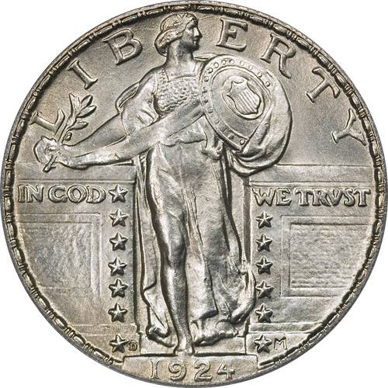
3 “Koins” in a Fountain
A Study of 3 Greek words.

Slide 2
The title of this lesson
First – coins is misspelled – KOINS
Reason – We are going to study 3 forms of a Greek word used in our New Testament.
Greek words have:
A root word
The endings will change the root word to a verb or a noun.
Different endings = changed meaning

Slide 3
1 – Koinos (noun / m) Greek – κοινός
Koinos = common, average, nothing special, ordinary
(Act 2:44) Now all who believed were together, and had all things in common,

Slide 4
1 – Koinos (noun / m) Greek – κοινός
Koinos = common, average, nothing special, ordinary
(Act 10:14) But Peter said, "Not so, Lord! For I have never eaten anything common or unclean."
(Act 10:15) And a voice spoke to him again the second time, "What God has cleansed you must not call common."

Slide 5
1 – Koinos (noun / m) Greek – κοινός
Koinos = common, average, nothing special, ordinary
The idea is seen in:
(Revelation 3:15) "I know your works, that you are neither cold nor hot. I could wish you were cold or hot. (16) So then, because you are lukewarm, and neither cold nor hot, I will vomit you out of My mouth.

Slide 6
2 – Koinoo (verb) Greek – κοινόω
Koinoo is a verb often translated unclean, defile, pollute.
(Mark 7:15) There is nothing that enters a man from outside which can defile him; but the things which come out of him, those are the things that defile a man.

Slide 7
2 – Koinoo (verb) Greek – κοινόω
Koinoo is a verb often translated unclean, defile, pollute.
(Mark 7:18) So He said to them, "Are you thus without understanding also? Do you not perceive that whatever enters a man from outside cannot defile him,

Slide 8
2 – Koinoo (verb) Greek – κοινόω
Koinoo is a verb often translated unclean, defile, pollute.
(Mark 7:21) For from within, out of the heart of men, proceed evil thoughts, adulteries, fornications, murders, (22) thefts, covetousness, wickedness, deceit, lewdness, an evil eye, blasphemy, pride, foolishness. (23) All these evil things come from within and defile a man."

Slide 9
2 – Koinoo (verb) Greek – κοινόω
Koinoo is a verb often translated unclean, defile, pollute.
(Acts 21:28) crying out, "Men of Israel, help! This is the man who teaches all men everywhere against the people, the law, and this place; and furthermore he also brought Greeks into the temple and has defiled this holy place."

Slide 10
2 – Koinoo (verb) Greek – κοινόω
Koinoo is a verb often translated unclean, defile, pollute.
(Revelation 21:27) But there shall by no means enter it anything that defiles, or causes an abomination or a lie, but only those who are written in the Lamb's Book of Life.

Slide 11
3 – Koinonia (noun / f) Greek – κοινωνία
Koinonia is often translated fellowship, communion, partaker
(Act 2:42) And they continued steadfastly in the apostles' doctrine and fellowship, in the breaking of bread, and in prayers.

Slide 12
3 – Koinonia (noun / f) Greek – κοινωνία
Koinonia is often translated fellowship, communion, partaker
(1 Cor. 1:9) God is faithful, by whom you were called into the fellowship of His Son, Jesus Christ our Lord.
(2 Cor. 8:4) imploring us with much urgency that we would receive the gift and the fellowship of the ministering to the saints.

Slide 13
3 – Koinonia (noun / f) Greek – κοινωνία
Koinonia is often translated fellowship, communion, partaker
(1Peter 4:13) but rejoice to the extent that you partake of Christ's sufferings, that when His glory is revealed, you may also be glad with exceeding joy.

Slide 14
3 – Koinonia (noun / f) Greek – κοινωνία
Koinonia is often translated fellowship, communion, partaker
(1Cor. 10:16) The cup of blessing which we bless, is it not the communion of the blood of Christ? The bread which we break, is it not the communion of the body of Christ?

Slide 15
3 – Koinonia (noun / f) Greek – κοινωνία
Koinonia is often translated fellowship, communion, partaker
(2Cor 8:23) If anyone inquires about Titus, he is my partner and fellow worker concerning you. Or if our brethren are inquired about, they are messengers of the churches, the glory of Christ.

Slide 16
4 – Koinonia is NOT: Greek – κοινωνία
Koinonia is NOT evil deeds:
(2John 1:9) Whoever transgresses and does not abide in the doctrine of Christ does not have God. He who abides in the doctrine of Christ has both the Father and the Son. (10) If anyone comes to you and does not bring this doctrine, do not receive him into your house nor greet him; (11) for he who greets him shares in his evil deeds.

Slide 17
4 – Koinonia is NOT: Greek – κοινωνία
Koinonia is NOT with evil:
(2Cor. 6:14) Do not be unequally yoked together with unbelievers. For what fellowship has righteousness with lawlessness? And what communion has light with darkness?

Slide 18
4 – Koinonia is NOT: Greek – κοινωνία
Koinonia does NOT:
Fellowship with error.
Mean just eat a meal together

Slide 19
5 – Koinonia IS: Greek – κοινωνία
Koinonia IS:
Worship
Work
Shared Joy and Sorrow
Salvation and Hope
Association with others who have the same goals, faith, and hope.

Slide 20
Conclusion
Christians are NOT –
Koinos common, average, ordinary
Koinoo unclean, defile, pollute
Christians ARE –
Koinonia fellowship, communion, partaker, share

