Slide 1
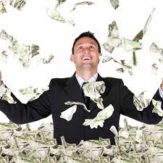
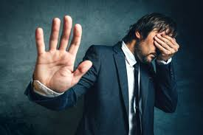
Why do BAD things happen to GOOD people?
OFTEN ASKED QUESTION
WHAT IS THE ANSWER?

Slide 2
Introduction
Sermons, books, discussion on this question.
It is a common question to ask.
There are many answers offered to this question.
In my view – this is not the right question.

Slide 3
What is BAD?
What do we mean when we say “bad things”?
Usually we mean –
Tragic events in the world
Natural disasters – flood, hurricane, tornado
Personal problems in our life – loss of income
Problems with our health, finances, family, marriage
Current events – Covid-19

Slide 4
What is BAD?
All of these things happen to ALL people – good and bad
(Esther 4:13) And Mordecai told them to answer Esther: "Do not think in your heart that you will escape in the king's palace any more than all the other Jews.

Slide 5
IS BAD ALWAYS BAD?
Man works hard, climbs the ladder to a high position and income.
Buys bigger house, nicer car, joins country club, has many wealthy friends
WE THINK THIS IS GOOD.

Slide 6
IS BAD ALWAYS BAD?
What if with this “success” he also:
Stops going to church to play golf
Not involved with his home / family
Money becomes more important than his marriage, his family, or his God

Slide 7
IS BAD ALWAYS BAD?
What if with this “success” he also:
He has a serious heart attack
Spends 7 days in ICU on machines to keep him alive
Is this bad?

Slide 8
IS BAD ALWAYS BAD?
Think about Joseph
(Genesis 45:7) And God sent me before you to preserve a posterity for you in the earth, and to save your lives by a great deliverance.
(Genesis 45:8) So now it was not you who sent me here, but God; and He has made me a father to Pharaoh, and lord of all his house, and a ruler throughout all the land of Egypt.

Slide 9
IS BAD ALWAYS BAD?
Think about Paul
2 Corinthians 11:16-33 – Paul lists all the “bad” things that have happened to him.
(Romans 8:28) And we know that all things work together for good to those who love God, to those who are the called according to His purpose.

Slide 10
Who are good people?
In common thinking
A faithful Christian
Any decent, moral person
Who is GOOD?
Mark 10:18 – No one is good but God.
Who here today is without sin? John 8:7
1 John 1:10 – One who claims to have no sin is a liar!

Slide 11
What is GOOD?
Successful man in ICU with heart attack – repents and returns to God and faithful worship
Joseph sold into slavery – saves his father and family
Paul in prison in Rome
(Philippians 1:12-14) But I want you to know, brethren, that the things which happened to me have actually turned out for the furtherance of the gospel, (13) so that it has become evident to the whole palace guard, and to all the rest, that my chains are in Christ; (14) and most of the brethren in the Lord, having become confident by my chains, are much more bold to speak the word without fear.

Slide 12
What is GOOD?
Is wealth good or bad?
Is a heart attack good or bad?
Is being sold into slavery good or bad?
Is being a prisoner in Rome good or bad?

Slide 13
Mark 8:33
But when He had turned around and looked at His disciples, He rebuked Peter, saying, "Get behind Me, Satan! For you are not mindful of the things of God, but the things of men.“
J. B. Phillips paraphrase – You are looking from man’s viewpoint, not from God’s.

Slide 14
Ask the right question
NOT: Why do bad things happen to good people?
ASK: Can God take what I think is bad and turn it into something good?

