Slide 1
Why did they live so long before the flood?
Why don’t we live that long?
What caused the change in life span?

Slide 2
Metheuselah’s Diet
Methuselah ate what he found on his plate, And never, as people do now, Did he note the amount of the calorie count. He ate it because it was chow.
He wasn’t disturbed as at dinner he sat, Devouring a roast or a pie, To think it was lacking in granular fat Or a couple of vitamins shy.
He cheerfully chewed each species of food, Unmindful of troubles or fears Lest his health might be hurt by some fancy dessert, And he lived over 900 years.

Slide 3
Two Passages
And the Lord said, "My Spirit shall not strive with man forever, for he is indeed flesh; yet his days shall be one hundred and twenty years." Genesis 6:3

Slide 4
Two Passages
And Jacob said to Pharaoh, "The days of the years of my pilgrimage are one hundred and thirty years; few and evil have been the days of the years of my life, and they have not attained to the days of the years of the life of my fathers in the days of their pilgrimage." Genesis 47:9

Slide 5
Doubters
Some claim these numbers are myth, legends
Some say they skip generations
One doubter said they were lunar years (months) rather than solar years (12 months)
This would make Methuselah about 81
Problem – some were fathers at age 4 or 5
Moses was trying to make them “super” human

Slide 6
Did they really live to be 900?
The ages in the Bible closely matches the natural exponential equation. (This will be dealt with later in this study.)
The ages when the Patriarchs died show that the post-genesis flood world was being affected by some natural factors causing declining life spans.
All of these factors indicate that the ages in the Bible were genuine, not fabrications.

Slide 7
Possible Factors
There are many possible factors to consider
Earth was destroyed
And God said to Noah, "The end of all flesh has come before Me, for the earth is filled with violence through them; and behold, I will destroy them with the earth. Genesis 6:13
Thus I establish My covenant with you: Never again shall all flesh be cut off by the waters of the flood; never again shall there be a flood to destroy the earth." Genesis 9:11

Slide 8
Possible Factors
There are many possible factors to consider
Earth was destroyed
Global changes in climate, atmosphere, UV rays
Changes in diet, health
Geologic, cosmic changes
Genetic changes

Slide 9
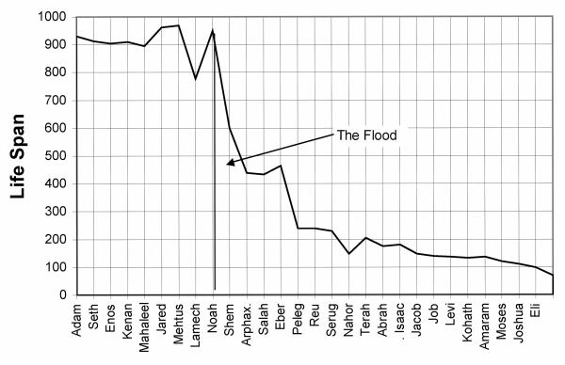
Chart of life spans

Slide 10
Decline in life span
Life Spans BEFORE FLOOD |  |  | Life Spans AFTER FLOOD
Person | Life Span |  | Person | Life Span
Adam | 930 |  | Shem | 600
Cainan | 910 |  | Eber | 464
Jared | 962 |  | Terah | 205
Methuselah | 969 |  | Abraham | 175
Noah | 950 |  | Moses | 120
AVERAGE | 944 |  | AVERAGE | 312

Slide 11
Decline in life span
10 Generations before the flood – average life span was 857 years
10 Generations after the flood – average life span was 317 years

Slide 12
Eponential decay rate
I am not an expert in the area of physiology or mathematics.
Here is what I have learned:
All things – plant, animal, mineral – have a decay rate. You have heard of the “half-life” of some nuclear material.
Carbon-dating is based on this decay rate.

Slide 13
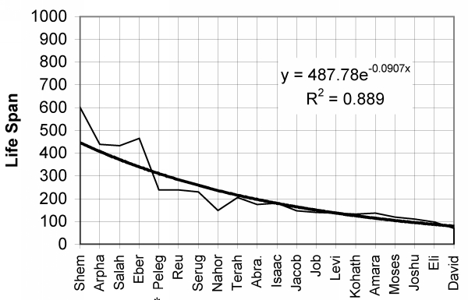
Decay rate / life spans

Slide 14
Statistically close match
The coefficient of 1 = a perfect match with the rate.
The life spans of this period have a coefficient of .889 (89% match – 11% deviation).

Slide 15
Here is my list of possible reasons:
Genetic loss after the flood – limited gene pool
Two bottlenecks – flood
Tower of Babel
Pure and natural foods – more vegetarian
No pollution
Plenty of exercise – physical labor
No drugs – natural plant remidies
God protected them
No war, no dangerous weapons or machinery

Slide 16
Here is my list of possible reasons:
Climate changes
Did it rain before the flood?
Why was there never a rainbow before the flood?
Was man now subject to UV rays?
Some illnesses crept in
Exodus 15:26 and said, "If you diligently heed the voice of the Lord your God and do what is right in His sight, give ear to His commandments and keep all His statutes, I will put none of the diseases on you which I have brought on the Egyptians. For I am the Lord who heals you."

Slide 17
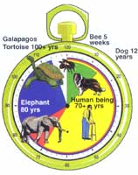
The best answer
Cells are coded for different life spans
Bee – 5 weeks
Dog – 12 years
Man – 70+ years
Elephant – 80 years
Galapagos turtle – 100+ years

Slide 18
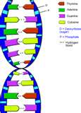
The Best Answer
Let me try to explain
“Ignoring death by accident or disease, different living things seem to be genetically programmed to live for different average periods.”
Facts to understand:
Every living cell has DNA
DNA is a long line or string of matched pairs of chromosomes
When a cell divides – half of that string goes into each new cell

Slide 19
The Best Answer
On the end of the DNA string is an “end cap”
It is called a telomere – “end part”.
The telomere shortens with each cell division
Once the limit is reached – the cells can no longer divide – and the cell dies.

Slide 20
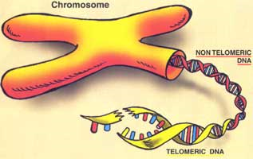
The Best Answer
A scientist said, “This is probably the only way in which our limited life spans are ‘programmed’ into us. There is no biological reason at all why people could not live much longer than they do at present, if they had the appropriate genetic makeup. “

Slide 21
The Best Answer
Remember - And the Lord said, "My Spirit shall not strive with man forever, for he is indeed flesh; yet his days shall be one hundred and twenty years." Genesis 6:3
I believe that when the flood occurred, God re-programmed the DNA of man so there would be a 120 year limit on our life span.

