Slide 1


ARE WE GROWING
OR DYING?

Slide 2
IS THE LORD’S CHURCH DYING?
From you own knowledge – talking to people from other congregations is the church growing or dying?
  In Gibson County
  In West Tennessee
  Across the state of Tennessee
  All across America

Slide 3
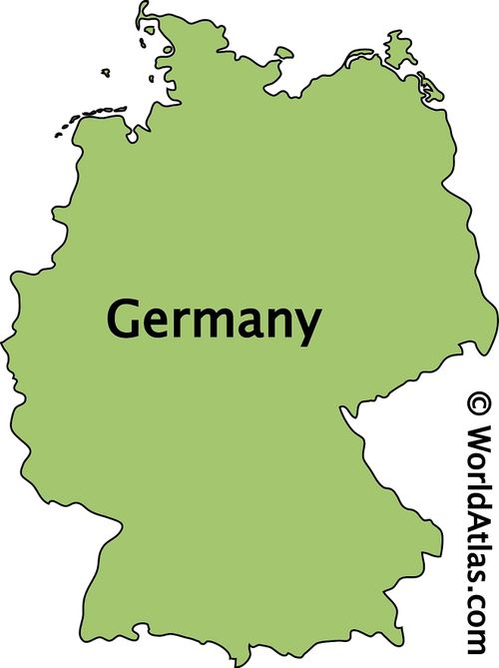
RELIGION AROUND THE WORLD
GERMANY – more than 500 Catholic churches have closed since 2000

Slide 4
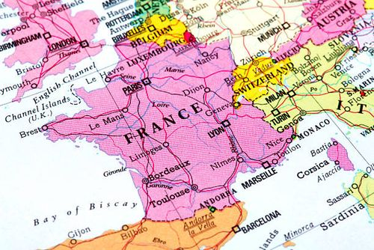
RELIGION AROUND THE WORLD
GERMANY – more than 500 Catholic churches have closed since 2000
FRANCE – 50% of the population do not believe in God

Slide 5
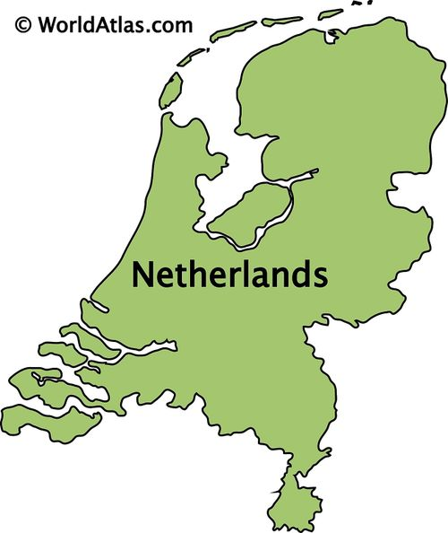
RELIGION AROUND THE WORLD
GERMANY – more than 500 Catholic churches have closed since 2000
FRANCE – 50% of the population do not believe in God
HOLLAND – 63% believe religion is more harmful than good

Slide 6

RELIGION AROUND THE WORLD
GERMANY – more than 500 Catholic churches have closed since 2000
FRANCE – 50% of the population do not believe in God
HOLLAND – 63% believe religion is more harmful than good
CANADA – 20% of ALL churches have closed since 2000

Slide 7

RELIGION AROUND THE WORLD
GERMANY – more than 500 Catholic churches have closed since 2000
FRANCE – 50% of the population do not believe in God
HOLLAND – 63% believe religion is more
harmful than good
CANADA – 20% of ALL churches have closed
since 2000
AMERICA – In 2020, 64% identified
as “Christian”
BUT – the fastest growing number:
30% identified as “NONES.”

Slide 8
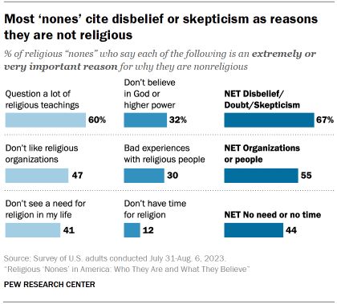
Who are the ‘nones’?

Slide 9
Religion in America
Congregations are closing or merging
  Change in demographics – less rural; more in cities
  Ease of travel – no need to be close to the church you attend
  Many are willing to drive 15-20 miles to attend a church they prefer

Slide 10
Religion in America
Congregations are closing or merging
Population shifts
  Decline in farming population
  Large equipment replace many farm workers
  Higher education = better jobs in cities, not rural areas

Slide 11
Religion in America
Recent study for period of 1976 - 2022
Jehovah’s Witness and Mormons
They are the only 2 groups that showed growth in the period.
However:
  They showed LESS growth from 2003 – 2018.
  This growth was the SMALLEST in their history.
  Both are at near ZERO growth since 2019.

Slide 12
Churches of Christ in America
WHEN YOUR OUTGO
EXCEEDS YOUR INCOME;
THAT IS THE UPSTART
OF YOUR DOWNFALL

Slide 13
ARE WE GROWING
OR DYING?

Slide 14
Religion in America
Recent study for period of 1976 - 2022
Evangelical Lutherans – lost 30% in membership
United Methodist – lost 17% of membership
Presbyterian Church USA – lost 40% in membership
Roman Catholic Church – lost 2 million from 2000 – 2017
Southern Baptist Church reports that 5,771 churches has ZERO baptisms in 2023

Slide 15
Churches of Christ in America
Churches of Christ are also:
Seeing the decline in members,
attendance, and baptisms.
Many congregations have closed
or are close to closing.
There are MORE deaths or falling away
than there are baptisms.

Slide 16
Churches of Christ Around the World
We WERE the fastest growing church from 1945 – 1966.
In the late 1960s growth declined – continues to the present.
These facts match what has happened across all religious groups in America during this period.

Slide 17
Will the church survive?
Jesus’ church will stand forever.
(Dan 2:44) And in the days of these kings the God of heaven will set up a kingdom which shall never be destroyed; and the kingdom shall not be left to other people; it shall break in pieces and consume all these kingdoms, and it shall stand forever.
(Luk 8:11) "Now the parable is this: The seed is the word of God.

Slide 18
Will the church survive?
Jesus’ church will stand forever.
(1Pe 1:25) BUT THE WORD OF THE LORD ENDURES FOREVER." Now this is the word which by the gospel was preached to you.
(Mat 24:35) Heaven and earth will pass away, but My words will by no means pass away.

Slide 19
Will the church survive?
Jesus’ church was under severe persecution in 1st and 2nd centuries.
Even with persecution – the church grew.
After the problem of caring for widows - - -
(Act 6:7) Then the word of God spread, and the number of the disciples multiplied greatly in Jerusalem, and a great many of the priests were obedient to the faith.

Slide 20
Will the church survive?
Jesus’ church was under severe persecution in 1st and 2nd centuries.
Even with persecution – the church grew.
After the conversion of Saul, the persecutor - - -
(Act 9:31) Then the churches throughout all Judea, Galilee, and Samaria had peace and were edified. And walking in the fear of the Lord and in the comfort of the Holy Spirit, they were multiplied.

Slide 21
Will the church survive?
Jesus’ church was under severe persecution in 1st and 2nd centuries.
Even with persecution – the church grew.
After the death of persecutor King Herod- - -
(Act 12:23) Then immediately an angel of the Lord struck him, because he did not give glory to God. And he was eaten by worms and died.
(Act 12:24) But the word of God grew and multiplied.

Slide 22
Churches of Christ around the World
India – There are MORE members of the church than ANY NATION on earth.
There are MORE members of the church in India that in North, Central and South America combined.
India has more than 30,000 congregations.
India churches baptize an average of 875 per day in 2023.
This means there were 319,375 baptisms in India during 2023.

Slide 23
Churches of Christ around the World
Nigeria – In 2002 more than a million members of the church is this nation.
NOTE: There are prophets of DOOM who preach the death of the church.
DO NOT JUST FOCUS ON THE CHURCH IN AMERICA.
THE CHURCH IS LARGER THAN AMERICA.

Slide 24
The church existed BEFORE Campbell
We often think that Alexander Campbell was the first to revive and restore the church.
A preacher in England did research on the history of the church in the United Kingdom.
Keith Sisman’s book, Traces of the Kingdom, documents the church from the Middle Ages.

Slide 25
The church existed BEFORE Campbell
The following is from Keith Sisman’s book, Traces of the Kingdom
The church flourished in the Middle Ages in the British Isles.
In Tottlebank, England – built a building, (still standing) kept notes of their teachings, worship, and membership.
This is 136 years BEFORE Campbell and Restoration Movement in America.

Slide 26
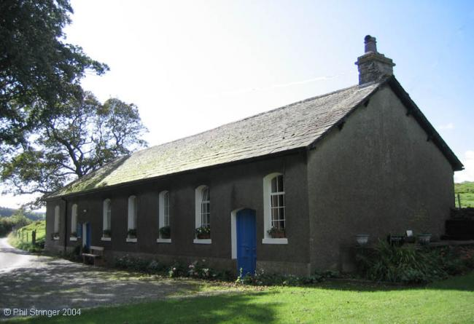
Tottlebank church – 1669 - 1842
136 years before Campbell came to America.
Campbell came to America in 1805.

Slide 27
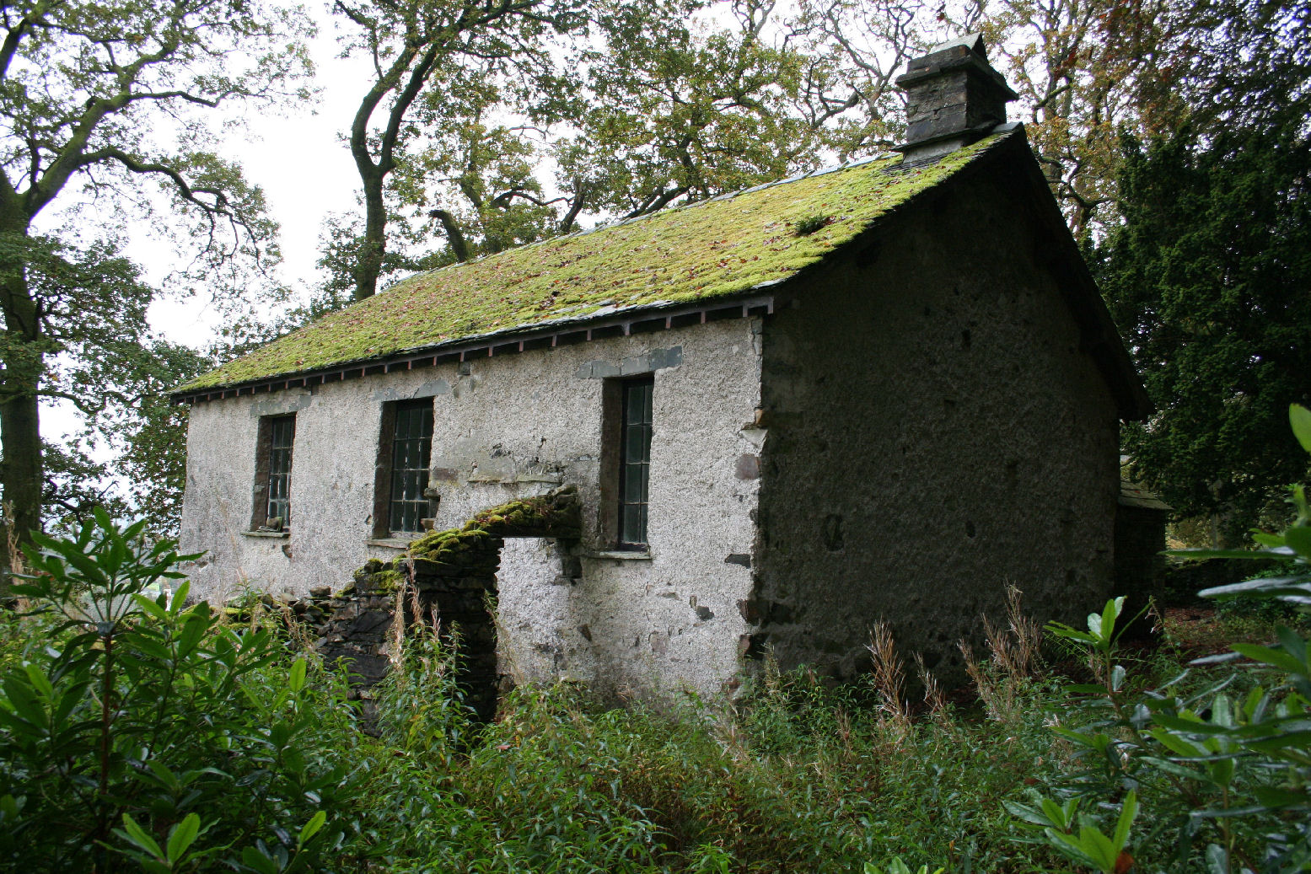
1678 church at Torver, England
130 years before Alexander Campbell came to America

Slide 28
ARE WE GROWING
OR DYING?

Slide 29
Why are we NOT growing?
Let’s face the painful situation
What has changed? Why are we not doing today, what was being done in the 1950’s? It was in 1950 that churches of Christ were the “fastest growing religious body in America,”

Slide 30
Why are we NOT growing?
Let’s face the painful situation
Some reasons we are not growing include:
America is more material / less spiritual today.

Slide 31
Why are we NOT growing?
Let’s face the painful situation
Some reasons we are not growing include:
America is more material / less spiritual today.
Worldly attitudes have crept into our thinking.

Slide 32
Why are we NOT growing?
Let’s face the painful situation
Some reasons we are not growing include:
America is more material / less spiritual today.
Worldly attitudes have crept into our thinking.
Other things occupy our time and energy.

Slide 33
Why are we NOT growing?
Let’s face the painful situation
Some reasons we are not growing include:
America is more material / less spiritual today.
Worldly attitudes have crept into our thinking.
Other things occupy our time and energy.
We have allowed the world to penetrate the church.

Slide 34
Why are we NOT growing?
Let’s face the painful situation
Some reasons we are not growing include:
America is more material / less spiritual today.
Worldly attitudes have crept into our thinking.
Other things occupy our time and energy.
We have allowed the world to penetrate the church.
Doctrine has become less important.

Slide 35
Why are we NOT growing?
Let’s face the painful situation
There are moral and doctrinal issues that have weakened the church - - -
Marriage / Divorce / Re-marriage

Slide 36
Why are we NOT growing?
Let’s face the painful situation
There are moral and doctrinal issues that have weakened the church - - -
Marriage / Divorce / Re-marriage
Confused roles of men and women

Slide 37
Why are we NOT growing?
Let’s face the painful situation
There are moral and doctrinal issues that have weakened the church - - -
Marriage / Divorce / Re-marriage
Confused roles of men and women
Music – choir, solos, praise teams, instruments

Slide 38
Why are we NOT growing?
Let’s face the painful situation
There are moral and doctrinal issues that have weakened the church - - -
Marriage / Divorce / Re-marriage
Confused roles of men and women
Music – choir, solos, praise teams, instruments
Communion – on days other than Sunday

Slide 39
Why are we NOT growing?
Let’s face the painful situation
There are moral and doctrinal issues that have weakened the church - - -
Failure to emphasize baptism

Slide 40
Why are we NOT growing?
Let’s face the painful situation
There are moral and doctrinal issues that have weakened the church - - -
Failure to emphasize baptism
Absent teaching on hell, eternal punishment

Slide 41
Why are we NOT growing?
Let’s face the painful situation
There are moral and doctrinal issues that have weakened the church - - -
Failure to emphasize baptism
Absent teaching on hell, eternal punishment
Fail to understand the relationship of Faith; Works; and Grace.

Slide 42
Conclusion
The church IS GROWING in India and most nations in central Africa and other places.
They are teaching the fundamentals of:
  The Plan of Salvation
  The Worship of the Church
  The work of evangelism
The Church in America needs to get back to doing the same and we will grow.

