Slide 1
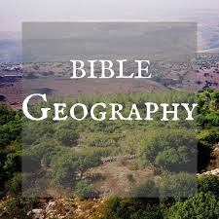
JERUSALEM

Slide 2
General View

Slide 3
Pool of Bethesda

Slide 4
Pool of Bethesda

Slide 5
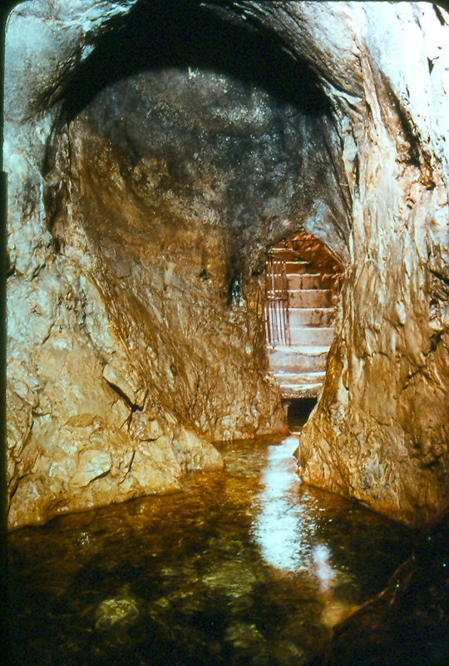
Hezekiah's Tunnel

Slide 6
From Mt. of Olives, Kidron Valley, Jerusalem

Slide 7
From Mt. of Olives, Kidron Valley, Jerusalem

Slide 8
Tombs in Kidron Valley

Slide 9
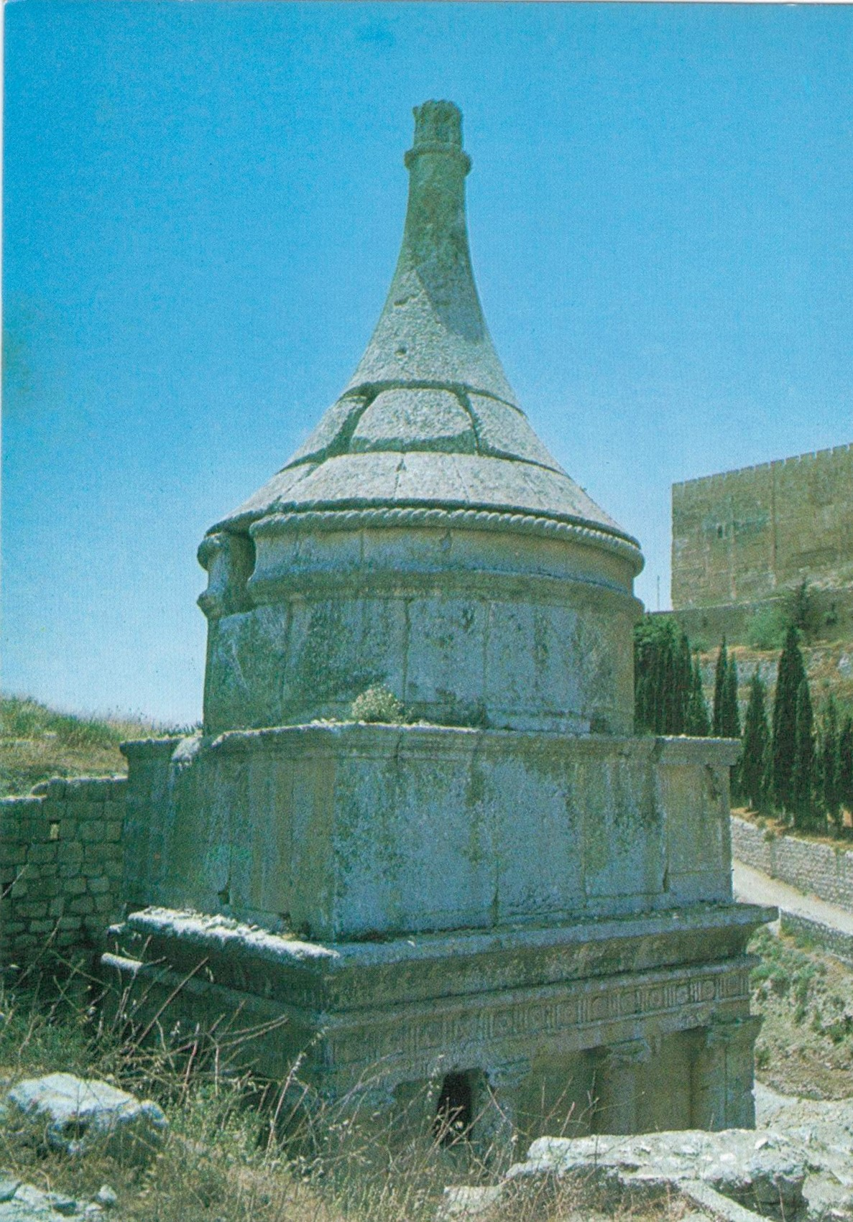
Absolom, James, Zechariah

Slide 10
James and Zachariah

Slide 11
Western Wall (Wailing Wall)

Slide 12
Western Wall (Wailing Wall)

Slide 13
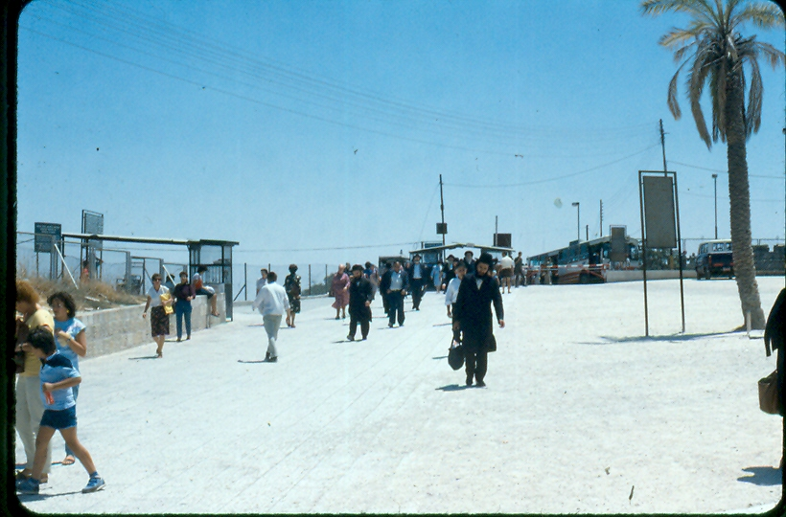
Hasidic Jews (strictly follow Law of Moses)

Slide 14
Typical street in Old Jerusalem

Slide 15
Damascus Gate

Slide 16
Golden Gate (Beautiful Gate)

