Slide 1
Jerusalem: Model of 1st Century City

Slide 2
General View of the city

Slide 3
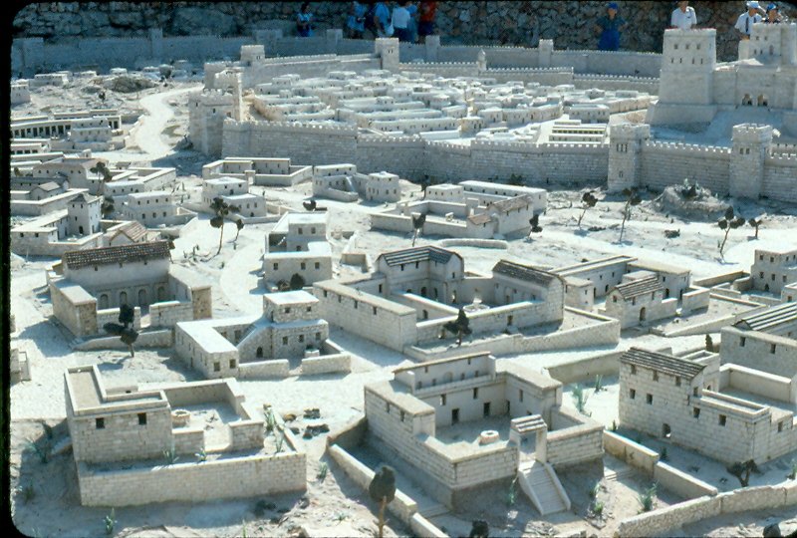
2 Walls of Jerusalem

Slide 4
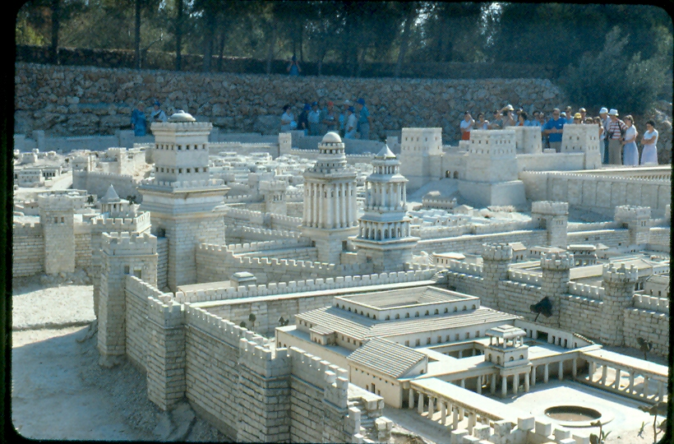
Heord’s Palace, tower of David, Fortress

Slide 5
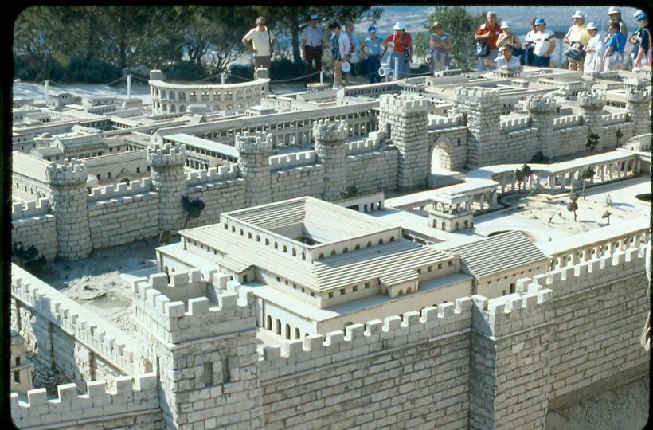
Herod’s Palace

Slide 6
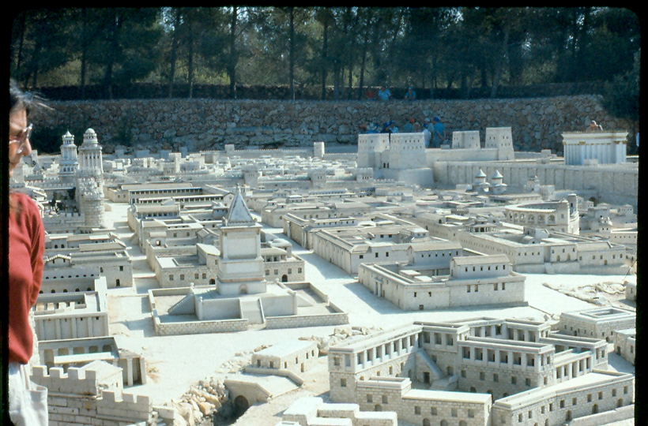
Fortress and Temple

Slide 7
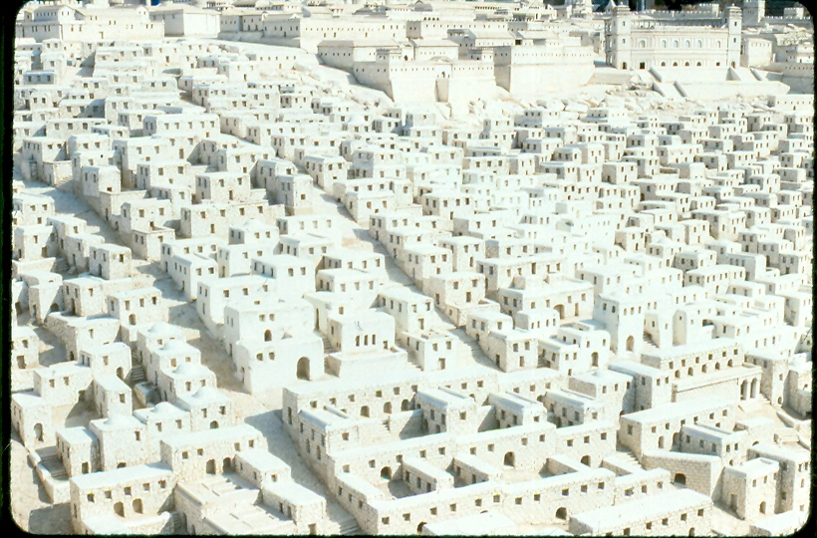
Up toward the Temple

Slide 8
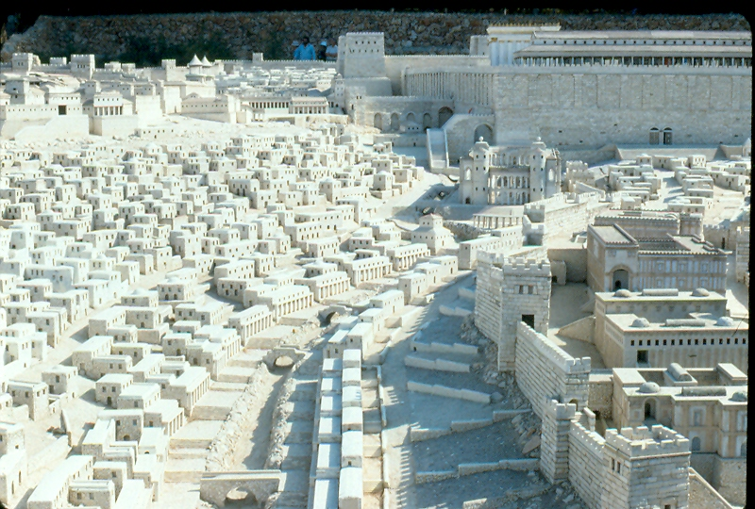
Holder Gate, water system to Pool of Saloam

Slide 9
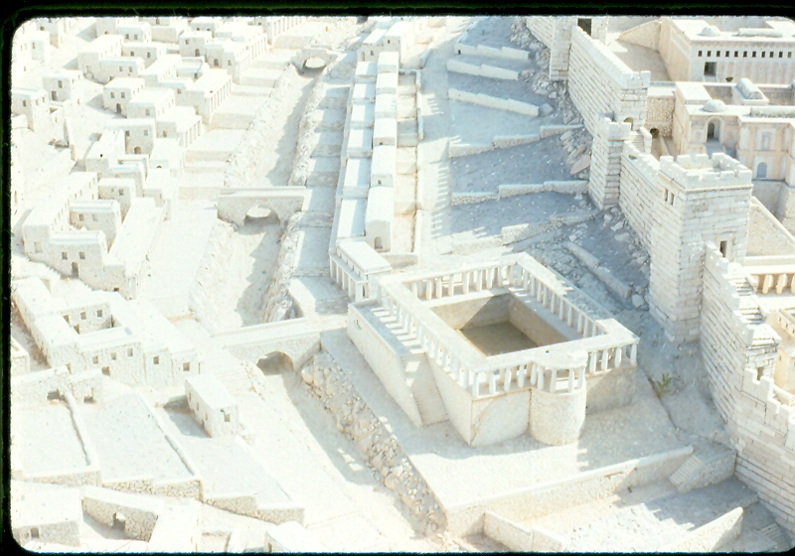
Pool of Siloam – John 9 – Blind healed

Slide 10
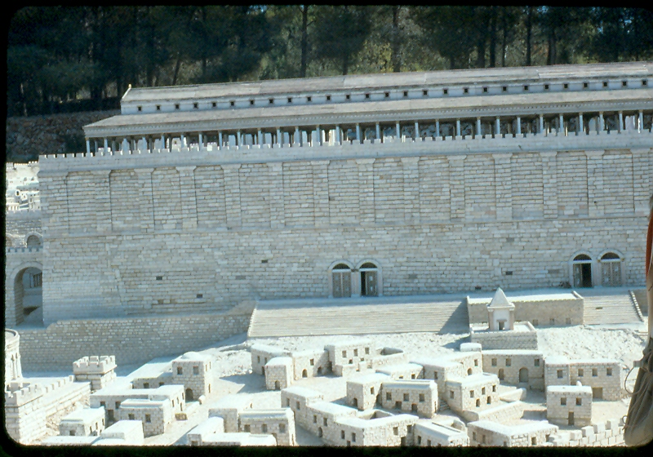
Holder Gates, Herod’s overlook

Slide 11
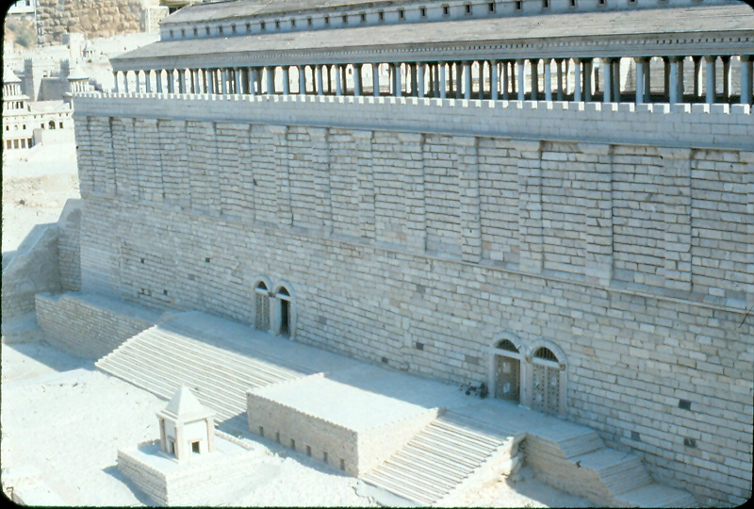
Holder Gates, Herod’s overlook

Slide 12
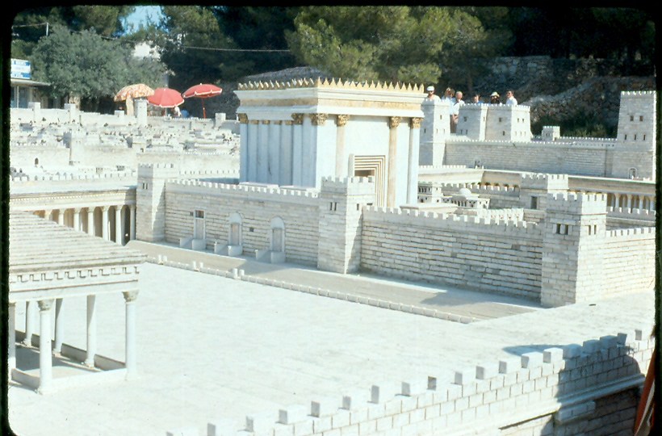
Temple – Court of the Gentiles

Slide 13
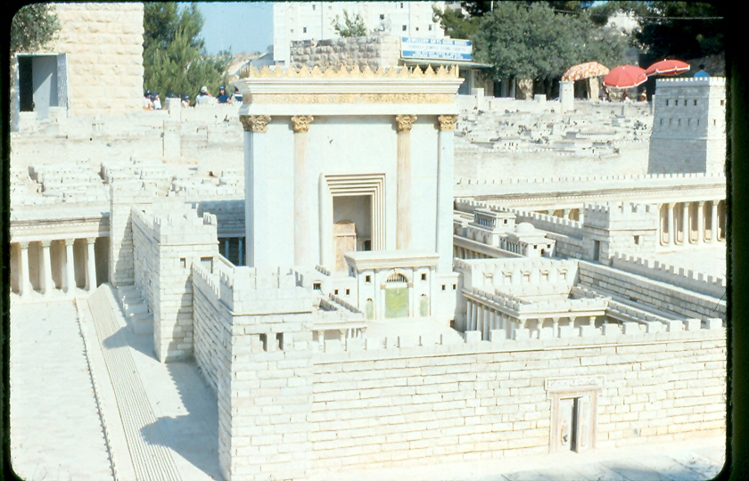
Temple (2nd Temple)

Slide 14
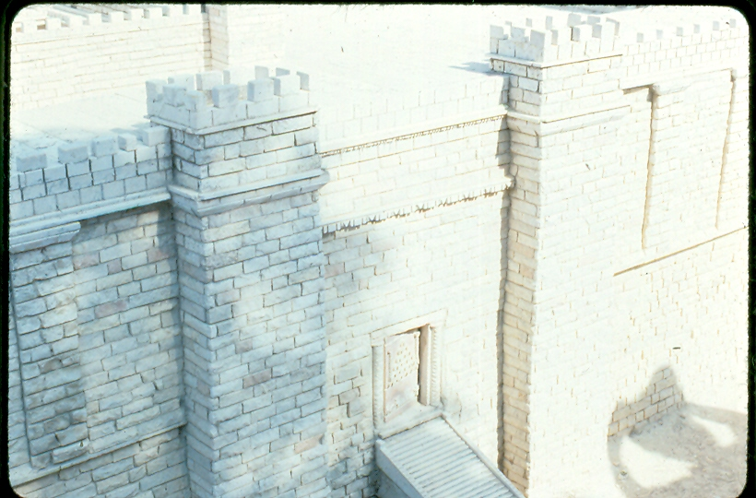
Golden Gate / Gate Beautiful

Slide 15
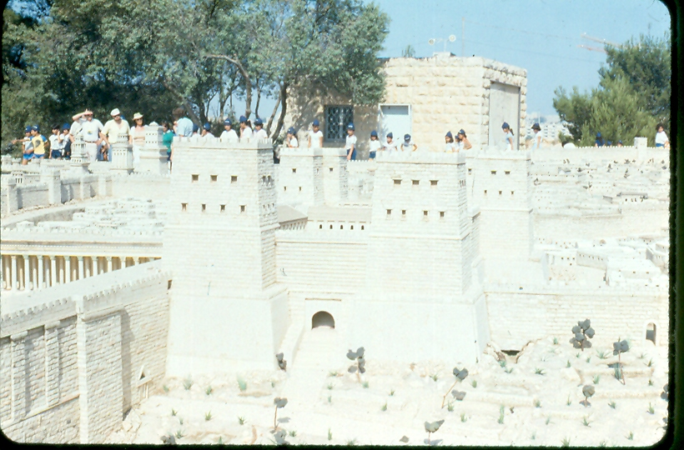
Antonio Fortress (Pilate’s Praetorium)

Slide 16
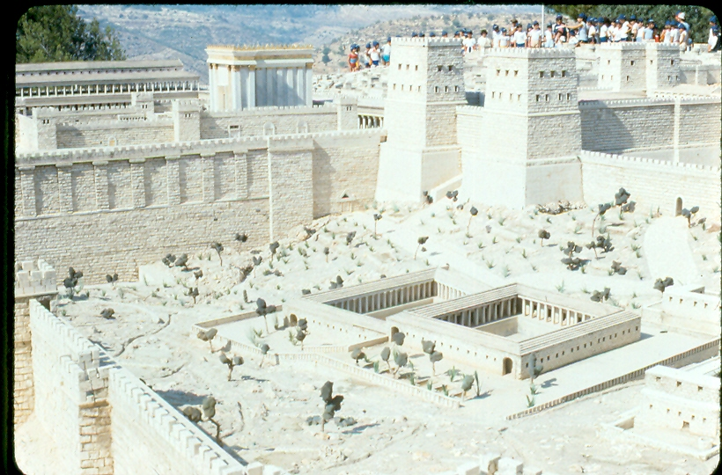
Pool of Bethesda / Fortress / Temple / Herod’s Porch

Slide 17
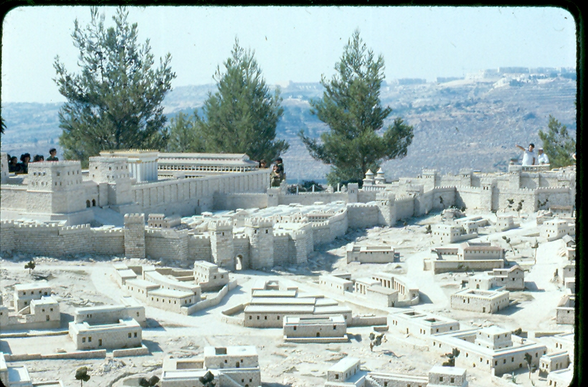
Fortress / Temple / Herod’s Porch

Slide 18
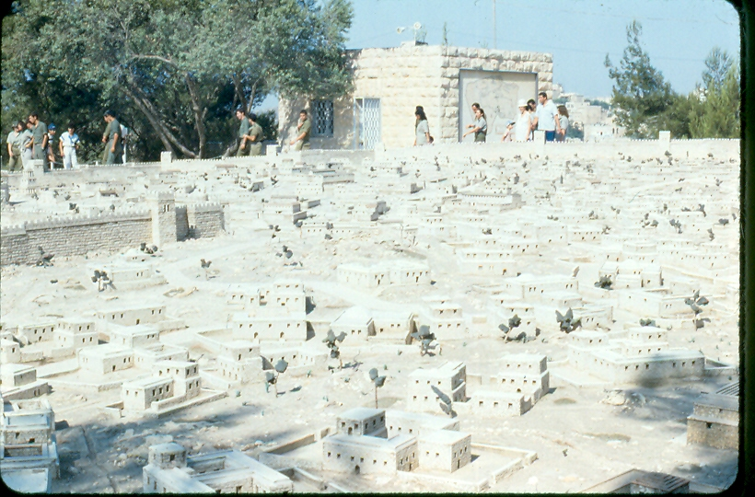
General View of Jerusalem

Slide 19
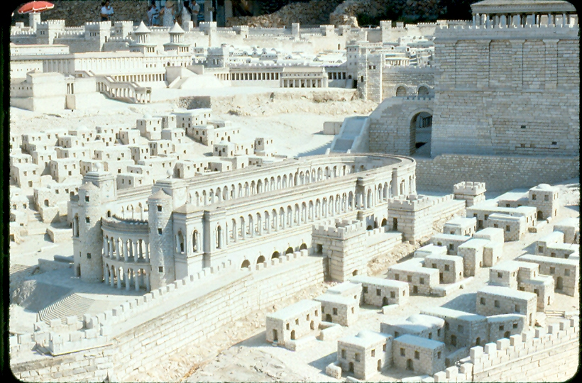
Games / Racetrack

Slide 20
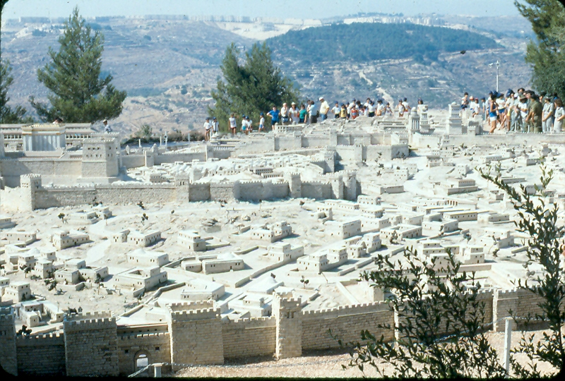
Damascus Gate / 2 walls

Slide 21
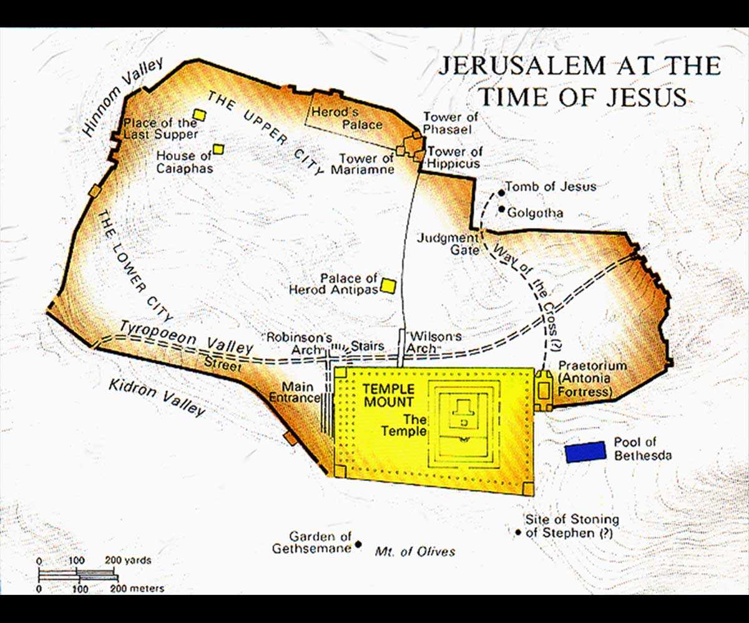
Map of Jerusalem

