Slide 1
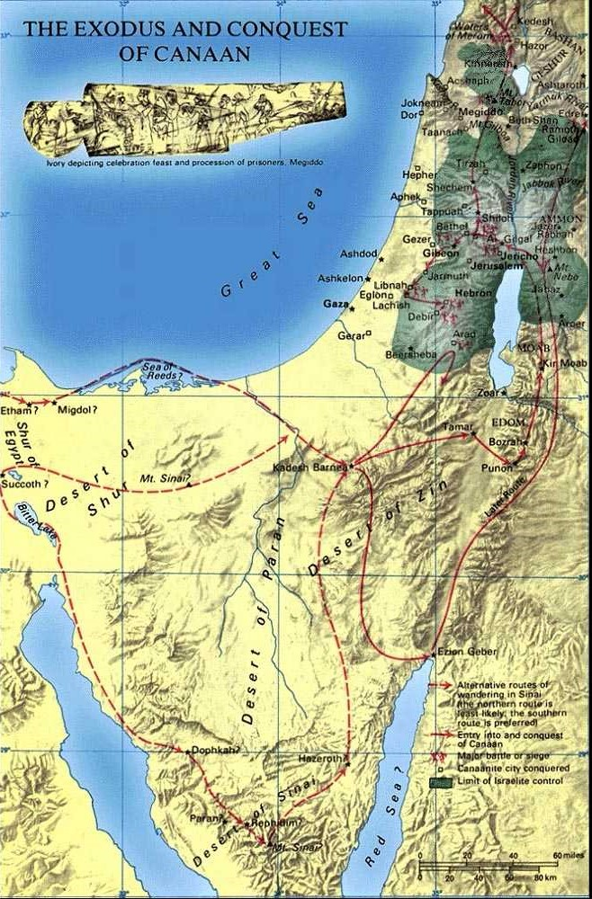
Exodus, Mt. Sinai, Wandering, Conquest, Division,
Judges

Slide 2
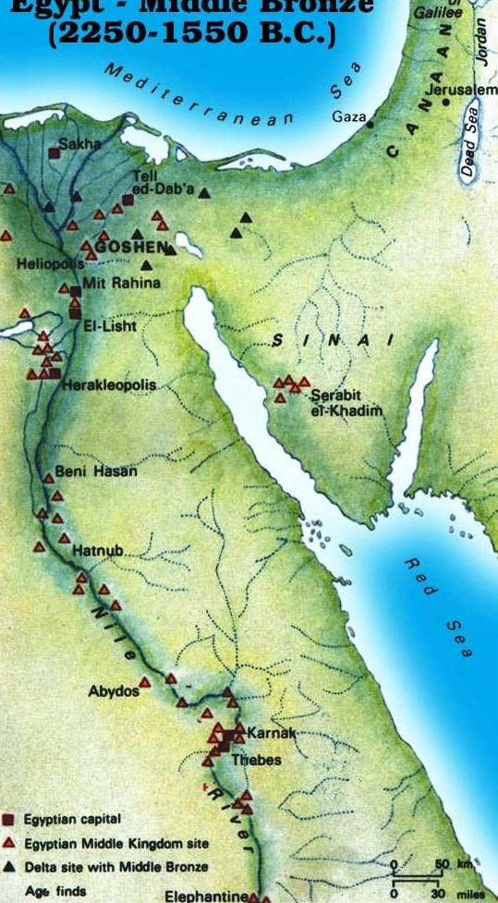
Crossing the Red Sea
Where did Israel cross the Red Sea?
Why not enter Sinai above the Red Sea?
(Exodus 14:2) "Speak to the children of Israel, that they turn and camp before Pi Hahiroth, between Migdol and the sea, opposite Baal Zephon; you shall camp before it by the sea.

Slide 3
The Exodus from Egypt
Israel crossed the Red Sea
They travel south to Mount Sinai
(Exodus 19:1-2) In the third month after the children of Israel had gone out of the land of Egypt, on the same day, they came to the Wilderness of Sinai. (2) For they had departed from Rephidim, had come to the Wilderness of Sinai, and camped in the wilderness. So Israel camped there before the mountain.

Slide 4
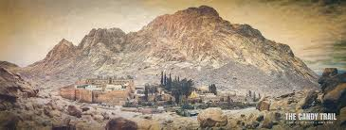
Events at Mount Sinai
Law given
Golden Calf
Tabernacle constructed
Numbered (census of
able bodied men)
Begin observing Passover

Slide 5
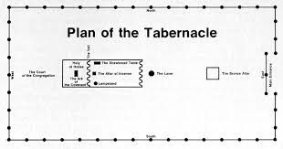
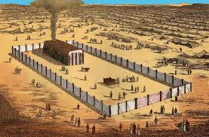
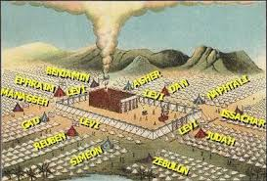
The Tabernacle

Slide 6
Head toward Palestine
(Numbers 13:1-3) And the LORD spoke to Moses, saying, (2) "Send men to spy out the land of Canaan, which I am giving to the children of Israel; from each tribe of their fathers you shall send a man, every one a leader among them.“ (3) So Moses sent them from the Wilderness of Paran according to the command of the LORD, all of them men who were heads of the children of Israel.
The go to Kadesh-Barnea
Sent out 12 spies (1 from each tribe)
Decision time – forward or go back?

Slide 7
Head toward Palestine
(Numbers 13:31-33) But the men who had gone up with him said, "We are not able to go up against the people, for they are stronger than we.“ (32) And they gave the children of Israel a bad report of the land which they had spied out, saying, "The land through which we have gone as spies is a land that devours its inhabitants, and all the people whom we saw in it are men of great stature. (33) There we saw the giants (the descendants of Anak came from the giants); and we were like grasshoppers in our own sight, and so we were in their sight.“
False report and lack of faith
40 years in the wilderness

Slide 8
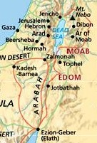
Wandering – but not far
From Kadesh-Barnea
To Ezion-Geber
Up through EDOM and MOAB
To Mt. Nebo – Moses died
Joshua ready to lead them in the land

Slide 9
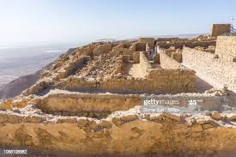
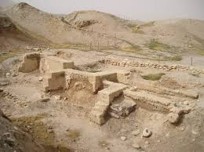
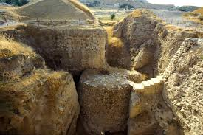
Conquest of the land
(Numbers 36:13) These are the commandments and the judgments which the LORD commanded the children of Israel by the hand of Moses in the plains of Moab by the Jordan, across from Jericho.
Cross Jordan – Fall of Jericho

Slide 10
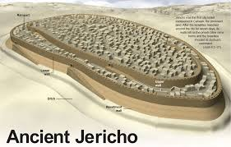
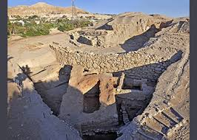
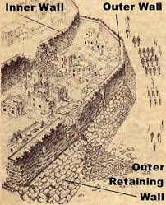
Jericho

Slide 11
Conquest of the land
Cross Jordan River
Fall of Jericho
Defeat Kings of AI

Slide 12
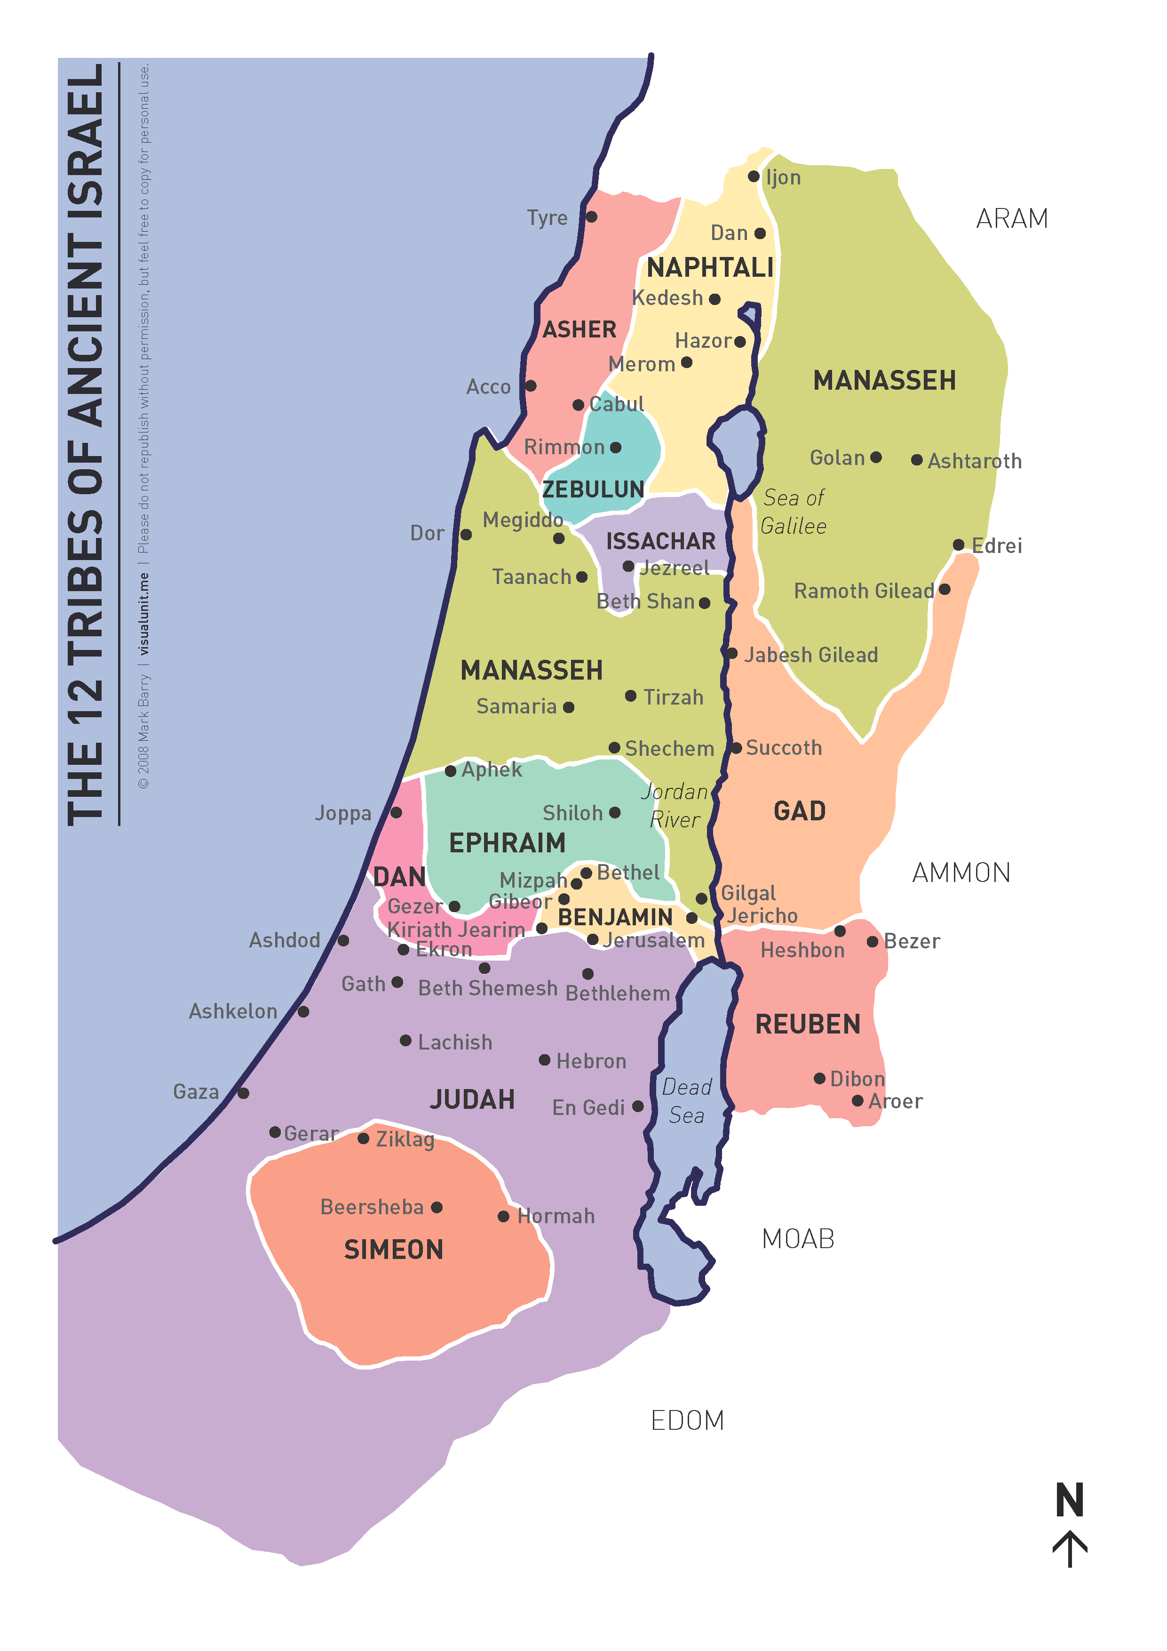
Division of the Land
(Joshua 13:7) Now therefore, divide this land as an inheritance to the nine tribes and half the tribe of Manasseh.“
Gad and Reuben – other side of Jordan
Also half of the tribe of Manasseh
12 Tribes inherit land
From Dan to Beersheba

Slide 13
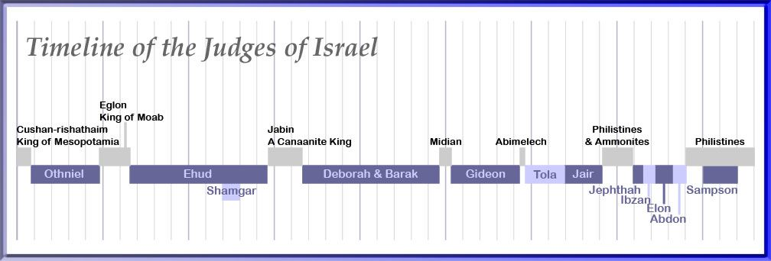
Judges
After the death of Joshua
Land ruled by Judges
(Judges 2:16) Nevertheless, the LORD raised up judges who delivered them out of the hand of those who plundered them.

