Slide 1
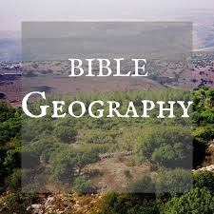
Joseph in Egypt

Slide 2
Genesis 45:7-10
(7) And God sent me before you to preserve a posterity for you in the earth, and to save your lives by a great deliverance. (8) So now it was not you who sent me here, but God; and He has made me a father to Pharaoh, and lord of all his house, and a ruler throughout all the land of Egypt. (9) "Hurry and go up to my father, and say to him, 'Thus says your son Joseph: "God has made me lord of all Egypt; come down to me, do not tarry. (10) You shall dwell in the land of Goshen, and you shall be near to me, you and your children, your children's children, your flocks and your herds, and all that you have.

Slide 3
Many years later - - - Exodus 1:8-11
(8) Now there arose a new king over Egypt, who did not know Joseph. (9) And he said to his people, "Look, the people of the children of Israel are more and mightier than we; (10) come, let us deal shrewdly with them, lest they multiply, and it happen, in the event of war, that they also join our enemies and fight against us, and so go up out of the land.“ (11) Therefore they set taskmasters over them to afflict them with their burdens. And they built for Pharaoh supply cities, Pithom and Raamses.

Slide 4
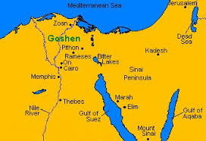
Land of Goshen

Slide 5
Suez Canal Port

Slide 6
Suez Canal at sea level

Slide 7
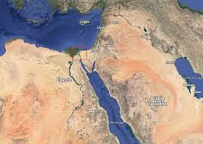
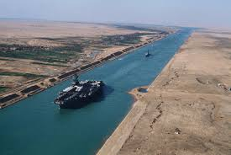
Suez Canal

Slide 8
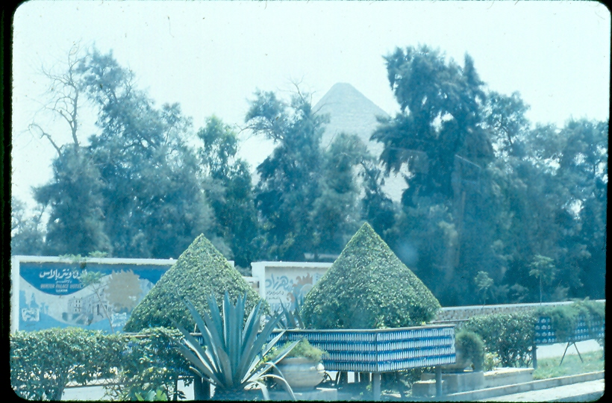
Pyramid in distance from Cairo

Slide 9
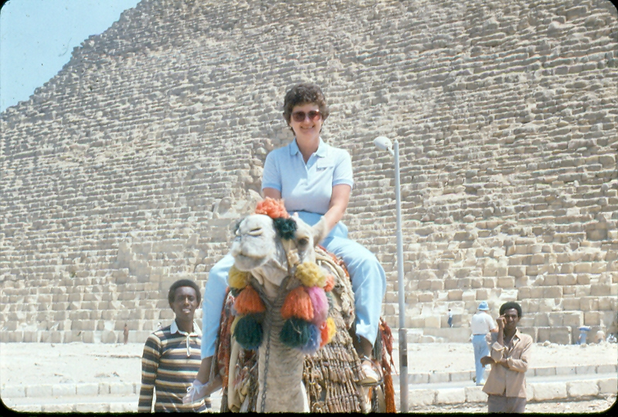
Ride a Camel

Slide 10
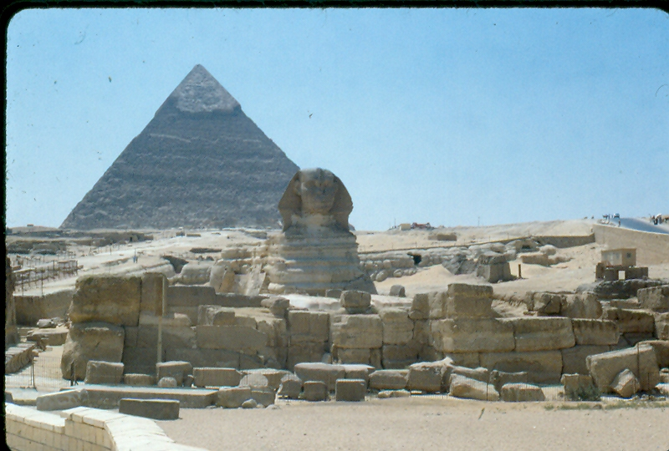
Great Pyramid (Cheops – 2900 BC) and Sphinx
Abraham lived about 2000 BC
Moses lived about 1600 BC
This pyramid is 487 feet high. Equal to a 50 story building.

Slide 11
Middle Pyramid (Khafra – 2650 BC)

Slide 12
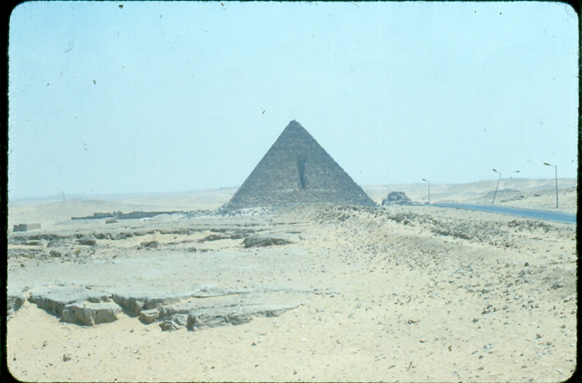
Small Pyramid (Mankara – 2600 BC)

Slide 13
Large Stones
The stone behind us is:
About 5 feet high
About 9 feet long
About 5 feet deep

Slide 14
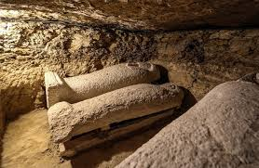
Sarcophagus and mummy in Cairo Museum

Slide 15
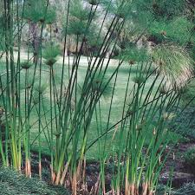
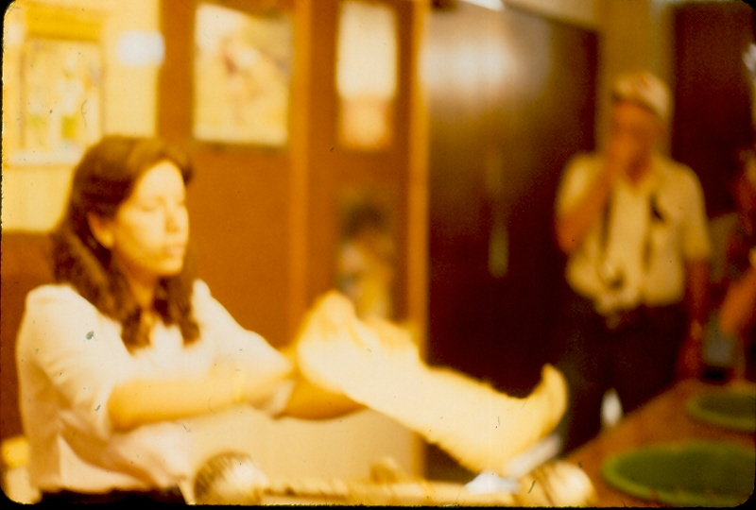
Papyrus – from reed to paper

Slide 16
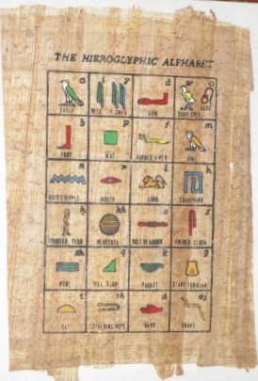
Papyrus – from reed to paper

Slide 17
Cairo, Egypt

Slide 18
Cairo Shopping Plaza

Slide 19
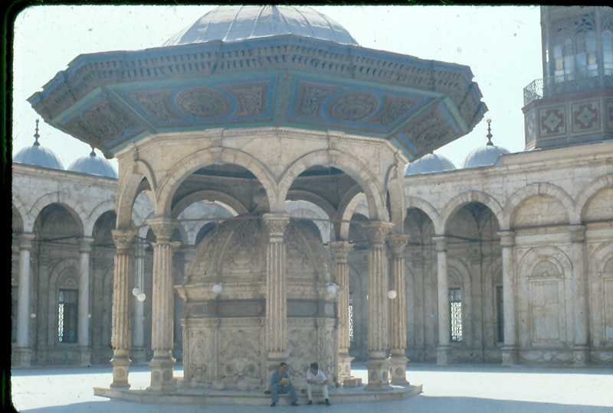
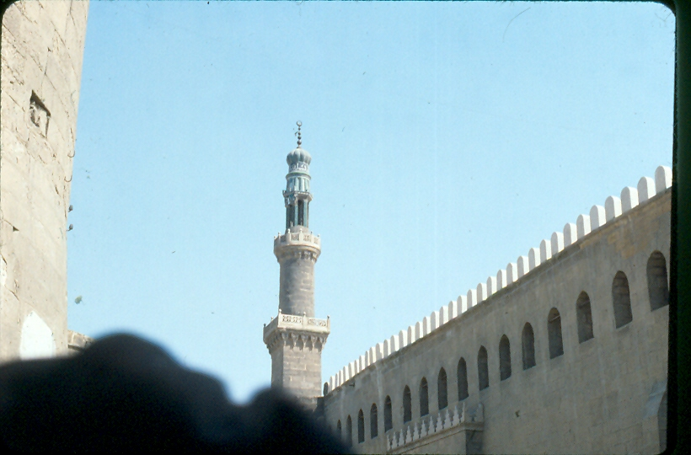
Huge Mosque in Cairo

