Slide 1
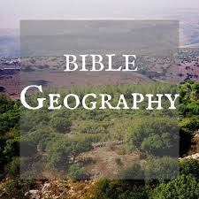
Garden of Eden Flood Tower of Babel

Slide 2
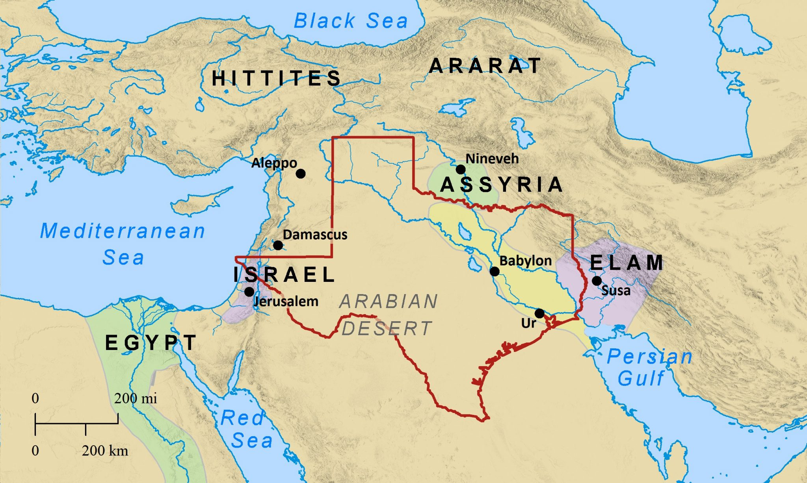
Size of area we will study

Slide 3
Genesis 2:10-14
(10) Now a river went out of Eden to water the garden, and from there it parted and became four riverheads. (11) The name of the first is Pishon; it is the one which skirts the whole land of Havilah, where there is gold. (12) And the gold of that land is good. Bdellium and the onyx stone are there. (13) The name of the second river is Gihon; it is the one which goes around the whole land of Cush. (14) The name of the third river is Hiddekel; it is the one which goes toward the east of Assyria. The fourth river is the Euphrates.

Slide 4
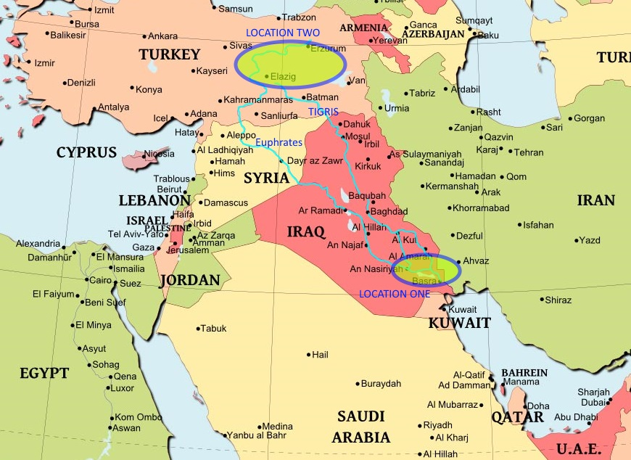
Garden of Eden?

Slide 5
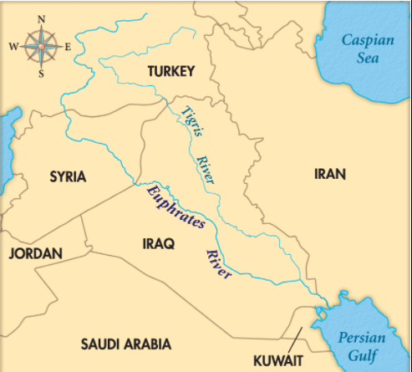

Slide 6
Genesis 8:1-4
(1) Then God remembered Noah, and every living thing, and all the animals that were with him in the ark. And God made a wind to pass over the earth, and the waters subsided. (2) The fountains of the deep and the windows of heaven were also stopped, and the rain from heaven was restrained. (3) And the waters receded continually from the earth. At the end of the hundred and fifty days the waters decreased. (4) Then the ark rested in the seventh month, the seventeenth day of the month, on the mountains of Ararat.

Slide 8
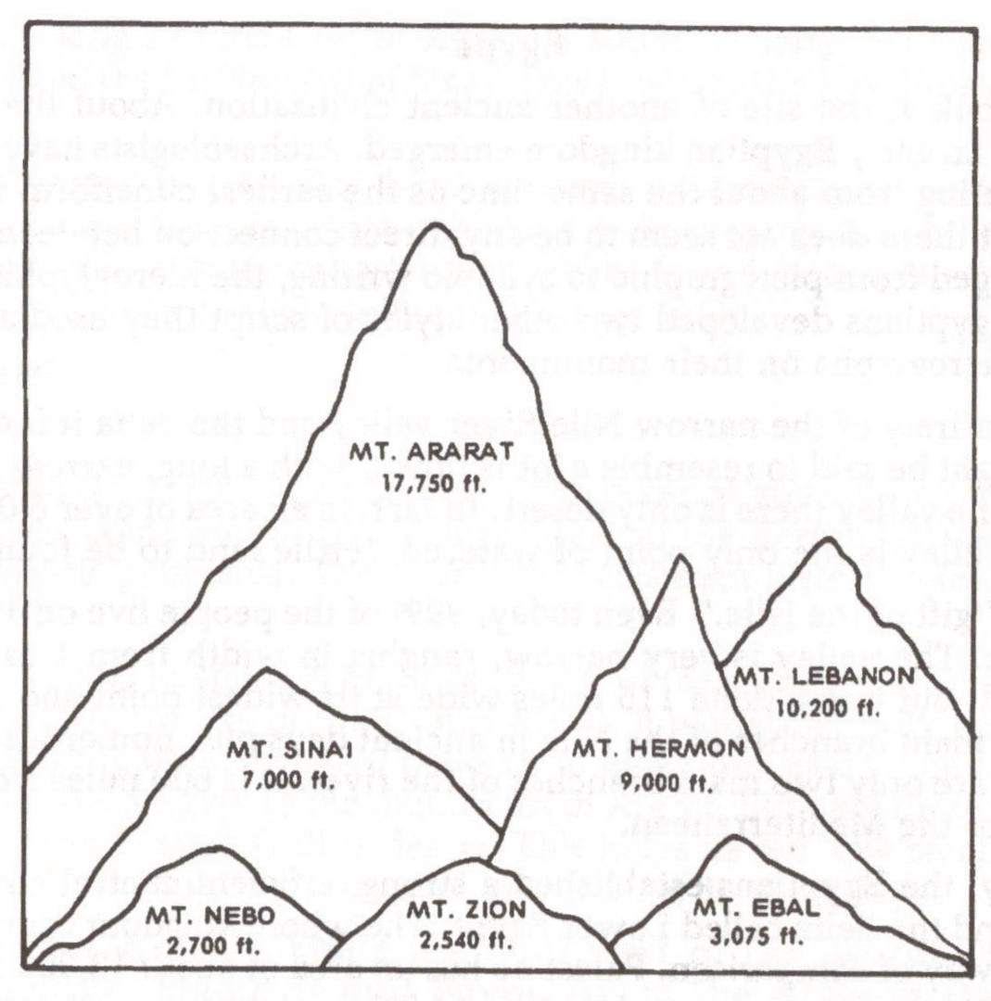

Slide 9
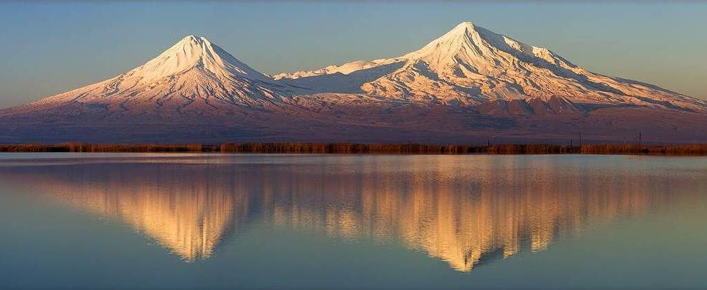

Slide 10
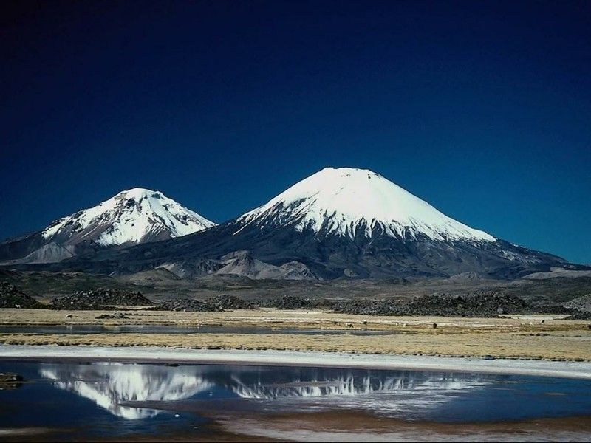

Slide 11
Mt. Ararat – part of Zagros Mountains – E. Turkey

Slide 12
Genesis 11:4-7
(4) And they said, "Come, let us build ourselves a city, and a tower whose top is in the heavens; let us make a name for ourselves, lest we be scattered abroad over the face of the whole earth.“ (5) But the LORD came down to see the city and the tower which the sons of men had built. (6) And the LORD said, "Indeed the people are one and they all have one language, and this is what they begin to do; now nothing that they propose to do will be withheld from them. (7) Come, let Us go down and there confuse their language, that they may not understand one another's speech."

Slide 13
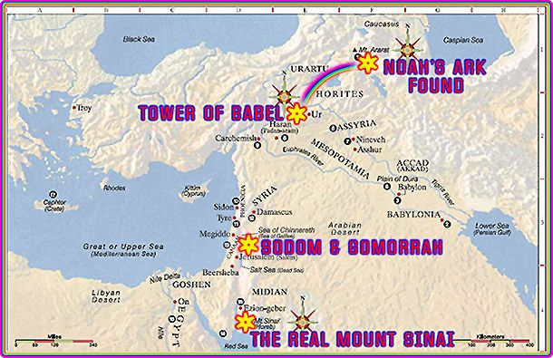

Slide 14
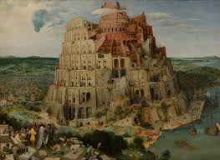

Slide 15
Genesis 10:32
These were the families of the sons of Noah, according to their generations, in their nations; and from these the nations were divided on the earth after the flood.

