Slide 1
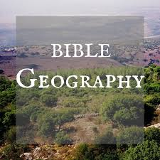
NEW
TESTAMENT
LANDS

Slide 2
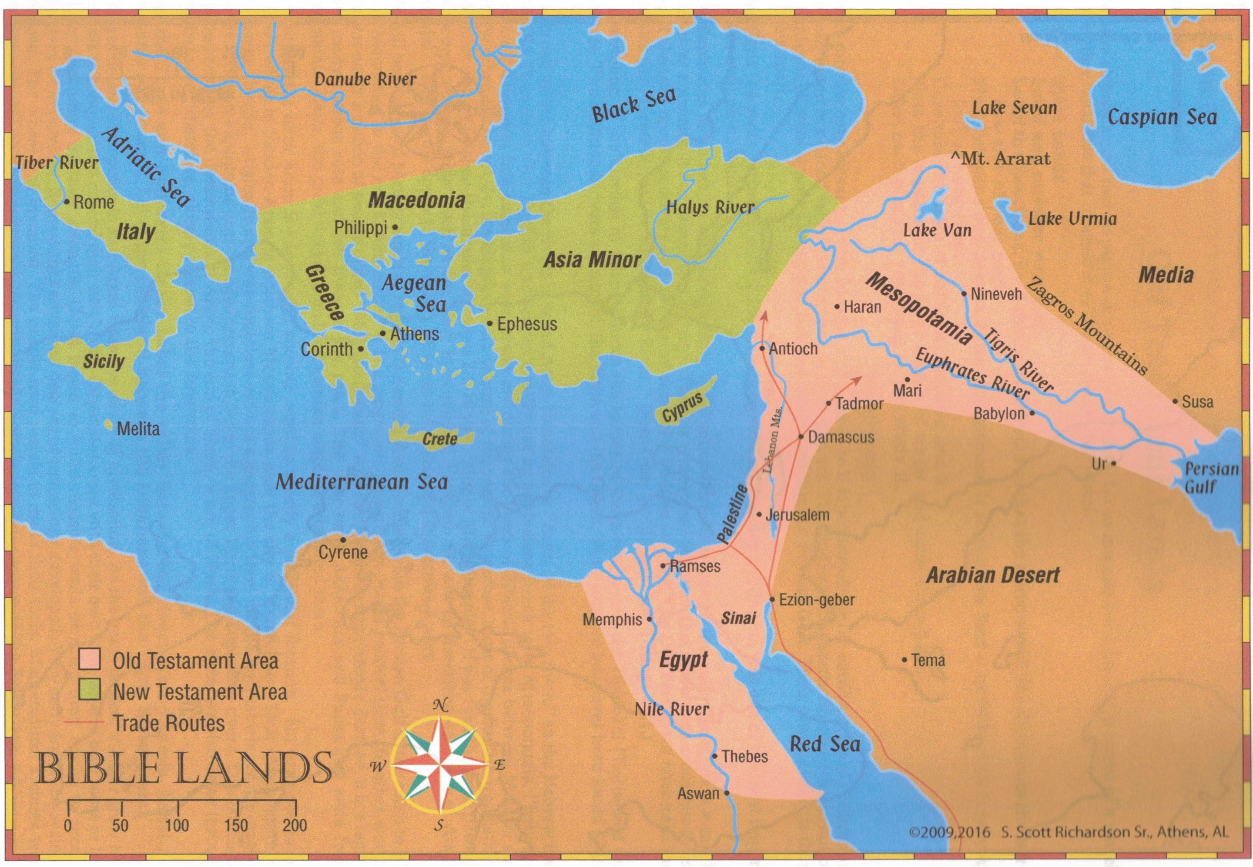
New Testament Lands

Slide 3
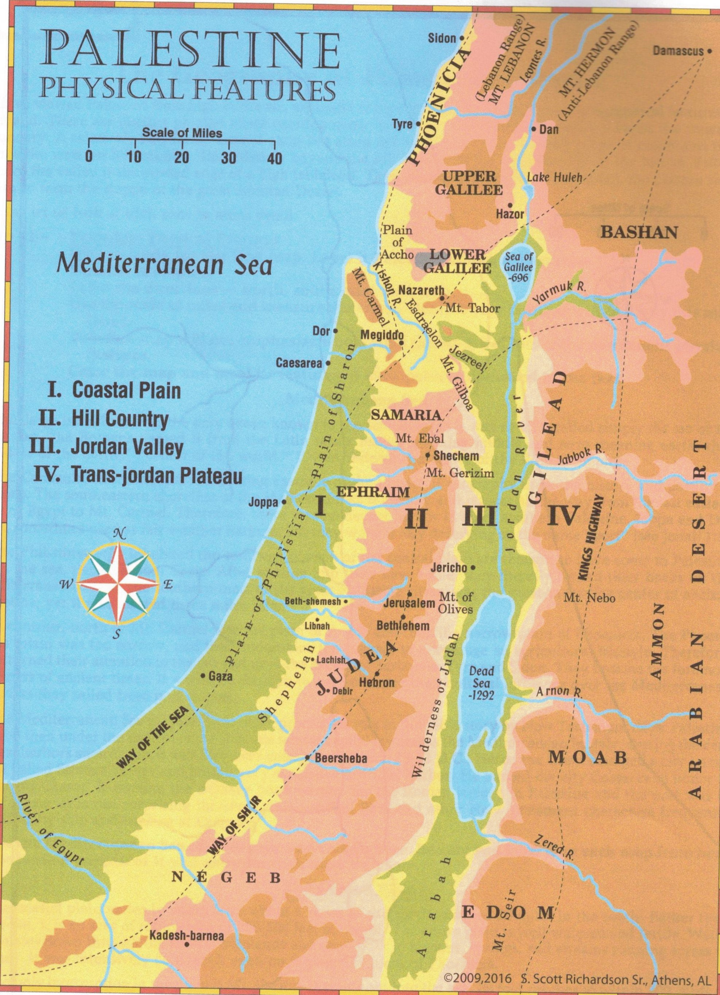
New Testament Lands
4 Geographical Regions
Costal Plains
Hill Country
Jordan Valley
Trans-Jordan Plateau

Slide 4
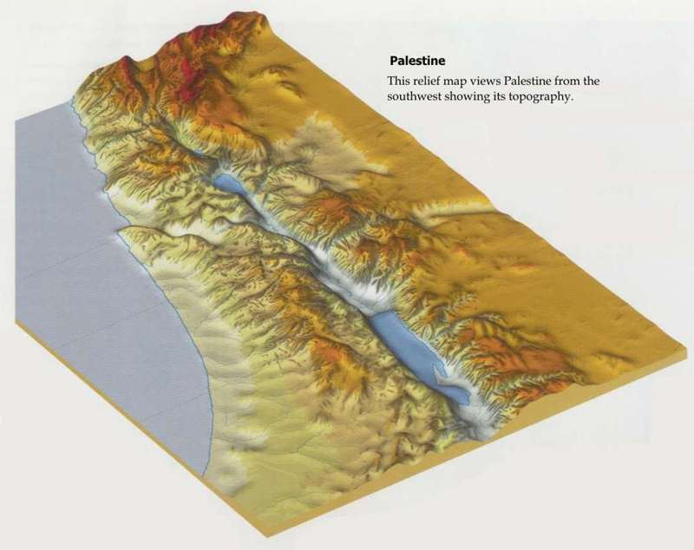
Elevations in Palestine

Slide 5
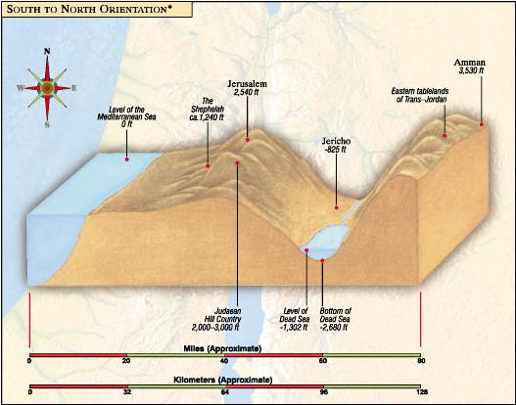
Elevations in Palestine
Important Numbers
Mediterranean Sea – Sea Level
Jerusalem – 2,540 above sea level
Jericho – 825 below sea level
Dead Sea – 1,302 below sea level
Bottom of Dead Sea – 2,680 below sea level

Slide 6
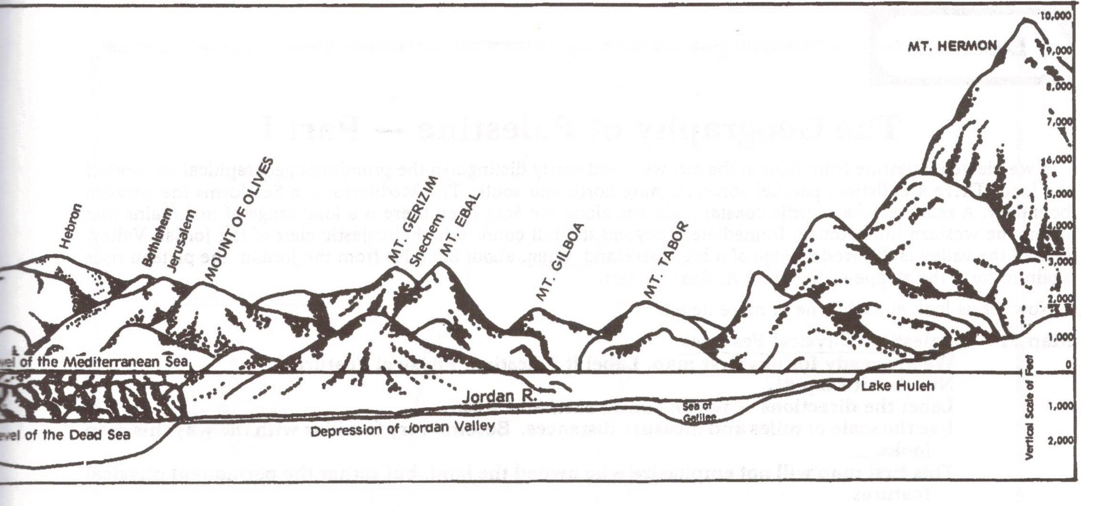
Mountains in Palestine

Slide 7
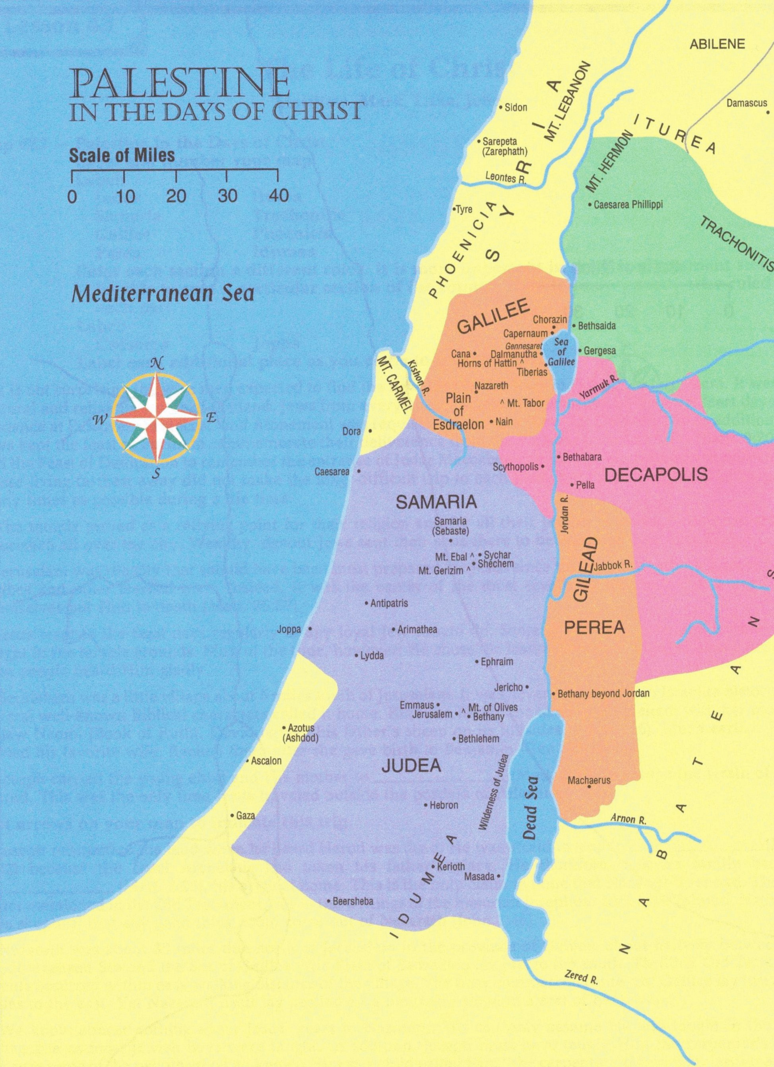
Divisions of Palestine
3 Divisions at the time of Christ
South – Judah (including Jerusalem, Bethlehem)
Middle – Samaria (including Shechem)
North – Galilee (Including Nazareth, Capernaum

Slide 8
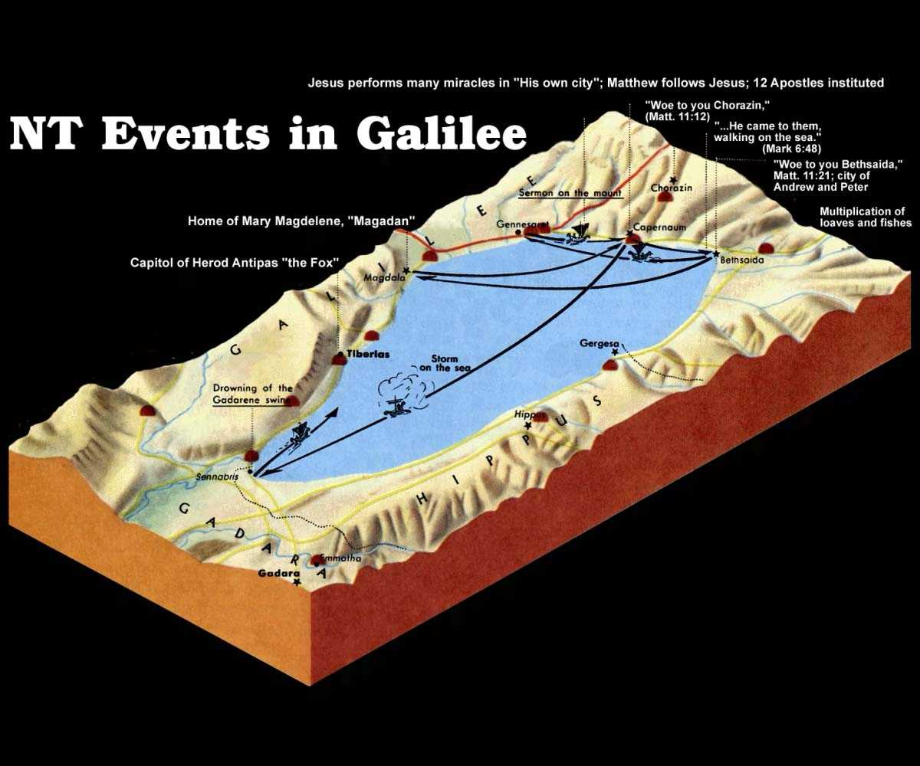
Galilee Region
Events in Galilee
Gaderene – Drowning of pigs
Tiberias – capital of Herod Antipas
Magadan – Home of Mary Magdelene
Capernaum – much of His ministry here
Several events on the water, walked on water, preached from a boat, stilled the storm

Slide 9
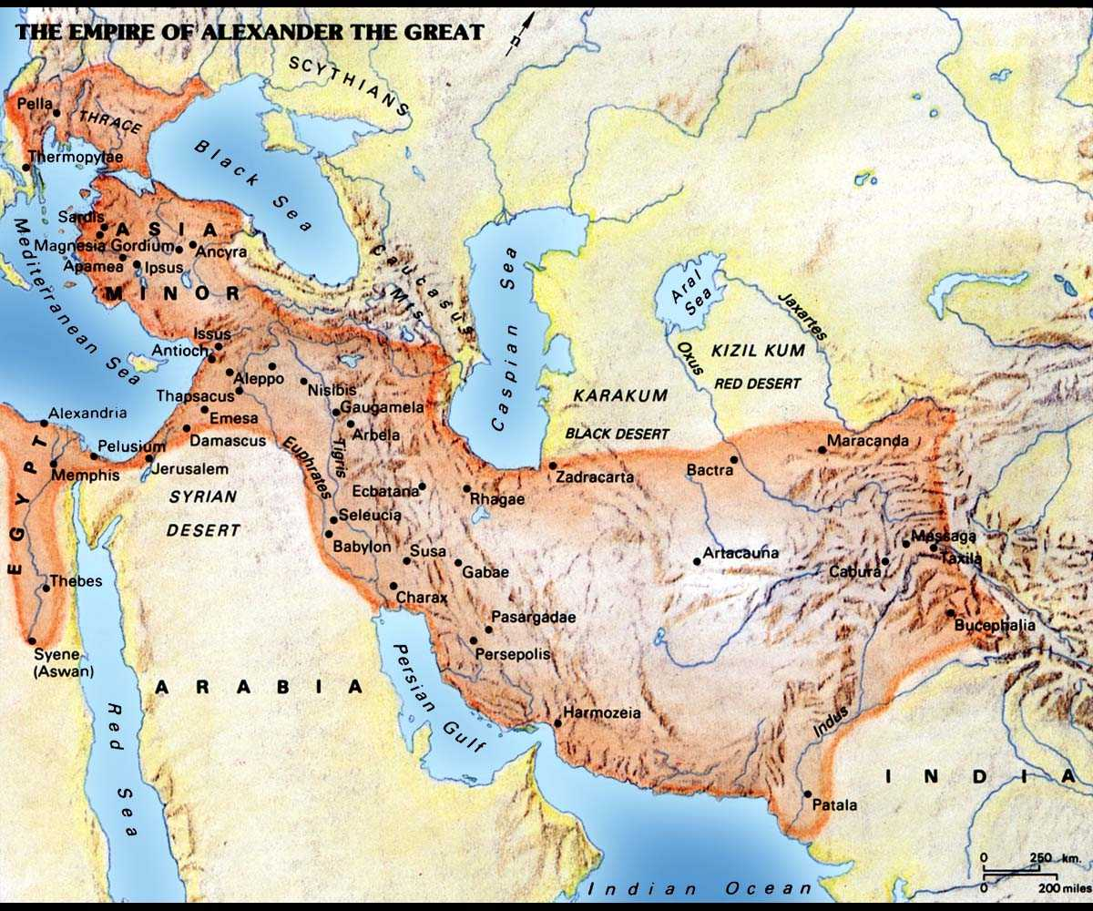
Greek Empire

Slide 10
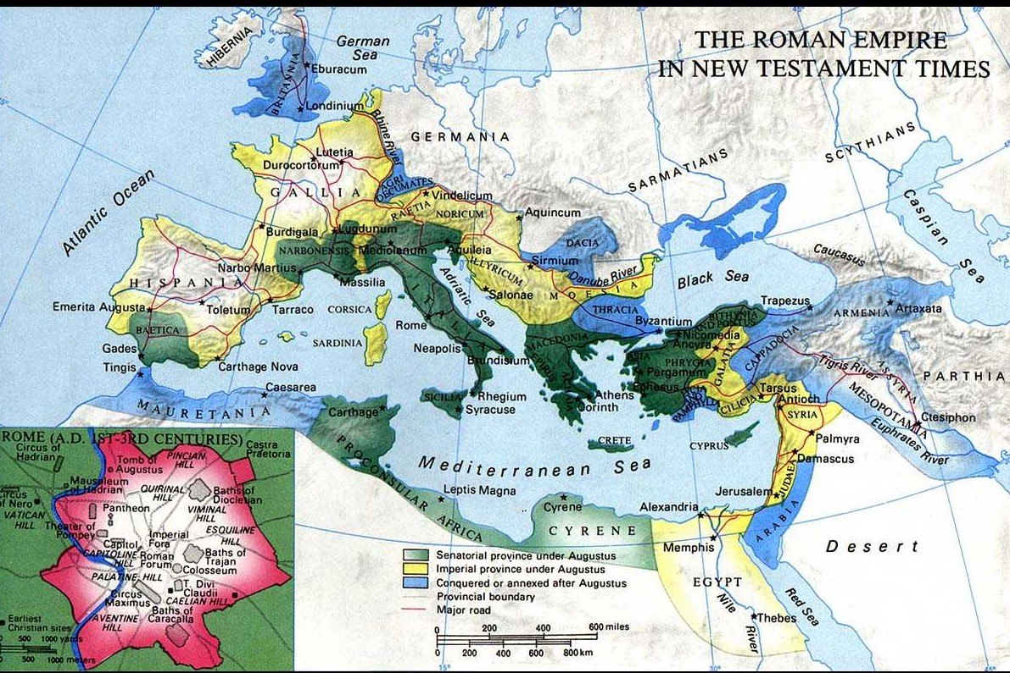
Roman Empire
Color code on map
Green = under Augustus control
Yellow = Imperial Provinces under Augustus
Blue = Gained after Augustus

Slide 11
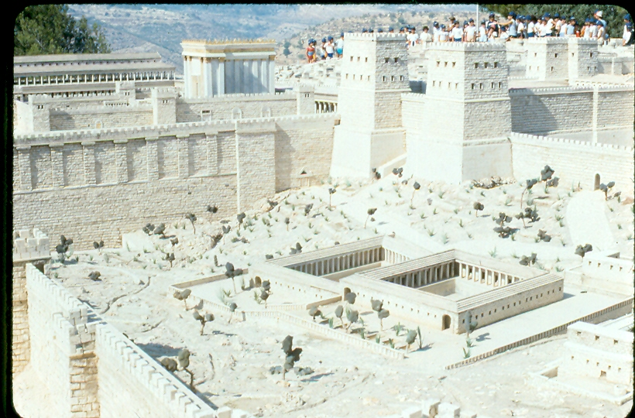
Part of Jerusalem (model of 1st century city)

Slide 12
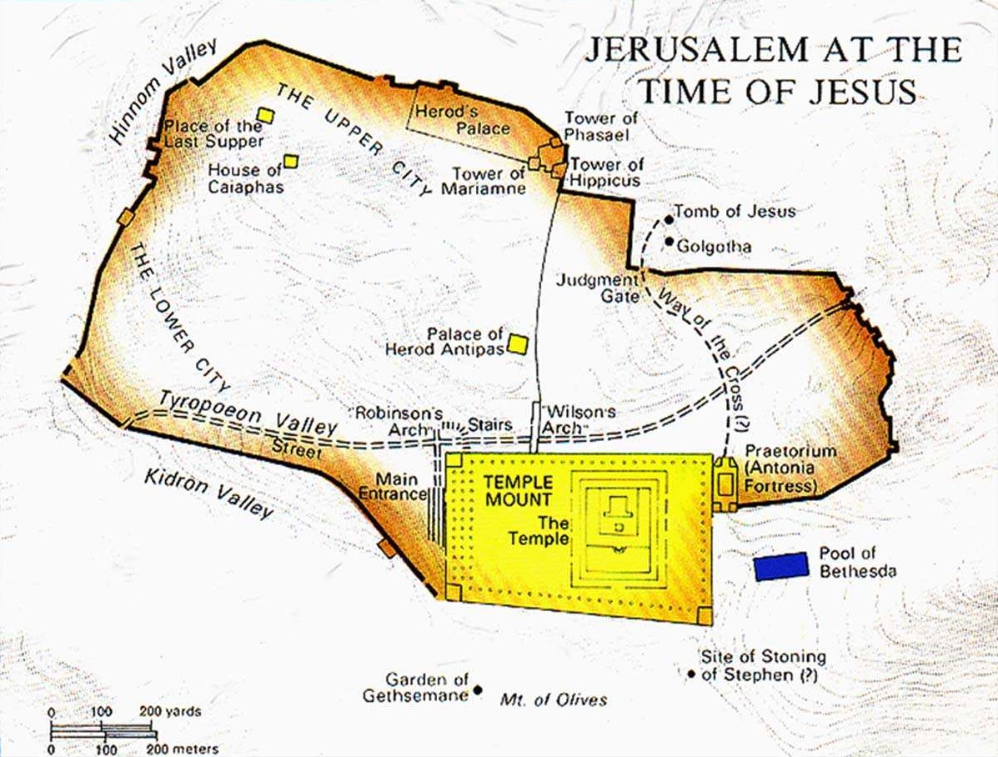
Jerusalem

