Slide 1
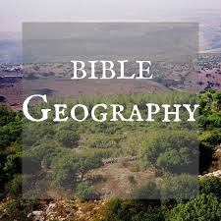
Galilee Region

Slide 2
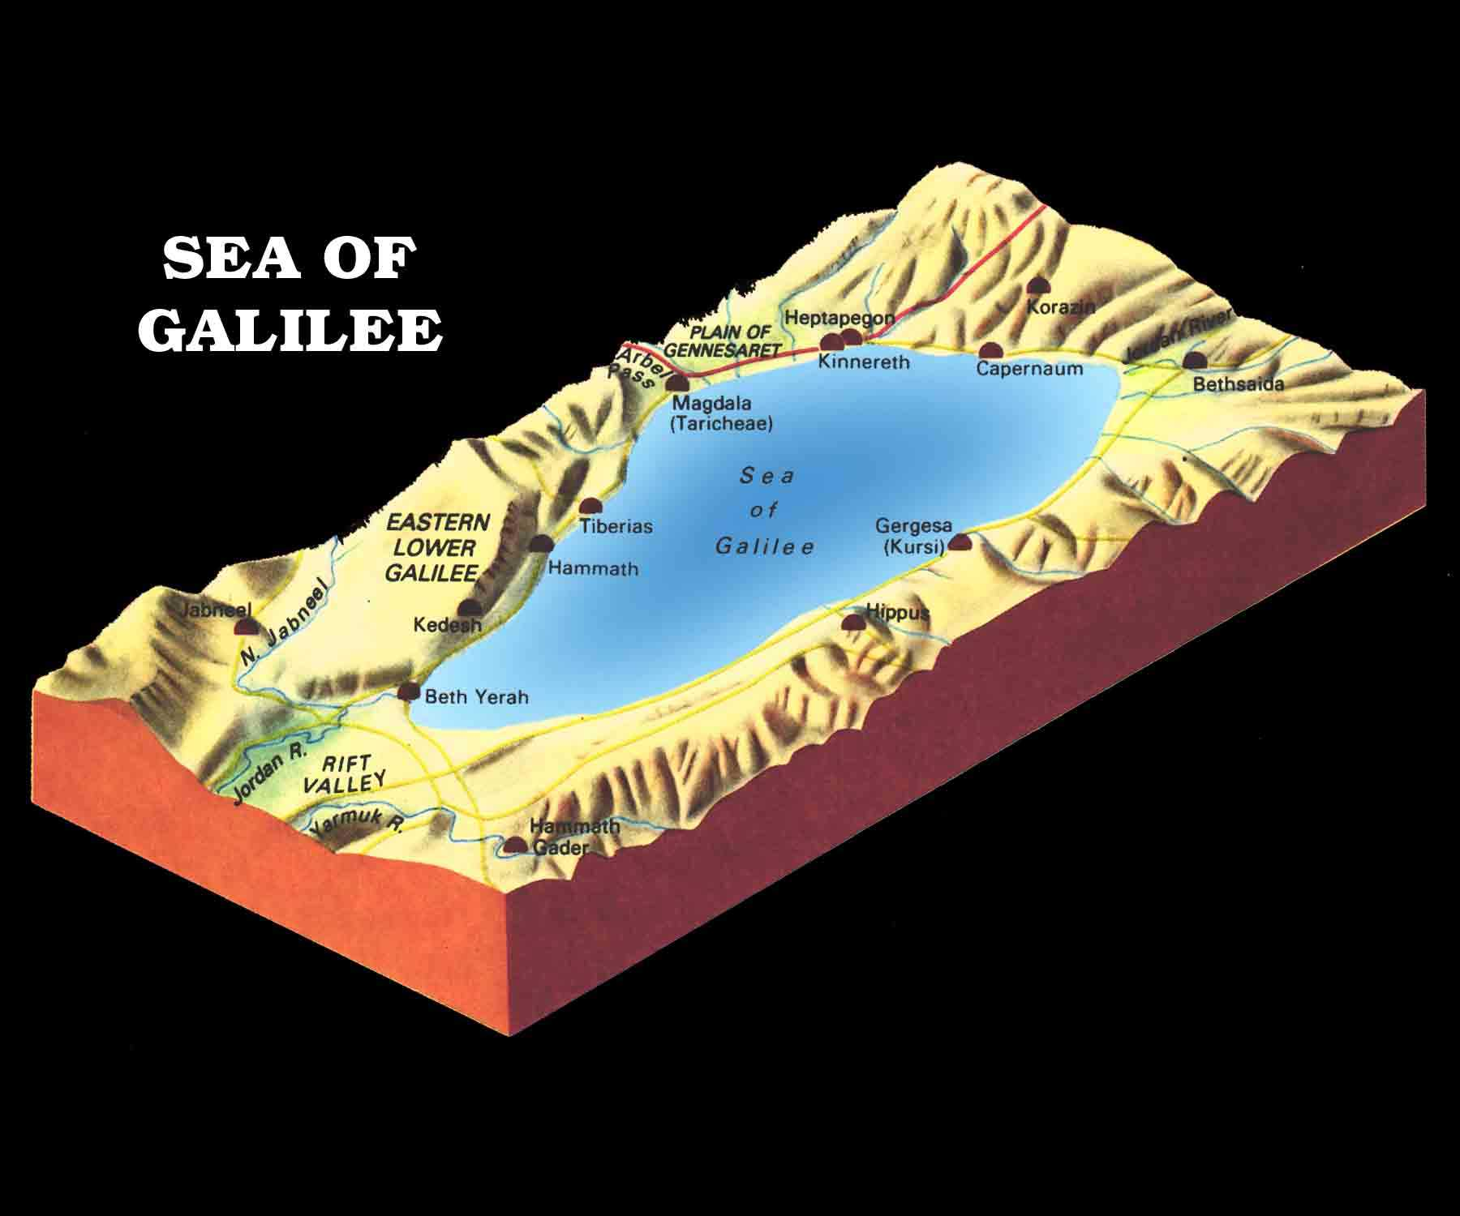
Galilee Region
It is called the Sea of Galilee, but it is a small lake.
It is about 6 miles wide and 13 miles long.
The water from Galilee flows to form the Jordan River

Slide 3
Luke 23:6-11 – Herod at Tiberias
(6) When Pilate heard of Galilee, he asked if the Man were a Galilean. (7) And as soon as he knew that He belonged to Herod's jurisdiction, he sent Him to Herod, who was also in Jerusalem at that time. (8) Now when Herod saw Jesus, he was exceedingly glad; for he had desired for a long time to see Him, because he had heard many things about Him, and he hoped to see some miracle done by Him. (9) Then he questioned Him with many words, but He answered him nothing. (10) And the chief priests and scribes stood and vehemently accused Him. (11) Then Herod, with his men of war, treated Him with contempt and mocked Him, arrayed Him in a gorgeous robe, and sent Him back to Pilate.

Slide 4
Tiberias

Slide 5
Tiberias Shoreline

Slide 6
Tiberias Shoreline

Slide 7
Golan Heights – Jordan

Slide 8
Golan Heights – Jordan

Slide 9
Capernaum

Slide 10
Mark 1:21-26 – Synagogue at Capernaum
(21) Then they went into Capernaum, and immediately on the Sabbath He entered the synagogue and taught. (22) And they were astonished at His teaching, for He taught them as one having authority, and not as the scribes. (23) Now there was a man in their synagogue with an unclean spirit. And he cried out, (24) saying, "Let us alone! What have we to do with You, Jesus of Nazareth? Did You come to destroy us? I know who You are—the Holy One of God!“ (25) But Jesus rebuked him, saying, "Be quiet, and come out of him!“ (26) And when the unclean spirit had convulsed him and cried out with a loud voice, he came out of him.

Slide 11
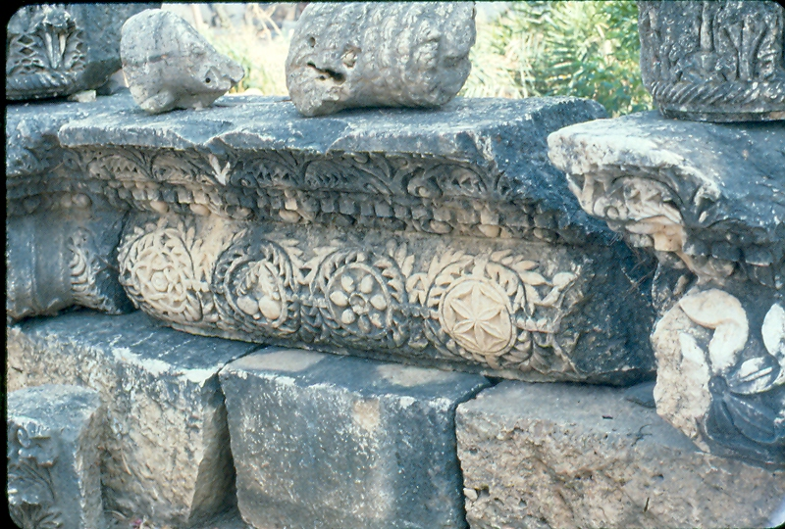
Capernaum – 2nd Century Synagogue

Slide 12
Capernaum – 2nd Century Synagogue

Slide 13
Capernaum – 2nd Century Synagogue

Slide 14
Capernaum – 2nd Century Synagogue

Slide 15
Capernaum – 2nd Century Synagogue

Slide 16
Mark 1:29-34
(29) Now as soon as they had come out of the synagogue, they entered the house of Simon and Andrew, with James and John. (30) But Simon's wife's mother lay sick with a fever, and they told Him about her at once. (31) So He came and took her by the hand and lifted her up, and immediately the fever left her. And she served them. (32) At evening, when the sun had set, they brought to Him all who were sick and those who were demon-possessed. (33) And the whole city was gathered together at the door. (34) Then He healed many who were sick with various diseases, and cast out many demons; and He did not allow the demons to speak, because they knew Him.

Slide 17
Capernaum – Peter’s House

Slide 18
Capernaum – Ark of Covenant

Slide 19
Capernaum – Olive Press

Slide 20
Capernaum – Sermon on the Mount

Slide 21
Capernaum – Galilee, Golan Heights

Slide 22
Matthew 14:17-21
(17) And they said to Him, "We have here only five loaves and two fish.“ (18) He said, "Bring them here to Me.“ (19) Then He commanded the multitudes to sit down on the grass. And He took the five loaves and the two fish, and looking up to heaven, He blessed and broke and gave the loaves to the disciples; and the disciples gave to the multitudes. (20) So they all ate and were filled, and they took up twelve baskets full of the fragments that remained. (21) Now those who had eaten were about five thousand men, besides women and children.

Slide 23
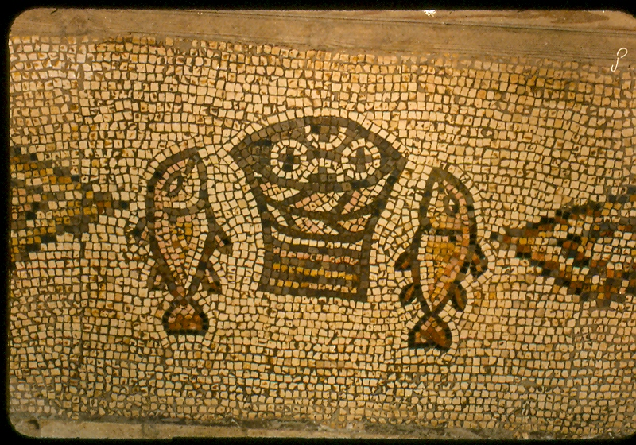
Capernaum – Feeding of 5,000

