Slide 1
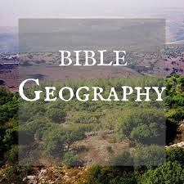
Dead Sea / Masada / Qumran

Slide 2
Elevation of the Dead Sea

Slide 3
Map of Dead Sea area

Slide 4
Background of area
Qumran – At the north end of the Dead Sea the Essenes made copies of OT books The scrolls were copied and stored – about 200 BC.
The caves are where the Dead Sea scrolls were discovered in 1947.
This is where John the Baptizer lived and preached.
Masada – This is where Herod the Great had a hide away. He was the king at the birth of Christ. He was extremely paranoid. He thought everyone was out to get him. (40-4 BC)
This is where some Jews hid to survive the Roman invasion that destroyed Jerusalem in 70 AD – Masada.
The southern end is where Sodom was located – Gen. 19.

Slide 5
Bedouin Goat trails

Slide 6
Bedouin Shepherds

Slide 7
Good Samaritan Inn

Slide 8
Jericho

Slide 9
Jericho

Slide 10
Down toward the Dead Sea

Slide 11
Down toward the Dead Sea

Slide 12
Manly wading in the Dead Sea

Slide 13
Salt on a rock

Slide 14
Qumran Ariel View

Slide 15
Qumran Entrance

Slide 16
Qumran

Slide 17
Qumran Synagogue

Slide 18
Qumran Synagogue

Slide 19
Qumran Copyist Rooms

Slide 20
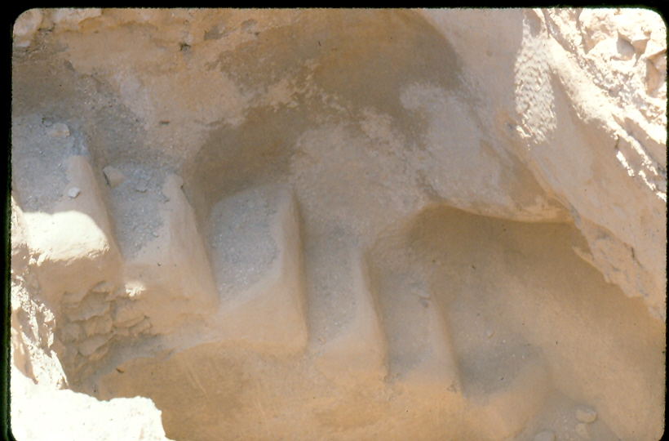
Cistern – less than 2 inches rain per year

Slide 21
Qumran Bath

Slide 22
Qumran

Slide 23
Dead Sea Caves

Slide 24
Dead Sea Caves

Slide 25
Dead Sea Caves

Slide 26
Dead Sea Caves

Slide 27
Scroll Museum

Slide 28
Isaiah Scroll

Slide 29
Isaiah Scroll

Slide 30
Masada Grain Bins – Dead Sea

Slide 31
Masada

Slide 32
From Masada to Dead Sea

Slide 33
Before Masada Herod’s Hideout

Slide 34
Before Masada Herod’s Hideout

Slide 35
Masada Ramp – Sodom area of Sea

Slide 36
Masada – Roman Ramp

Slide 37
Sodom End of Dead Sea

Slide 38
Sodom End of Dead Sea

