Slide 1
Jerusalem – Way of the Cross

Slide 2
Entrance to Upper Room

Slide 3
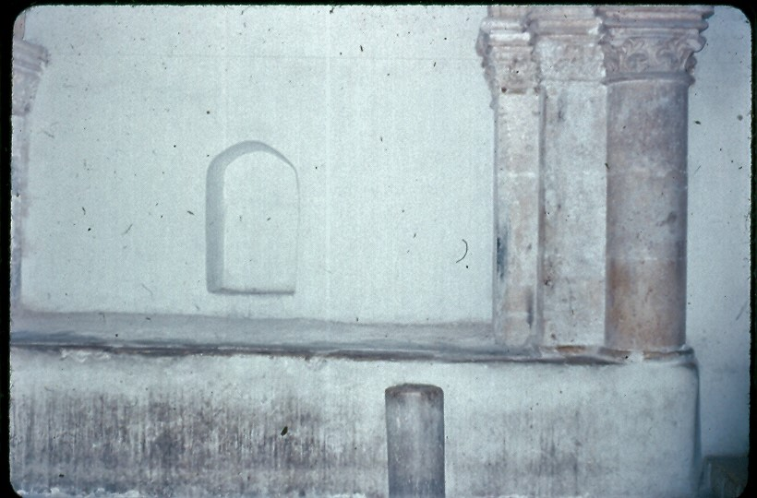
Upper Room (Last Supper)

Slide 4
Upper Room

Slide 5
Garden of Gethsemane / Golden Gate

Slide 6
Very Old Olive Tree in Gethsemane

Slide 7
Garden of Gethsemane

Slide 8
Gethsemane up to Golden Gate

Slide 9
Caiaphas House (High Priest)

Slide 10
Caiaphas house (jail at right)

Slide 11
Toward Antonio Fortress (Praetorium)

Slide 12
Crown of Thorns

Slide 13
The Way of the Cross – Narrow Streets

Slide 14
Way of the Cross (Via dolorosa)

Slide 15
Station 9 – Mary sees Jesus

Slide 16
Out of the city

Slide 17
Golgotha (The Skull)

Slide 18
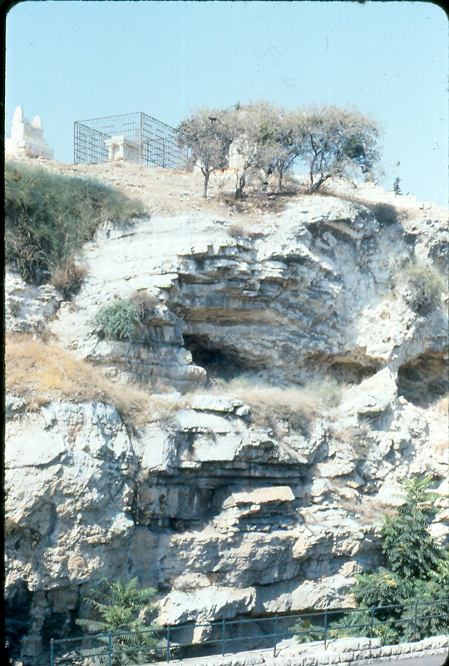
Golgotha (The Skull)

Slide 19
Near Golgotha, a Garden

Slide 20
Entrance to Garden

Slide 21
The Tomb of Christ

Slide 22
The Tomb of Christ

Slide 23
The Tomb of Christ

Slide 24
The Tomb of Christ

Slide 25
The Mount of Ascension

