Slide 1
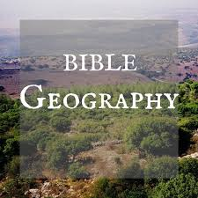
0LD
TESTAMENT
LANDS

Slide 2
Old Testament Lands
Plan for this study
OT Lands
NT Lands
Beginnings
Abraham
Egypt
Exodus, Wandering, Conquest, Division of Land
Kingdom Expansion, Captivities, Return
Jerusalem (Model city)
Jerusalem (photos)
Way of the Cross
Dead Sea
Jesus life and ministry
Galilee Region
Paul’s Journeys
Ephesus

Slide 3
Old Testament Lands
5 major areas
Mesopotamia
Arabian Desert
Egypt
Sinai
Fertile Crescent

Slide 4
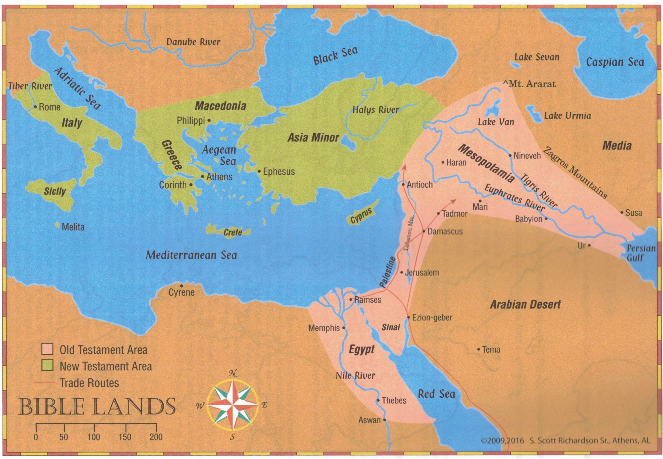
Area in Pink = OT Lands

Slide 5
1 - Mesopotamia
Mesopotamia – means “Between the Rivers”
Often referred to as Babylon
Through history it had many names (nations)
Sumar
Chaldea
Babylon
Assyria
Neo-Babylon
Mede-Persia
Persian
Currently - Iraq

Slide 6
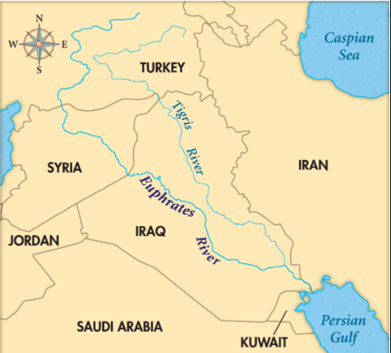

Slide 7
1 - Mesopotamia
Tigris River – 1,150 miles long from Zagros Mountains to the Persian Gulf
City of Nineveh was capital of Assyria, on the Tigris River
Euphrates River – 1,700 miles long, from Zagros Mountains to the Persian Gulf
Ur, Babylon, and Haran are important cities on the Euphrates River.

Slide 8
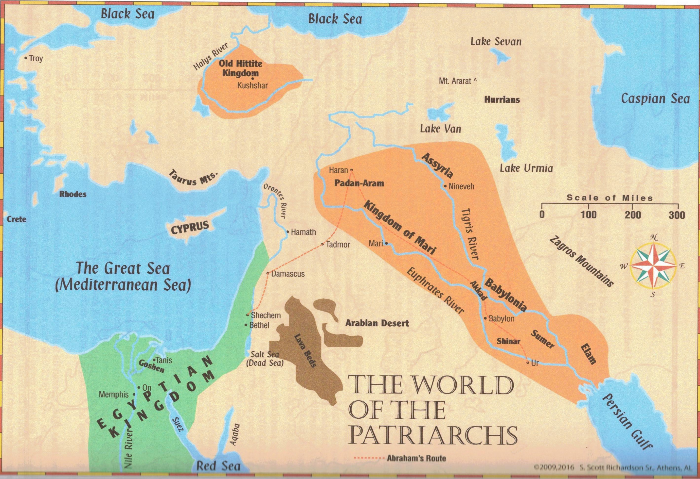
1 – Mesopotamia – Mountains and valleys

Slide 9
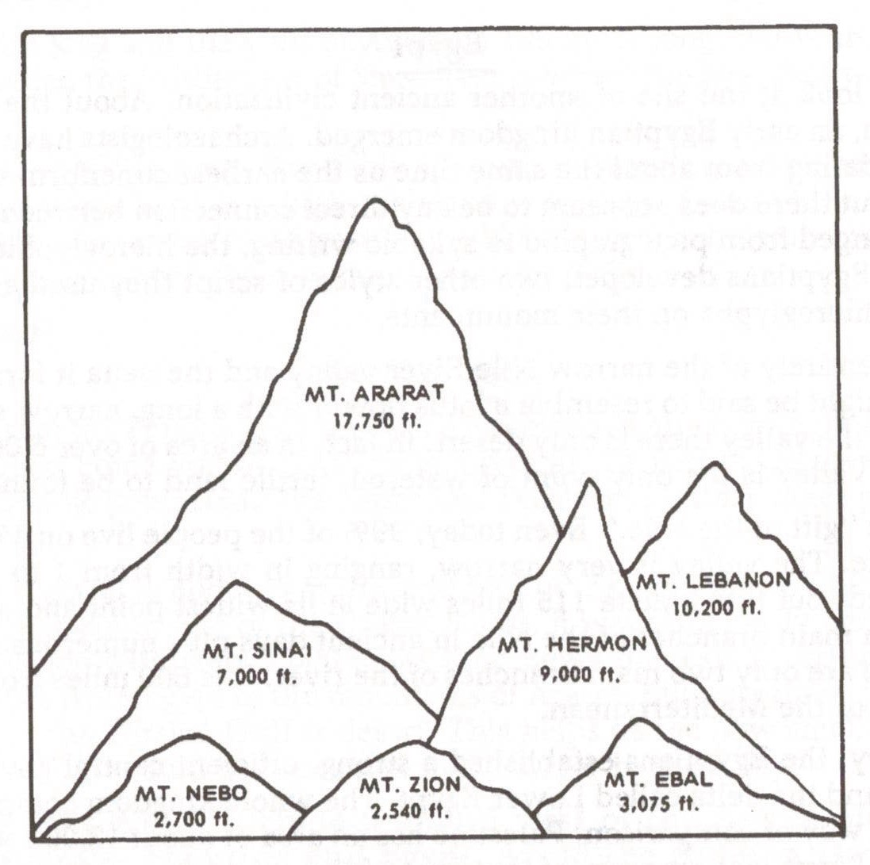
1 – Mesopotamia – Mountains

Slide 10
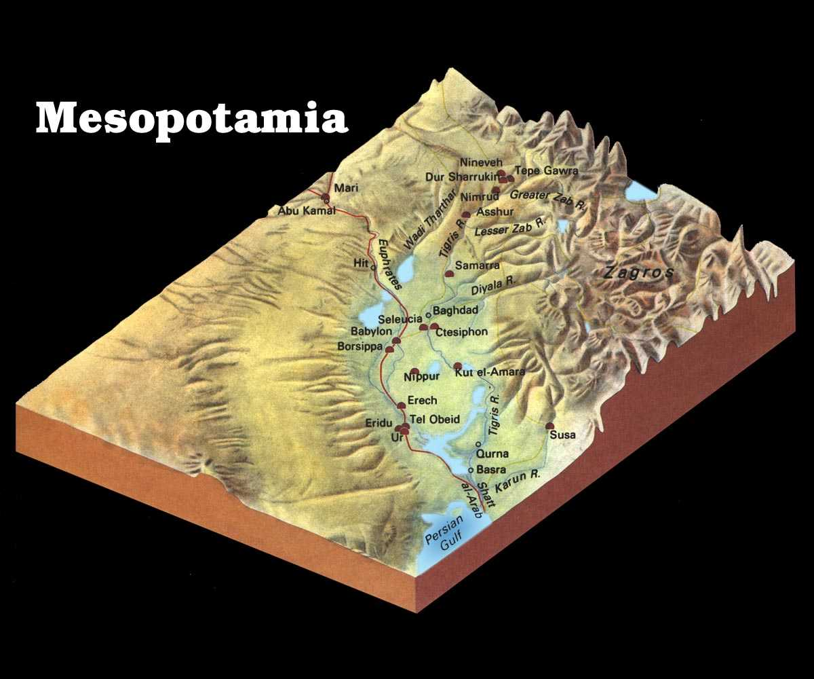
1 – Mesopotamia – Mountains and valleys

Slide 11
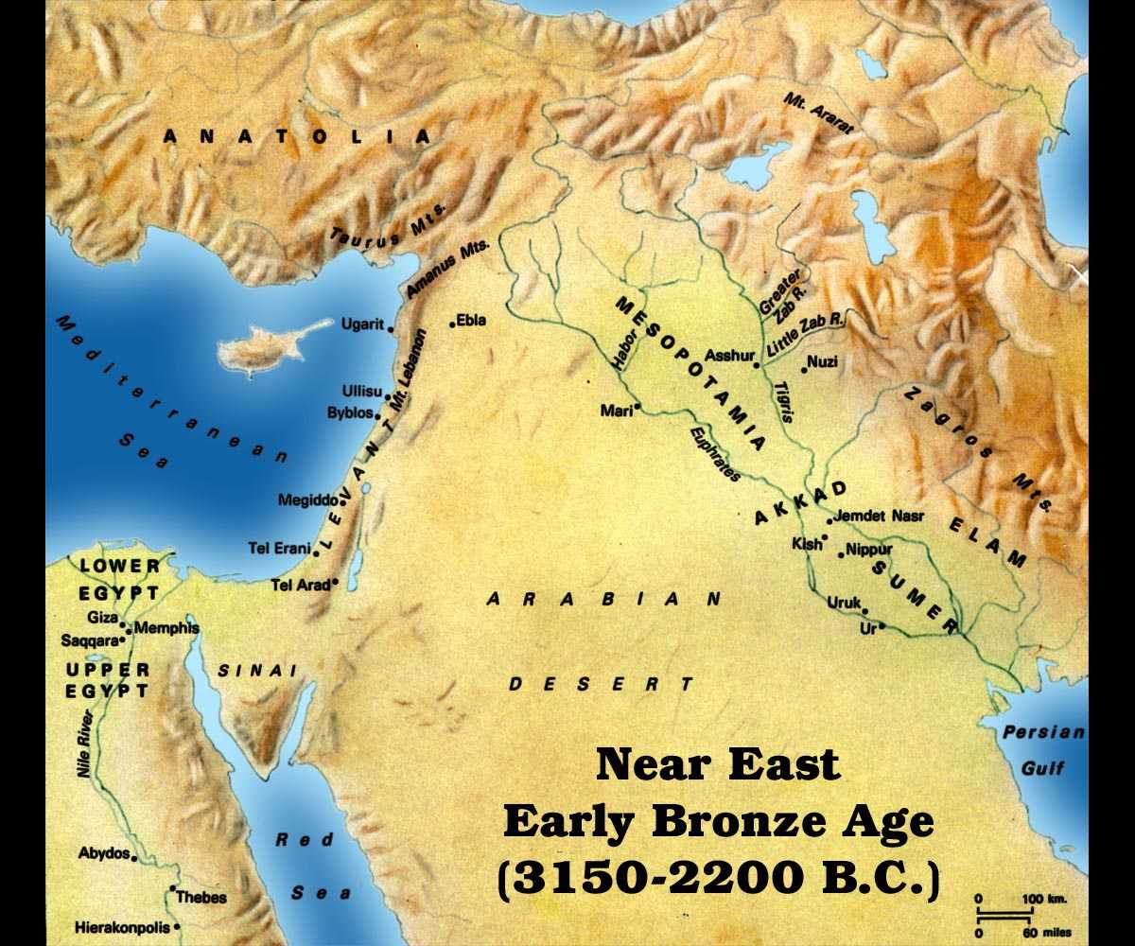
2- Desert

Slide 12
2- Desert
Arabian desert is an extension of the vast Sahara Desert.
The Sahara Desert covers more than 1 million square miles.
The Sahara covers part of Africa and interrupted with the Red Sea and the Nile River.
There are huge lava beds in the Arabian Desert

Slide 13
2 – Desert

Slide 14
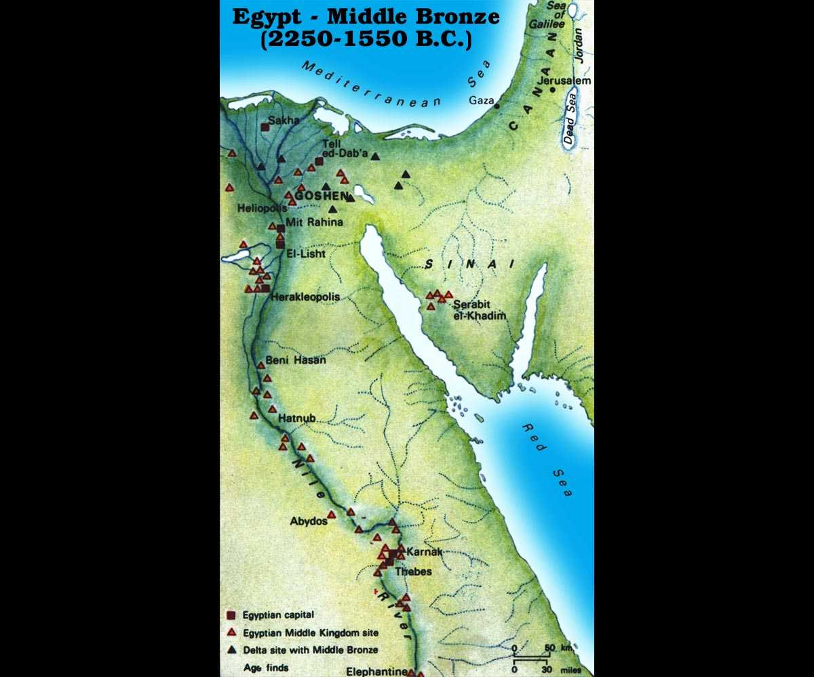
3 - Egypt

Slide 15
3 - Egypt
99% of the population live on 2% of the land.
Hieroglyphics (picture writing) was an early form of writing.
Nile River is longest river in the world (4,100 miles).
The Nile delta region is very rich fertile ground.
In the delta region is Goshen – when Israel settled.

Slide 16
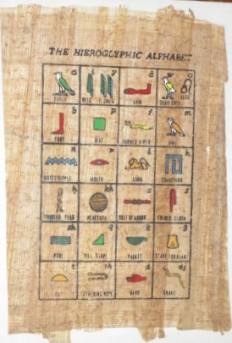
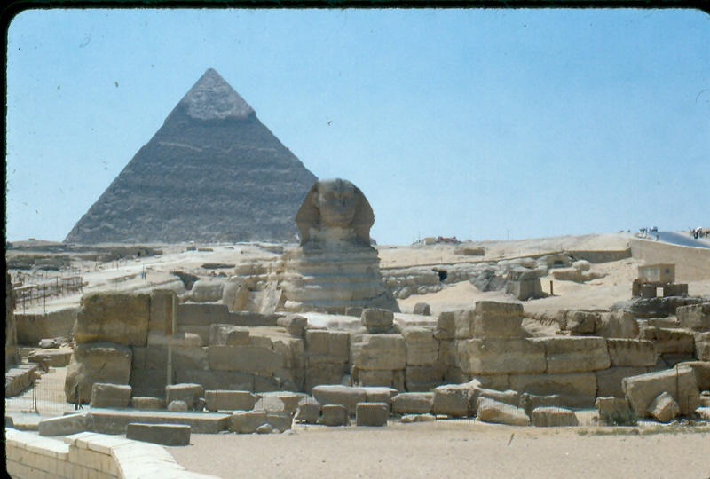
3 – Egypt (A tease – coming soon)

Slide 17
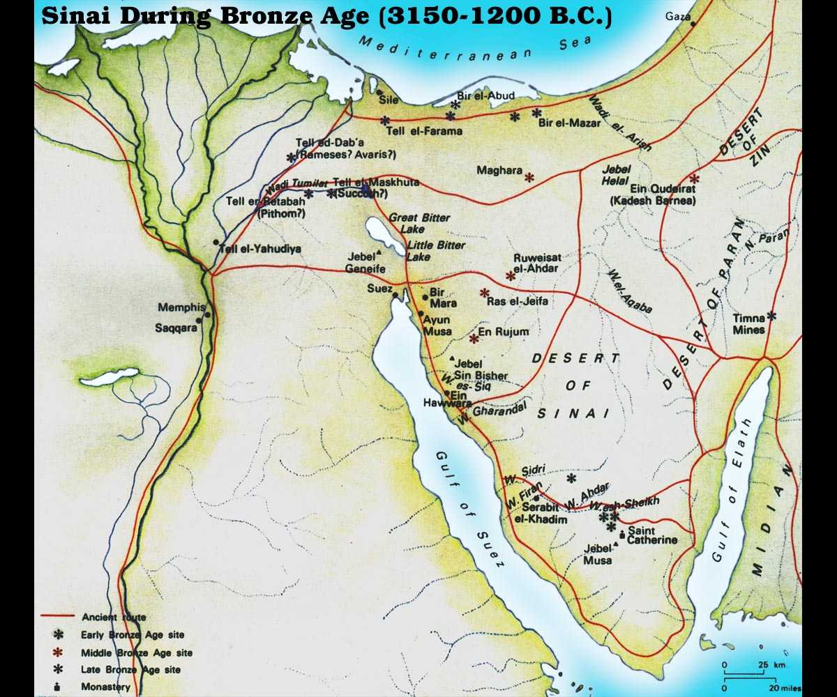
4 - Sinai

Slide 18
4 - Sinai
The Red Sea goes south and empties in the Indian Ocean.
At the north end of the Red Sea are two branches.
  Gulf of Suez – 200 miles long, between Sinai and Egypt.
  Gulf of Aqaba – 100 miles long, between Sinai and Arabia.
Sinai is not desert, but wilderness.
Wilderness = uncultivated, uninhabited, rugged hills, little water

Slide 19
5 – Fertile Crescent

Slide 20
5 – Fertile Crescent
All travel in this area of the world would travel in a “C” route.
Persian Gulf up Mesopotamia to Haran.
From Haran south and west down through Palestine.
They could continue to Sinai, Egypt or edge of Arabia

