Slide 1
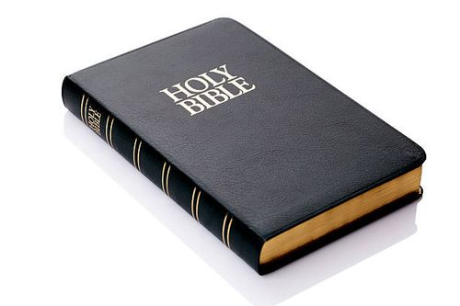
English Translations of the Bible
Translation Issues and Problems
Word for Word - - - Thought for Thought

Slide 2
Bible Translation Challenges
Language and Cultural Barriers: The original texts of the Bible were written in ancient languages (Hebrew, Greek, and Aramaic) and cultures, making it difficult to accurately convey their meaning in modern languages.

Slide 3
Bible Translation Challenges
Language and Cultural Barriers: The original texts of the Bible were written in ancient languages (Hebrew, Greek, and Aramaic) and cultures, making it difficult to accurately convey their meaning in modern languages.
Rare Words: Words that appear only once in the Hebrew Bible, requiring translators to make educated guesses about their meaning.

Slide 4
Bible Translation Challenges
Language and Cultural Barriers: The original texts of the Bible were written in ancient languages (Hebrew, Greek, and Aramaic) and cultures, making it difficult to accurately convey their meaning in modern languages.
Rare Words: Words that appear only once in the Hebrew Bible, requiring translators to make educated guesses about their meaning.
Contextual Understanding: Translators must grasp the historical, cultural, and literary context of the original texts to ensure accurate interpretation and translation.

Slide 5
Bible Translation Challenges
Diverse Interpretations: Different scholars and traditions may have varying understandings of the same text, leading to disagreements on translation.

Slide 6
Bible Translation Challenges
Diverse Interpretations: Different scholars and traditions may have varying understandings of the same text, leading to disagreements on translation.
Paragraph Divisions: The lack of paragraph divisions in the original texts means translators must decide how to break up the text into readable sections.

Slide 7
Bible Translation Challenges
Diverse Interpretations: Different scholars and traditions may have varying understandings of the same text, leading to disagreements on translation.
Paragraph Divisions: The lack of paragraph divisions in the original texts means translators must decide how to break up the text into readable sections.
Archaisms: Retaining archaic language and forms in translation, such as using “thou” and “thee” when addressing God, can be challenging and may not be suitable for all audiences.

Slide 8
Bible Translation Challenges
Textual Variants: Minor variations in the manuscript tradition can affect translation decisions, requiring careful evaluation of the evidence.

Slide 9
Bible Translation Challenges
Textual Variants: Minor variations in the manuscript tradition can affect translation decisions, requiring careful evaluation of the evidence.
Linguistic and Semantic Ambiguities: Words and phrases with multiple meanings or connotations can be difficult to translate accurately.
Example: “drive” – a car, a golf ball, a nail
“piece of cake” “eye to eye” “cost an arm and a leg”
“hot dog” “cat out of the bag” “under the weather”

Slide 10
Bible Translation Challenges
Theological and Dogmatic Concerns: Translators may need to balance fidelity to the original text with theological and dogmatic considerations, potentially leading to differing translation approaches.
Our bias, preconceived ideas, what fits our view or beliefs
A Catholic might translate some passages differently from a Baptist.
A Jew might translate some words differently from a Christian.

Slide 12
Example of an Interlinear – Matthew 1:1
γενέσεως genealogy N-GFS
1 Βίβλος 1 book 1 N-NFS
Ἰησοῦ Jesus N-GMS
Χριστοῦ , Christ N-GMS
υἱοῦ son N-GMS
Δαυὶδ , David N-GMS
υἱοῦ son N-GMS
Ἀβραάμ : Abraham N-GMS
Here is the NKJV:
The book of the genealogy of Jesus Christ, the Son of David, the Son of Abraham:

Slide 13
Compare John 3:16 in 4 translations
For God so loved the world that He gave His only begotten Son, that whoever believes in Him should not perish but have everlasting life. - NKJV
God gave Himself to the people of the world, for their good, expecting nothing in return, by giving up His one and only Son. Every person who commits himself to Jesus will not be destroyed. Instead, that person will have eternal life. – New Covenant
for God did so love the world, that His Son--the only begotten--He gave, that every one who is believing in him may not perish, but may have life age-during. – Young’s Literal
For God had such love for the world that he gave his only Son, so that whoever has faith in him may not come to destruction but have eternal life. Basic English

